Slide 1
Widespread Implementation of Family-Problem Solving Treatment for Adolescents with Acquired Brain Injuries
Dr. Shari Wade
Professor of Pediatrics and Psychology
University of Cincinnati
Director of Research,
Pediatric Rehabilitation Medicine
Cincinnati Children’s Hospital Medical Center
Cincinnati, Ohio, USA

Slide 2
Acknowledgements
Program development supported by NIDILRR and NICHD
Subsequent evaluation supported by the CDC, NIDILRR, NIMH, and PCORI
Clinical implementation award from PCORI
Funding for website commercialization came from the State of Ohio, Ohio Development Services Agency, Ohio Third Frontier, Grant Control No. TECG2019-0159 and Cincinnati Children’s Hospital Medical Center’s Innovation Fund.
We have no conflicts to disclose

Slide 3
Objectives
Describe
Review
Evidence supporting its efficacy and identify who is most likely to benefit.
Describe
The rationale for Family Problem Solving Treatment with ABI.
The current implementation project and its progress to date.

Slide 4
> 50% of children with TBI have problems with behavior and executive functioning.
Most do not receive treatment
Notes:
almost of half of kids with epilepsy have EF deficits and contrary to popular belief, good seizure control does not solve the EF deficits.
These kids are more likely to have academic difficulties, difficulty with social relationships. poor adherence to treatment, and poor quality of life.

Slide 6
Child’s behavioral, emotional, & cognitive problems
Role changes
Financial stress
Parental distress
Marriage problems
Uncertainty regarding child’s future
Impact of TBI on the Family
Rashid et al., 2014
Wade et al., 2006
Hawley et al., 2003

Slide 9
Problem Solving Therapy as an Intervention for TBI
Facilitates parent/family coping in response to injury and other stresses in their lives
Provides the injured individual with an executive function heuristic for addressing post-injury challenges
Flexible to accommodate the different kinds of issues facing survivors and their families

Slide 10
Online Family Problem Solving
7-10 core sessions and 4 supplemental sessions
Initial face to face meeting with therapist
Subsequent meetings via videoconferencing
Each session has 2 components:
A self-guided web module
A synchronous session with the therapist

Slide 11
Research & Development: 1999-2018
Initial Face-to-Face Trial
5 RCT
CE
Meta Analysis

Slide 12
Summary of Studies Included in Meta-analysis
368 children ages 5 to 18 with complicated mild to severe TBI.
Randomly assigned to online family problem solving or control condition (either access to internet resources or treatment as usual)
Provided with computer and internet access for the duration of the study
Outcomes assessed at baseline and 6 months in all studies

Slide 13
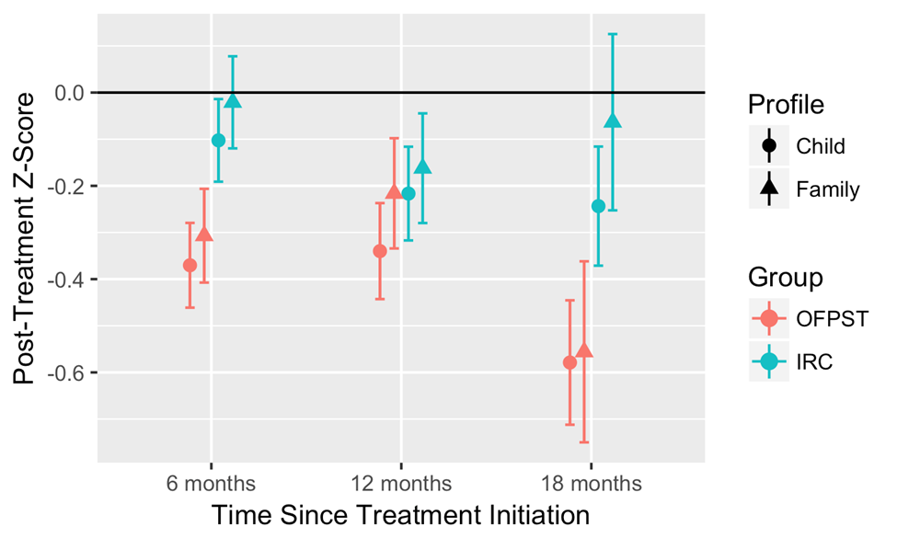
Meta-Analysis of 5 Randomized Controlled Trials

Slide 14
Comparative Effectiveness: Aims & Hypotheses
Compare 3 treatment delivery modalities on parent and adolescent self-reported outcomes.
Therapist-guided online
Face to face
Self-guided online
Identify moderating factors

Slide 15
Method
Assessments
Baseline (pre-treatment), 6-month (post-treatment), 9-month (maintenance)
Outcome assessed
Adolescent Quality of Life
Parent and adolescent-report 23-item PedsQL (Varni et al., 1999)
Brain Injury Symptoms
Parent and adolescent report 50-item Health Behavior Inventory (Yeates et al., 1999)

Slide 16
Treatment Groups
Face-to-Face
Met with therapist in clinic
Reviewed didactic content using handouts from website and then guided through problem solving practice
Therapist-Guided Online
Independently completed online modules followed by Skype sessions with the therapist
Reviewed didactic content, and guided through problem solving practice
New materials released up completion of sessions
Self-Guided Online
Same content as above without therapist support

Slide 17
Quality of Life
Notes:
Parents in both online treatment groups reported significant improvement in their teen’s overall QOL from baseline to the end of the study.
Parents in the online therapist-guided group reported a 7-point increase in PedsQL total score from baseline to 9-month – with moderate effect size
Parents in the self guided online group reported a 12 point improvement with large effect size
Group contrasts showed significant differences between parent reported scores in the face to face to face group and both the online therapist guided and online self-guided groups at the 6 month follow-up
The self-guided online group maintained those differences at the 9-month followup.
For adolescent self-report, only those in the self-guided online group reported a significant improvement from baseline to the end of the study. With a moderate effect size.

Slide 18
“My general experience with this project was amazing. I really felt that it was a huge part in helping me understand my injury and helping me cope with the side effects.”
-TOPS Participant

Slide 19
“The problem-solving process from the program helped a lot because it gave me a new outlook on how to handle things.”
-TOPS Participant

Slide 20
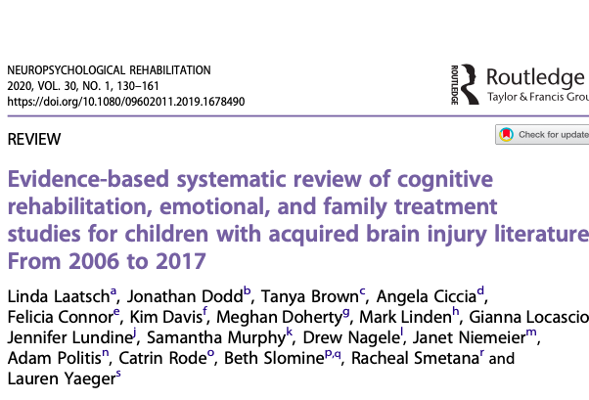
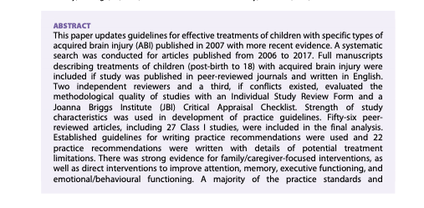
Guidelines Paper

Slide 21
Evidence-based systematic review of cognitive rehabilitation, emotional, and family treatment studies for children with acquired brain injury literature: From 2006 to 2017
Online family problem-solving/Teen Online problem-solving was identified as a practice standard for:
Emotion and behavior regulation
Executive functioning
Caregiver and family function

Slide 22
Who benefits?
TOPS can work for most adolescents and families.
**Adolescents with higher levels of externalizing problems
**Families with less education and lower SES experienced less caregiver depression and distress
**Children with lower IQs had improved social competence

Slide 23
Widespread Implementation
Initial implementation at 10 sites in the United States.
Focus on reach, efficacy, adoption, implementation fidelity, and maintenance over time (RE-AIM).

Slide 24
Seattle Children’s
St. Luke’s
Holland Bloorview
Michigan Medicine
Primary Children’s
Colorado Children’s
UPMC
Nationwide
CHOP
Cincinnati Children’s
Kennedy Krieger
University of California San Francisco
Dell Children’s
TIRR Memorial Hermann
Phase I Sites
Texas Children’s
Phase II Sites

Slide 25
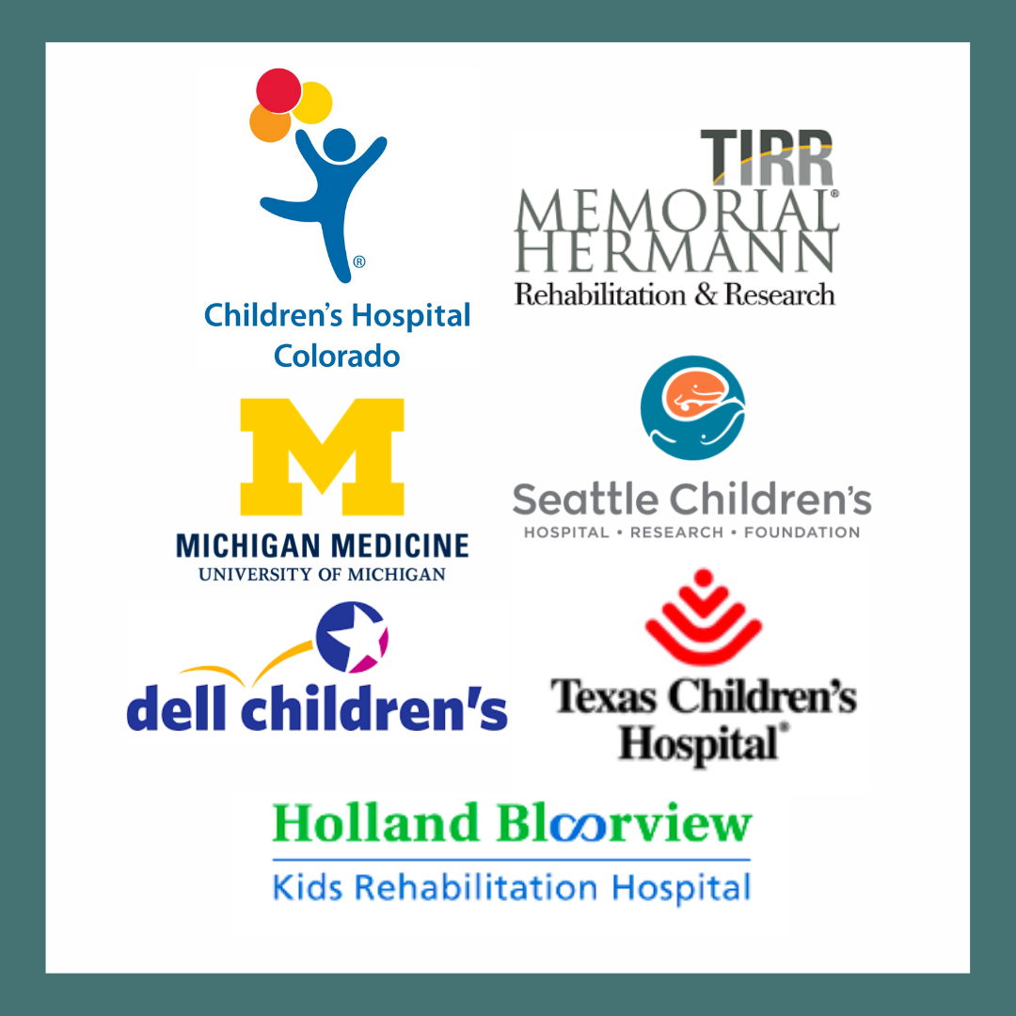

Slide 26
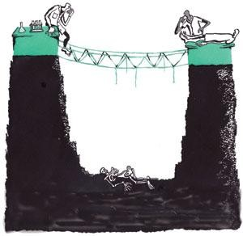
The Valley of Death

Slide 27
Therapist Trainings
Professions including
Clinical Psychologists
Neuropsychologists
School Psychologists
Clinical Social Workers
Speech Language Pathologists
Life Skills Specialists
Graduate Level Students
With an original goal of 5 therapists per site, we have trained a total of 277 trainees!
Across 14 States and Countries including the USA, Canada, Saudi Arabia, Italy and Argentina!
Notes:
How many folks trained/from how many sites/states/countries? 14 states: 10 implementation States +4 additional states (Alabama, Missouri, New York, Oklahoma), Countries: USA, Canada, Saudi Arabia, Italy, Argentina

Slide 28
Therapist Training Website
Special Topic Webinars
Returning to Learn After a TBI
Symptom-Related Challenges
Transitioning to Work
Self-Advocacy and Care Coordination
College Services & Accommodations
Working with Challenging Families
Working with Latinx Families
TOPS & Speech Language Pathologists
Virtual Training center: https://topstherapisttraining.fghxlwsl-liquidwebsites.com/

Slide 29
Flexibility versus Fidelity or “I’ve a feeling we’re not in Kansas anymore”

Slide 30
Re-examining and Expanding Exclusion Criteria
Relatively few patients screened met the initial strict inclusion/exclusion criteria
Therapists and referral sources asked to included older/younger patients and those with other neurological conditions with similar neurocognitive profiles

Slide 31
The Myth of Patient Choice
Family choice was restricted by a range of factors
State of residence
Insurance coverage
Availability of telehealth/in-person treatment
Availability of therapists
Hybrid models offered flexibility
Therapist meetings interspersed with self-guided treatment
Some face-to-face and some telehealth visits

Slide 32
PCORI COVID Expansion Funds: Fall 2020
Expand
Expand to other acquired brain injuries and neurological conditions.
Train
Train other providers (e.g., speech therapists) to deliver the program.
Add
Add 5 additional implementation sites.

Slide 33
New Diagnoses
Brain tumors
Strokes
Encephalitis/infectious insults
Spina Bifida
Epilepsy
Sickle Cell

Slide 34
Program Enrollment
To date, we have enrolled 265 participants!
54 different therapists have delivered the program to patients
Additional Diagnoses including Stroke, Encephalitis, Epilepsy, Brain Tumor, Sickle Cell, Myelomeningocele, Meningitis, Cerebellar Hypoplasia, Cerebral Palsy, and Hydrocephalus among others

Slide 35
New Sites
Began Enrolling
2020
2021
2022

Slide 36
COVID-19 Weekly Cases and Deaths per 100,000 Population by Sex
Notes:
https://covid.cdc.gov/covid-data-tracker/#demographicsovertime

Slide 37
Notes:
Run Chart Data 1 10 22

Slide 38
Barriers to Implementation
Medicaid Coverage and Regulations
COVID-19
Geographic Location
External
Systemic Racism
Lack of Medical Home/ Outpatient Follow-Up Clinics
Low Number of Eligible Patients
Hospital
Department Rigidity/ Infrastructure
Wait List for Therapists
Lack of buy in/interest in trying something new
Does not recognize a patient is eligible
Provider
Perception that a patient is not appropriate
Does not approach patient
Not interested
Lack of Knowledge
Lost to Follow-Up
Significant Other Life Stressors
Insurance
Patient

Slide 39
Solutions
Partnering with State Agencies
Offering Self-Guided TOPS
External
Retrospective Patient Searches
Offering Hybrid Models of TOPS
Hospital
Collaboration Across Departments
Training more TOPS Therapists
TOPS Presentations
Streamlining the Referral Process
Share positive patient/provider testimonial feedback
Provider
Pre-screen clinic lists to notify providers in advance
Create participant account login in clinic
Develop robust program handouts
Offering Self-Guided TOPS
Direct Marketing to Patients
Patient

Slide 40
Run Chart with Strategies
Notes:
not

Slide 41
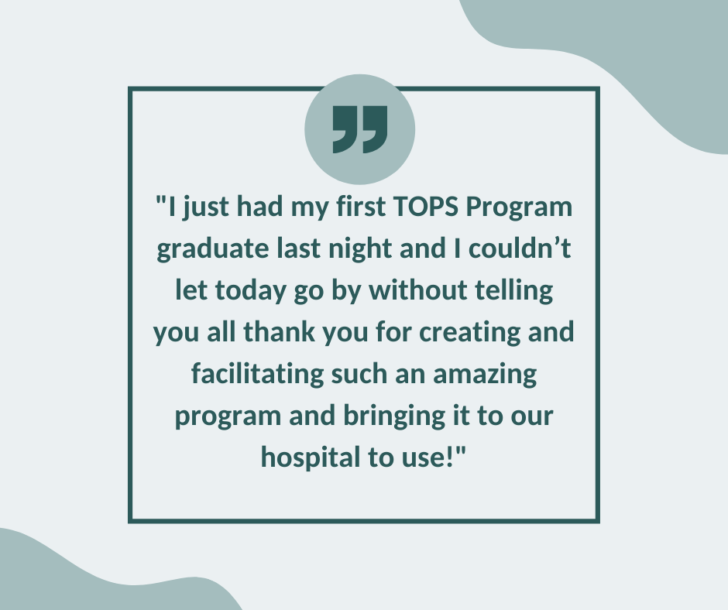
Hear from an SLP who recently delivered the program!

Slide 42
QR Codes and Direct Enrollments

Slide 43
Patient Handouts

Slide 44
Summary
Emerging from the valley of death (aka implementation) is an ongoing journey.
Mitigating barriers is possible but reliant on champions and support for their efforts.
Implementation can be facilitated by considering these issues when developing interventions.

Slide 45
Questions

Slide 46
Thank you!

