Slide 1
THE HIDDEN IMPACT OF TBI – PSYCHOLOGICAL TRAUMA
FT. THOMAS DIVISION – CINCINNATI VA MEDICAL CENTER
BETH LAGRANGE, M.A., CCC-SLP, CBIS
GREG BAILEY, PH.D.

Slide 2
DISCLOSURES
Both are salaried employees of the Cincinnati VA Medical Center and work within the PTSD/TBI Residential Treatment Program

Slide 3
OBJECTIVES
Identify signs of psychological trauma
Describe how mental health issues including PTSD can negatively impact cognitive functioning
Identify and describe principles of trauma-informed care
Identify resources for mental health services for yourself and others

Slide 4
PSYCHOLOGICAL TRAUMA AND PTSD
Sometimes the same event that led to a traumatic brain injury (TBI) leads to psychological trauma
What is trauma?
an emotional response to an often-unexpected terrible event—one that threatens injury, death, or the physical integrity of self or others—and causes horror, terror, or helplessness at the time it occurs
Notes:
Trauma in the context of TBI is referring to a physical event. Example: the head suddenly and violently hits an object, or an object hitting the head causing alteration of consciousness
Brain trauma and psychological trauma and coincide

Slide 5
PSYCHOLOGICAL TRAUMA AND PTSD
About 5/10 women and about 6/10 men experience at least one trauma in their lives
Fear and other emotions are normal after experiencing trauma
Most people recover after a traumatic event, but about 7-8/100 people may be diagnosed with PTSD
Certain aspects of the traumatic event and other factors like perceived social support affect whether a person develops PTSD

Slide 6
THE DIAGNOSIS OF PTSD: THE EVENT
Combat
Physical and sexual assault, including MST
Severe motor vehicle accidents
Childhood abuse
Repeated exposure to badly wounded service members and civilians
Muggings / attacks with weapons
Natural disaster (e.g., tornado, earthquake)
Witnessing violent crime (e.g., homicide)

Slide 7
THE DIAGNOSIS OF PTSD: THE RESPONSE

Slide 8
What is Post Traumatic Stress Disorder (PTSD)?
What is Cognitive Processing Therapy (CPT)?
Videos - PTSD: National Center for PTSD (va.gov)

Slide 9
THE BASICS OF PTSD BIOLOGY:
Three brain areas primarily involved:
Amygdala: detects threats, signals fear response.
Hippocampus: places threats in historical context.
Prefrontal cortex: reasoning, planning, making decisions, organizing, impulse control (executive functioning).

Slide 10
LIMBIC SYSTEM

Slide 11
MILD TBI AND PTSD: OVERLAPPING SYMPTOMS AND DIAGNOSTIC CLARIFICATION
Mild TBI
Insomnia
Impaired memory
Poor concentration
Depression
Anxiety
Irritability
Fatigue
Headache
Dizziness
Noise/Light intolerance
PTSD
Insomnia
Impaired memory
Poor concentration
Depression
Anxiety
Irritability
Emotional Numbing
Flashbacks/Nightmares
Avoidance
Notes:
Out of the residents in our program who have h/o TBI the majority have h/o mTBI

Slide 12
TBI AND PTSD
TBI is the most common type of physical injury sustained by Afghanistan and Iraq combatants (Stein & McAllister, 2009)
Surveys of soldiers returning from Iraq show that being wounded/injured is associated with increased prevalence for PTSD (Hoge, et al., 2004)
People with exposure to blasts have significantly higher levels of PTSD (Kennedy et al., 2007; Vasterling et al., 2009)

Slide 13
COGNITIVE PROCESSING THERAPY (CPT)
Cognitive Processing Therapy (CPT) is one specific type of Cognitive Behavioral Therapy. CPT teaches how to evaluate and change upsetting thoughts related to trauma.
Changed thoughts = changed emotions
“Stuck Point” 🡪 Alternative Thought
ex: Crowds are not safe 🡪 Most crowds are safe
ex: No one can be trusted 🡪 There are a lot of people who are trustworthy
Requires Veterans to talk about their thoughts and
complete assignments and worksheets
PTSD : Decision Aid (va.gov) Videos - PTSD: National Center for PTSD (va.gov)
Notes:
Other PTSD treatments offered at the VA include: Eye Movement Desensitization & Reprocessing (EMDR), Prolonged Exposure (PE), and antidepressant medications

Slide 14
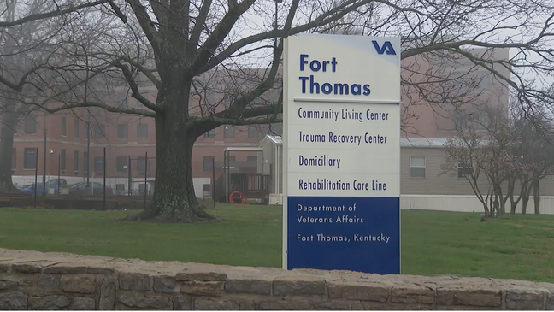
FT. THOMAS DIVISION OF THE CINCINNATI VA MEDICAL CENTER
Notes:
15-minute drive from main medical center in Cincinnati
Ft. Thomas facility houses PTSD residential programs, our domiciliary program and some outpatient PM&R services
From CVAMC public relations “The Cincinnati VA has a long history of caring for Veterans who suffer from Post-Traumatic Stress Disorder (PTSD) dating back to 1992 when the Cincinnati VA was one of the first five VA Medical Centers to offer an inpatient residential setting program. More than 20 years later, Veterans from all over the U. S. come to the Cincinnati VA (actually to our campus in Ft. Thomas, Kentucky) seeking help for PTSD. “

Slide 15
PTSD RESIDENTIAL TREATMENT PROGRAMS 3-COHORT PROGRAM
WOMEN’S PTSD RESIDENTIAL PROGRAM
MEN’S PTSD RESIDENTIAL PROGRAM
MEN’S PTSD/TBI RESIDENTIAL PROGRAM
Notes:
10 WOMEN WITH PTSD, 12 MEN WITH PTSD AND 10 MEN WITH PTSD AND H/O TBI, CURRENT MODIFICATION D/T COVID19 PANDEMIC
Max of 32 Veterans, currently about half that d/t covid restrictions

Slide 16
PTSD RESIDENTIAL TREATMENT PROGRAMS
Goal: Help Veterans learn how to decrease their distress due to PTSD and related symptoms
SYMPTOM REDUCTION AND IMPROVEMENT IN FUNCTIONING
Participate in intensive PTSD treatment with supplemental services
7-week duration
Veterans of all ages/conflicts are eligible
Must meet certain criteria
Notes:
Per admission coordinator “essentially, they need a primary diagnosis of PTSD, stable medically, stable in terms of substance abuse, independent with ADLs. They really should have at least attempted PTSD treatment previously in order to be considered for this HIGHER level of care”
Intensive PTSD treatment – if receiving outpatient CPT, they would do 12 outpatient sessions, here they do individual CPT x2/wk and CPT group x2/week

Slide 17
ADMISSION WEEK
Admission Assessments PTSD Residential Program
 | Med Rec | Nursing | History & Physical | Psychiatric Interview | MHS Intake | Neuro- Psychology | Spirituality Assessment | Speech Assessment | Recreation Assessment
H/o TBI is documented in the PTSD Residential Treatment Consult and a full chart review is completed
Speech, language and cognitive evaluation completed with any Veteran that has h/o TBI
Neuropsychological evaluation may also be completed
Veterans without h/o TBI will also be seen for speech therapy evaluation if deemed appropriate by treatment team
PTSD symptoms assessed pre and post treatment via Clinician-Administered PTSD Scale (CAPS) and weekly via PTSD Checklist (PCL)

Slide 18
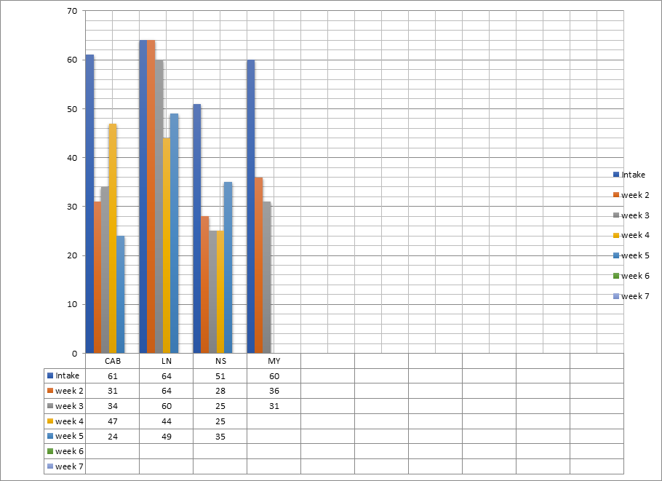
PTSD Checklist (PCL)

Slide 19
WEEKS 2-7
Individual treatment sessions:
CPT (x2/week)
Psychiatry
Adjunct individual sessions as needed:
Relapse prevention
Speech therapy
Nursing assistance with med planner
Dietician

Slide 20
 | Men's HYBRID COVID19 XIV 7/26/21-09/10/21 Weeks 2-6
 | STANDARD WEEKLY Residential PTSD Program Schedule
 | Monday |  | Tuesday |  | Wednesday |  | Thursday |  | Friday |  | Saturday |  | Sunday
7:15 | 7:00-8:00 Breakfast (7:00-7:30 2nd Floor) |  | 7:00-8:00 Breakfast (7:00-7:30 2nd Floor) |  | 7:00-8:00 Breakfast (7:00-7:30 2nd Floor) |  | 7:00-8:00 Breakfast (7:00-7:30 2nd Floor) |  | 7:00-8:00 Breakfast (7:00-7:30 2nd Floor) |  | 7:00-8:00 Breakfast (7:00-7:30 2nd Floor) |  | 7:00-8:00 Breakfast (7:00-7:30 2nd Floor)
7:30
7:45
8:00 | 0800-0830 Fresh Air (Christina) |  | 0800-0830 Vitals & Fresh Air (Nikki) |  | 0800 Fresh Air (Charles) |  | 0800-0900 Improving Sleep (Lina) |  | 0800-0830 Vitals & Fresh Air (Nikki) |  | Practice Leisure Skills; Weekend Goal Setting |  | Practice Leisure Skills; Weekend Goal Setting
8:15 |  |  |  |  | 8:15 - 9:15 Vocational Skills Group (Charles)
8:30 | 8:30 - 9:00 Weekend Review (Christina) |  | 8:30 - 9:30 Relapse Prevention (Nancy) |  |  |  |  |  | 8:30 - 0915 Stress & Your Health (Nursing)
8:45
9:00 | 9:00 - 12:00 Individual Appointments (e.g., CPT, Speech Tx, Psychiatry) (See your individual schedule for details) |  |  |  |  |  | 9:00 - 12:00 Individual Appointments (e.g., CPT, Speech Tx) (See your individual schedule for details)
9:15
9:30 |  |  |  |  | 9:30 - 10:45 Interpersonal Effectiveness (Nicola) |  |  |  | 9:30 - 10:45 Social Cognition (Beth)
9:45 |  |  | 9:45 - 10:45 Spirituality (Chaplain Lowry)
10:00 |  |  |  |  |  |  |  |  |  |  | 10:00-12:00 Leisure Activity (Jon) |  | 10:00 to 12:00 Leisure Activity (Charles)
10:15
10:30
10:45
11:00 |  |  | 11:00 - 12:15 Distress Tolerance (Amy) |  | 11:00 - 12:00 Nutrition (Jessica) | 11:00-12:00 Tx Team Mtg |  |  | 11:00-12:15 Anger Management (Toby)
11:15
11:30
11:45
12:00 | Lunch 12:30-1:00 |  |  |  | Lunch 12:30-1:00 |  | Lunch 12:30-1:00 |  |  |  | Lunch 12:30-1:00 |  | Lunch 12:30-1:00
12:15 |  |  | Lunch 12:30-1:00 |  |  |  |  |  | Lunch 12:30-1:00
12:30
12:45
1:00 | 1:00 - 2:00 Individual Appts (e.g., CPT, Speech, Psychiatry) |  | 1:00 - 2:00 Gardening (Jessica) |  | 1:00-2:00 Compensatory Cognitive Training (Beth) |  | 1:00 - 2:00 Individual Appts (e.g., CPT, Speech, Psychiatry) |  | 1:00 - 2:00 PTSD 101 (Dr. Kepner) |  | 1:00-2:00 Rec Therapy (Mandatory) (Jon) |  | 1:00-2:00 Leisure Activity (Charles)
1:15
1:30
1:45
2:00 |  |  |  |  |  |  |  |  |  |  | Practice Leisure Skills; Weekend Goal Setting |  | Practice Leisure Skills; Weekend Goal Setting
2:15 | 2:15-3:30 CPT Group (Amy & Toby) |  | 2:15 - 3:15 Communication (Christina) |  | 2:15 - 3:15 Yoga (Andrea R) |  | 2:15-3:30 CPT Group (Amy & Toby) |  | 2:15 - 3:15 Behavioral Activation/Wkend Goal Setting (Christina)
2:30
2:45
3:00
3:15
3:30 |  |  | 3:30 - 4:30 Peer Support (Rick) |  | 3:30 - 4:30 Extra individual session as needed
3:45 | 3:45-4:15 Fresh Air (Rick) |  |  |  |  |  | 3:45 - 4:15 Fresh Air (Rick) |  | 3:45 - 4:15 Fresh Air (Jon)
4:00
4:15
4:30
4:45
5:00 | 5:00-6:00 Dinner (5:30-6:00 2nd Floor) |  | 5:00-6:00 Dinner (5:30-6:00 2nd Floor) |  | 5:00-6:00 Dinner (5:30-6:00 2nd Floor) |  | 5:00-6:00 Dinner (5:30-6:00 2nd Floor) |  | 5:00-6:00 Dinner (5:30-6:00 2nd Floor) |  | 5:00-6:00 Dinner (5:30-6:00 2nd Floor) |  | 5:00-6:00 Dinner (5:30-6:00 2nd Floor)
5:15
5:30
5:45
6:00 | 6:00-7:00 Exercise Group (Rick) |  |  |  | 6:00-7:00 Leisure Activity (Jon) |  | 6:00-7:00 Exercise Group (Rick) |  | 6:00-7:00 Leisure Activity (Jon)
6:15
6:30
6:45
7:00
7:15
 | CPT homework should be completed throughout the day, evening, and on weekends!
Compensatory Cognitive Training (CCT) and Social Cognition Rehabilitation for Veterans with TBI and PTSD
CPT group, relapse prevention, spirituality, nutrition, peer support, recreational therapy, anger management, distress tolerance, yoga, weekend goal setting, fresh air*

Slide 21
SPEECH-LANGUAGE PATHOLOGY ROLE
*PRIMARY* Provide support services for optimal Veteran participation in the residential program
organization, memory, attention 🡪 Day planners, smartphones, attention strategies for group sessions
Compensatory approach with focus on symptom management and building confidence
Work with Veterans on other areas of concern or interest
Fluency, note-taking, study skills, social skills, goal setting and planning
Notes:
I’M FACILITATING THEM GETTING THE MOST OUT OF THE PROGRAM AS POSSIBLE

Slide 22
PLAN OF CARE - A COLLABORATIVE PROCESS
Assessment – thorough chart review, informal speech, language and cognitive evaluation, self-report measure, possibly standardized assessment
TBI education
Expected recover following mTBI/concussion (85% of caseload), prevention, other factors that impact cognitive functioning (mental health, substance abuse, sleep, chronic health conditions)
Ongoing assessment
Track outcomes via self-report measures
Compensatory strategy training in relevant areas
Memory, attention, organization, planning
Discharge planning

Slide 23
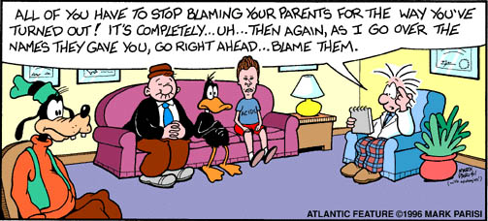
SLP ROLE (CONTINUED)
Compensatory Cognitive Training group
Social Cognition Rehabilitation for Veterans with TBI and PTSD
This Photo by Unknown Author is licensed under CC BY-NC-ND

Slide 24
COMPENSATORY COGNITIVE TRAINING (CCT)
Elizabeth W. Twamley, Ph.D., Marilyn Huckans, Ph.D. and colleagues (CCT)
cogSMART
Cogsmart.com
A form of cognitive training to help people improve their skills in:
prospective memory
Attention
learning/memory
executive functioning (problem-solving, planning, organization, and cognitive flexibility)
Goal is to help people with cognitive symptoms or impairments perform better in their everyday activities and reach their goals pertaining to school, work, social functioning, and independent living CogSMART
Notes:
Dr. Elizabeth Twamley VA San Diego Healthcare System
Learn and practice skills with activities, roleplays and discussions

Slide 25
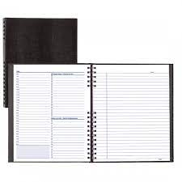
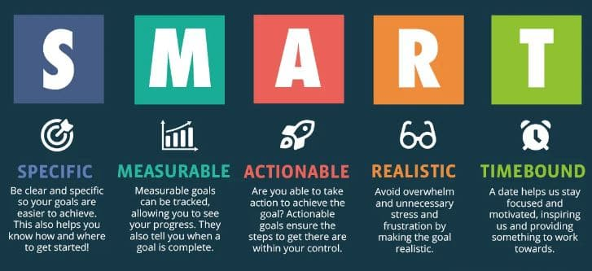
L - Listen actively
E - Eliminate distractions
A - Ask questions
P - Paraphrase
Define Brainstorm Evaluate Select Try Evaluate
P – Preparation
E – Energy Conservation
A – Active Effort
S – Self-talk

Slide 26
Primary Aim
Develop a renewed social life for group members that is rewarding, matches their goals, and is personally meaningful
Your Social Network
Active Listening*
Empathy*
Small Talk*
Turn-taking*
Using and Understanding Sarcasm
Effectively Reacting to Impoliteness
When Trust is Broken
Solitude versus Isolation
Washington, DC Veterans Affairs Medical Center
Notes:
Modified from original long version, picked out specific modules that fit well into our programs
*use of clinic iPad for roleplay exercises. Teach the skills then practice the skills. Get feedback from group members/SLP and watching themselves on the TV

Slide 27
CASE STUDY
33 y/o Army Veteran, deployed x2 to Afghanistan, diagnosed with major depressive disorder, chronic post-traumatic stress disorder, sleep apnea, multiple mTBIs/concussions, had heavy alcohol use while in Army, now uses marijuana regularly for sleep, recently quit school d/t PTSD symptoms, quit a job d/t interpersonal conflict with manager, lack of structure and activity in daily life, avoids going places because he doesn’t like being around others, cognitive complaints in the areas of attention, memory and organization
Notes:
Casting in parking lot/driveway, watches TV at home, sometimes lifts weights at gym
“I don’t know how to structure my own life. I don’t know what I can and can’t do. I need help figuring out what to do with my life. I hate getting the pension. I don’t know what I’m supposed to do every day.”

Slide 28
L - Listen actively
E - Eliminate distractions
A - Ask questions
P - Paraphrase
Define Brainstorm Evaluate Select Try Evaluate
P – Preparation
E – Energy Conservation
A – Active Effort
S – Self-talk

Slide 29
CASE STUDY - OUTCOMES
Veteran achieved all therapy goals
medication planner and day planner to manage appointments and take notes
Veteran reported seeing a change in his thinking skills since admission. He reported being "amazed" at how "powerful" internal and external memory strategies can be. He was impressed with his reduction in self-reported cognitive problems on a cognitive questionnaire. He was proud of himself.
Recommended outpatient speech therapy services (good candidate given motivation and success so far, employment and school).

Slide 30
A SAMPLE OF RECENT PTSD/TBI RESIDENTS
A sample of 320 Veterans who participate in the PTSD/TBI Residential Program
Average age = 39.2
Ethnicity:
Caucasian: 82.5%
African American: 10.2%
Other: 7.3%

Slide 31
SERVICE ERA

Slide 32
PRE AND POST DATA FOR RESIDENTIAL PROGRAMS
Notes:
Data pulled from 2014 forward, little to no data from covid era

Slide 33
PTSD OUTCOMES

Slide 34
TRAUMA-INFORMED CARE
Care that “acknowledges the need to understand a patient’s life experiences in order to deliver effective care and has the potential to improve patient engagement, treatment adherence, health outcomes, and provider and staff wellness.” – important for ALL providers
Reframe thinking from “What’s wrong with them?” to “What happened to them?”
Up to 60% of people will experience trauma, some will have persistent trauma-related problems
we are likely to meet trauma in our clinics, classrooms, and medical facilities
Look for signs of acute distress AND use universal precautions
Notes:
Key Ingredients for Successful Trauma-Informed Care Implementation (samhsa.gov)
Guidance from the Substance Abuse and Mental Health Services Administration which is a part of the U.S. Department of Health and Human Services

Slide 35
TRAUMA-INFORMED CARE
Signs that a patient may be experiencing acute trauma-related distress may include:
Highly anxious or “jumpy.”
Strong emotional reaction that doesn’t fit the situation.
Tearful without clear cause.
Difficulty focusing, seems to be thinking about something else.
Physically withdrawn, quiet, frozen.
Signs of flashback/re-experiencing.
A full chart review and interview will help to identify history of mental health issues

Slide 36
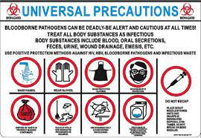
TRAUMA-INFORMED CARE
Universal precautions
Assume everyone you encounter may have experienced trauma
Use trauma-informed principles and practices

Slide 37
LANGUAGE
ENVIRONMENT
OTHER CONSIDERATIONS
Say what you are going to do and why, and then ask if that’s okay
Avoid giving orders: instead of “relax,” try “some people find it helpful to take some deep breaths at this point”
Give choices: where to sit, therapy tasks, helps to create a sense of control
Read body language, noticing signs of tension, fear, hypervigilance, and avoidance
Allow the patient to share what they are comfortable sharing
Good lighting and sufficient space
Offer to open a door or adjust lighting if you notice signs of possible discomfort or distress
Ask “Is there anything I can do to make you feel more comfortable?” allows them to indicate what they need
Take breaks when needed: Don’t persist through an assessment or task if your patient shows signs of discomfort or distress
Avoid unexpected physical touch
Be sensitive to possible cultural and gender issues
“Have you experienced anything that makes working with me/participating in the visit difficult or scary for you?”
Use empathy – avoid making assumptions or judgments about a patient and their behavior
Mental health providers? With permission, share pertinent information
Notes:
Cramped, small spaces (such as an audiology booth) and/or poor lighting can sometimes be triggering – AUDILOGY BOOTHS
Ex: more comfortable with a female or male provider. It’s helpful to have a diverse team of providers
Ex: If a patient hasn’t been showing up for appointments, for example, gather information about possible barriers and offer to help problem-solve through the issue

Slide 38
CONNECTING WITH MENTAL HEALTH SERVICES
Referrals for patients
Get to know the mental health providers within your organization
Seek recommendations and contacts from your interprofessional team
Speak with the patient’s primary care provider regarding your concerns
Get mental health services for yourself
Utilize mental health and wellbeing services
within your organization
Talk to your medical providers about your concerns
See resources on next slides

Slide 39
MENTAL HEALTH RESOURCES
National Suicide Prevention Lifeline: 800-273-8255, suicidepreventionlifeline.org/talk-to-someone-now.
Talk to trained crisis workers 24 hours/day, 7 days/week. Confidential, free crisis counseling and mental health referrals
Substance Abuse and Mental Health Services Administration (SAMHSA) Treatment Referral Helpline: 1-877-SAMHSA7, www.samhsa.gov/find-help/national-helpline.
confidential, free, 24-hour information service, in English and Spanish
provides referrals to local treatment facilities, support groups, and community-based organizations. Callers can also order free publications and other information.

Slide 40
MENTAL HEALTH RESOURCES
Veterans Crisis Line: 1-800-273-TALK or text 838255.
Crisis Text Line: Text the word “Home” to 741-741
The Trevor Lifeline for LGBTQ Youth: 1-866-488-7386
Trans Lifeline: 1-877-565-8860

Slide 41
Walter, K. H., Kiefer, S. L., & Chard, K. M. (2012). Relationship between posttraumatic stress disorder and postconcussive symptom improvement after completion of a posttraumatic stress disorder/traumatic brain injury residential treatment program. Rehabilitation Psychology, 57(1), 13. https://doi.org/10.1037/a0026254
Stein, M. B., & McAllister, T. W. (2009) Exploring the convergence of posttraumatic stress disorder and mild traumatic brain injury. The American Journal of Psychiatry, 166(7):768-76.
Hoge, C. W., Castro, C. A., Messer, S. C. , McGurk, D., Cotting, D. I., Koffman, R. L. (2004) Combat duty in Iraq and Afghanistan, mental health problems, and barriers to care. The New England Journal of Medicine, 1;351(1):13-22.
Vasterling, J. J., Verfaellie, M., Sullivan, K. D. ( 2009) Mild traumatic brain injury and posttraumatic stress disorder in returning veterans: Perspectives from cognitive neuroscience. Clinical Psychology Review, 29(8), 674-684.
Barnes, S. M., Walter, K. W., & Chard, K. M. (2012). Does a History of Mild Traumatic Brain Injury Increase Suicide Risk in Veterans with PTSD? Rehabilitation Psychology, 57, 18-26.
Loignon, A., Ouellet, M.C., & Belleville, G. (2019). A Systematic Review and Meta-Analysis on PTSD Following TBI Among Militar/Civilian Populations. The Journal of Head Trauma Rehabilitation, 35, E21-E35.
Vasterling, J. J., Jacob, S. N., & Rasmussen, A. (2018). Traumatic Brain Injury and Posttraumatic Stress Disorder: Conceptual, Dianostic, and Therapeutic Considerations in the Context of Co-Occurence. The Journal of Neuropsychiatry and Clinical Neurosciences, 30, 91-100.
Walter, K. W., Barnes, S. M., & Chard, K. M. (2012). The Influence of Comorbid MDD on Outcome After Residential Treatment for Veterans with PTSD and a History of TBI. Journal of Traumatic Stress, 25, 426-432.
Walter, K. W., Kiefer, S. L., & Chard, K. M. (2012). Relationship Between Posttraumatic Stress Disorder and Postconcussive Symptom Improvement After Completion of a Posttraumatic Stress Disorder/Traumatic Brain Injury Residential Treatment Program. Rehabilitation Psychology, 57, 13-17.

Slide 42
PTSD: National Center for PTSD Home (va.gov) www.ptsd.va.gov
Videos - PTSD: National Center for PTSD (va.gov) (whiteboard videos) www.ptsd.va.gov/appvid/video/index.asp
PTSD : Decision Aid (va.gov) www.ptsd.va.gov/apps/decisionaid/
CogSMART www.cogsmart.com
Traumatic Brain Injury Center for Excellence - Patient and Family Resources | Health.mil https://health.mil/About-MHS/OASDHA/Defense-Health-Agency/Research-and-Development/Traumatic-Brain-Injury-Center-of-Excellence/Patient-and-Family-Resources
SAMHSA's Concept of Trauma and Guidance for a Trauma-Informed Approach (hhs.gov)

Slide 43
THANK YOU
Beth LaGrange, M.A., CCC-SLP, CBIS
513-861-3100 x313013
Elizabeth.LaGrange@va.gov
Greg Bailey, Ph.D.
513-861-3100 x316758
Greg.Bailey@va.gov

