Slide 1
The New Normal: Understanding Family and Individual Dynamics Following Brain Injury
Deborah Gutteridge, MS, CBIST, Clinical Evaluator

Slide 2
Audio Check
To ensure that you can hear the presentation, please take a moment to double check your audio settings.
Go to the Audio tab in your GoToWebinar dashboard.
If you have selected phone call, make sure you’re dialed into the conference number.
If you are dialed in but cannot hear, try hanging up and calling back in.
If you are using only computer audio, check that your device isn’t muted.
If you’re using listening devices such as headsets, double check they are plugged in/turned on.

Slide 3
NeuroRestorative’s COVID-19 Response
We are committed to protecting the health and safety of the individuals we serve, our staff, and the community. Our services are considered essential, and we are taking precautions to minimize disruption to services and keep those in our care and our team members safe. In some programs, that has meant innovating our service delivery model through Interactive Telehealth Services. We provide Interactive Telehealth Services throughout the country as an alternative to in-person services. Through Interactive Telehealth Services, we deliver the same high-quality supports as we would in-person, but in an interactive, virtual format that is HIPAA compliant and recognized by most healthcare plans and carriers.
You can learn more about our COVID-19 prevention and response plan at our Update Center by visiting neurorestorative.com.

Slide 4
The Most Challenging Issue…
For survivors
For families
For professionals

Slide 5
Essential Basics That Must Be Considered
“Every brain is different……
every brain injury is different…”

Slide 6
Physical Givens:
3 pounds “jello”
18 years old/25 years old
Bones, walnuts, and mushrooms
“I feel no pain”

Slide 7
Physical Givens Continued..
100,000 miles of vessels
Fattest organ in body
75% water
Have most cells you will have at birth

Slide 8
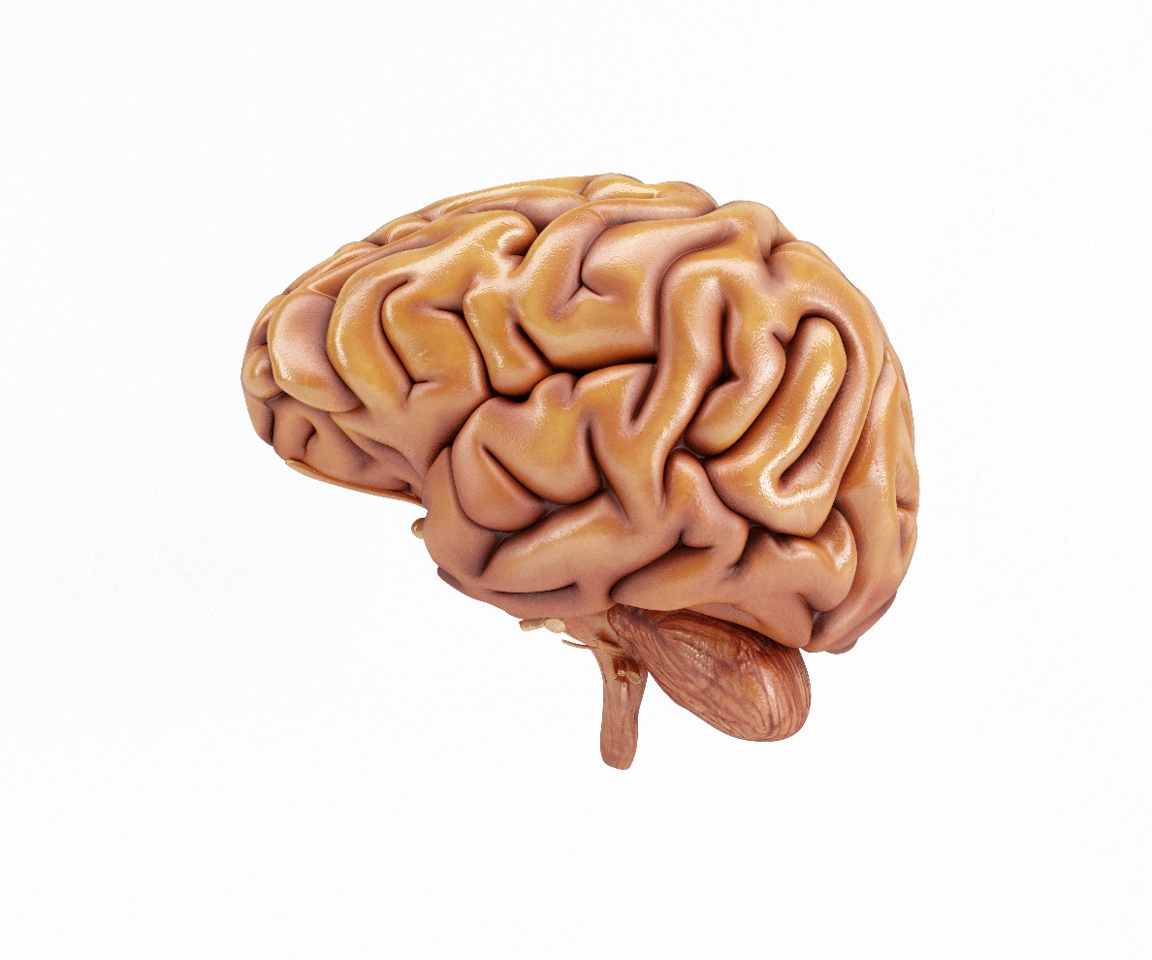

Slide 9
Key Factors Impacting Adjustment, Coping and Acceptance
Pre-injury lifestyle of family
Location of injury to brain
Pre-injury lifestyle of Individual with Acquired Brain Injury

Slide 10
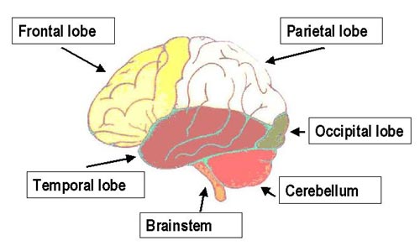
Brain Anatomy 101

Slide 11
Occipital Lobes
“Am I seeing what I think I see?”
“ I am seeing stars”

Slide 12
Temporal Lobes
“ I’m hearing what you’re saying!” (hearing)
“I remember what you’re saying!” (memory)
As Popeye says, “ I am what I am!” (sense of self)
“déjà vu”

Slide 13
Parietal Lobes
“ I feel no pain!”
“I feel ‘that’ pain!”

Slide 14
Cerebellum
1/8 of total brain weight
Skilled repetitive movements:
Running
Swimming
Writing
Holding a drink

Slide 15
Frontal Lobes
A + B= C (I’m thinking)
“Let’s go to the store” (I’m planning)
Per-son-ality (teens!)

Slide 16
Getting Thicker as You Use it!
Upper most cerebral cortex is 80%
“Brain Work”
Thinking
Perceiving
Speaking
Understanding
Other structures
Underneath-moving
Sleeping
Eating
Smelling
Seeing
Breathing
And more

Slide 17
“My half is better than your half”
Left Cerebral
Analytical, reasoning, logic, language
Right Cerebral
Artistic, creative, art, music, voice recognition, orientation in space, mapping
Corpus Callosum
Bridging the halves

Slide 18
“ 1 Cup ‘O Fluid’ Helps The Medicine Go Down”
Cerebrospinal fluid
Brain and spinal column
Your brain’s connected to the spinal column by the stem
Medulla
1 inch
Temperature
Breathing
Swallowing
Vomiting
HR
BP

Slide 19
Injury Site Plays Role
Damage to the frontal lobe is significant for behavior problems
Frontal lobes are regulators of integrative behavior
Poor attention to task, initiation or participation in goaled behaviors

Slide 20
Other Injury Sites
Damage to temporal lobes may cause verbal or physical outbursts
Damage to hypothalamus may cause appetite disturbances, mood swings, and irritability
Diffuse damage has shown to result in depression, poor frustration tolerance, and sexual dysfunction

Slide 21
Pre-Injury Lifestyle of Individual with Brain Injury
Personality
Body image
Previous satisfaction with life activities
Religion and philosophy of life
Life stage
Ability to live with uncertainty

Slide 22
Pre-Injury Lifestyle of Family
Proactive vs. Reactive
Eat well, exercise in hopes of long healthy life
Family members will become ill, disabled or suffer, age, die….or may sustain an ABI

Slide 23
Family Lifestyle cont.
Family Beliefs: untested myths vs. belief validations
“my family loves me so much they will always take care of me”
“we will never leave each other no matter what”
“I have sacrificed for my children, so I know they will take care of me when the time comes”

Slide 24
Additional Factors to Consider
Premorbid level of functioning
Severity of injury
Depth and length of coma
Age at time of injury
Premorbid educational level
Socioeconomic status

Slide 25
Adjustment, Coping and Acceptance in Families
Stage 1 (1-3 months)
Shock of the injury
Hopes for full recovery
Denial of severity

Slide 26
Adjustment, Coping, and Acceptance in Families
Stage 2 (3-9 months)
Recognition of severity
Helplessness
Frustration

Slide 27
Adjustment, Coping, and Acceptance in Families
Stage 3 (6-24 months)
Possible annoyance with survivor
Family expects full independence
Start to recognize the reality of impairment
Start information seeking about ABI

Slide 28
Adjustment, Coping, and Acceptance in Families
Stage 4 (10-24 months)
Realism of situation sets in
Family begins to get exhausted
Reduction of time with loved one
Bereavement like emotions may occur

Slide 29
Adjustment, Coping, and Acceptance in Families
Stage 5 (12-24 months)
Profound sadness
Families begin to grieve again
Mourn the loss of loved one’s personality

Slide 30
Adjustment, Coping, and Acceptance in Families
Stage 6 (2-3 years)
Greater understanding of the situation
Understanding person may never be the same
Begins to accept loved one’s condition
Can now address needs of entire family unit

Slide 31
Adjustment, Coping and Acceptance for Individual with Brain Injury
Stage 1-Denial of Trauma’s Impact
Denial that recovery won’t occur
Denial of past abilities or current limitations
Avoidance of tx/refusal of rehabilitation
Denial can be adaptive* (in control, reduce stress)
Long term denial can be detrimental

Slide 32
Adjustment, Coping and Acceptance For Individual with Brain Injury
Stage 2-Grieving Over Perceived Losses
Helplessness, sadness, sorrow
Anger directed toward others
Little dying/deaths along the way

Slide 33
Adjustment, Coping and Acceptance For Individual with Brain Injury
Stage 3-Depression
Limited control over life
Loneliness
Impact of varied losses upon life
Can come out as anger

Slide 34
Adjustment, Coping and Acceptance For Individual with Brain Injury
Stage 4-Guilt
Accident is their fault (seatbelt; motor cycle helmet; alcohol)
Families blame person for injury as they can’t believe what has happened

Slide 35
Adjustment, Coping and Acceptance For Individual with Brain Injury
Stage 5-Coping Styles
Displacement: anger over what one has lost may be displaced to family friends
Regression: reverts to past methods of gaining gratification
Intellectualization: “could have been worse” “now I’ll be better person”

Slide 36
Adjustment, Coping and Acceptance For Individual with Brain Injury
Stage 6-Acceptance
Gain new perspective on living
Mental decision to live with realities
Renegotiate old relationships
Redefining self based on new interactions with others

Slide 37
Taking Adjustment, Coping and Acceptance to the Next Level!
“AWARENESS”

Slide 38
Impaired Awareness
“Person lacks or has reduced insight into deficits, present changes, and their implications on daily life.”
Due to damage to certain areas of brain
Denials of illness secondary to psychological distress

Slide 39
Awareness in our Lives
We all struggle daily with awareness
Impacts all aspects of recovery
Impacts getting back to life activities
Requires self-monitoring
Guides our actions and approach

Slide 40
Pyramid of Model of Awareness
Intellectual Awareness: what has happened
Emergent Awareness: “I get it” but don’t do anything about it
Predictive Awareness: What happens if I don’t do anything different? Breakdowns?

Slide 41
The Struggle….
Understanding:
they have a problem and need to change
how awareness impacts their life
what they need to do about it

Slide 42
#1 Strategy for Increasing Awareness
Videotaping:
Allows person to analyze their behavior
Watch & ask how they think they did
Break down task steps
Teach compensatory strategy

Slide 43
Recalibration of Self
Re-evaluate yourself
Strengths and weaknesses evolve
What you do in your 40’s versus 20’s
What are my strengths, weaknesses, and challenges?
Don’t let the “weakness dialogue” overshadow the strengths!

Slide 44
Empower People
Give someone a greater sense of confidence of self-esteem
Families
Friends
professionals

Slide 45
Conclusions
Life changes for everyone after an ABI, but does not have to be for the bad.
Grief theory provides a framework for adjustment.
Take time to re-learn who you are now and how you have changed.
Exploring how you have changed can be empowering!

Slide 46
Thank you for listening!
Deborah Gutteridge, MS, CBIST
Deborah.gutteridge@neurorestorative.com

Slide 47
Questions?

