Slide 1
Meeting Yourself Where You Are
Valerie Hill, PhD, MS, OTR/L
College of Allied Health Sciences
Department of Rehabilitation, Exercise, and Nutrition Sciences

Slide 2
Objectives
Discuss what it means to be healthy
Reflect on who and where we are as individuals and explore ways to meet yourself where you
Provide strategies and resources for attendees to support living a healthier life

Slide 3
What does it mean to be healthy?
What does healthy mean to you?
What do you do to be healthy?

Slide 4
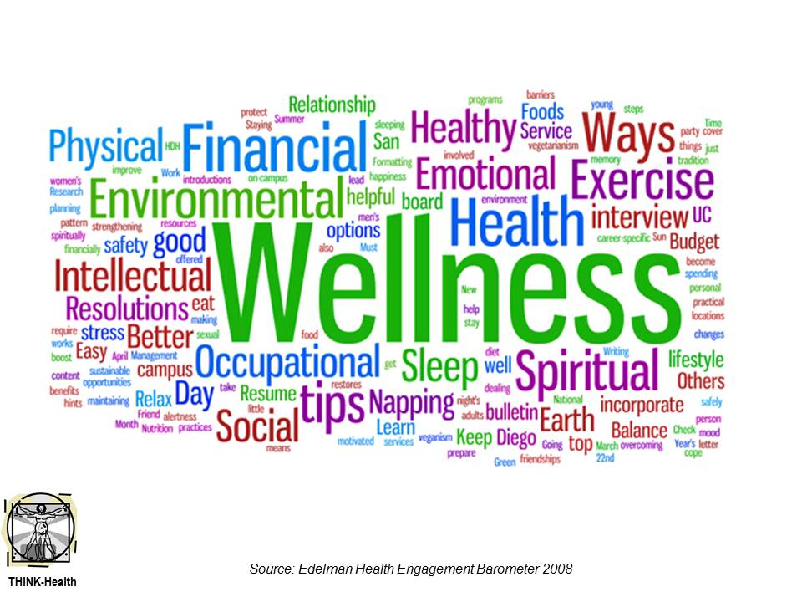
Health Beliefs
We share many similar ideas about health; however, we are all different.
We each need our own approach to health and wellness based on where we are and where we want to go.

Slide 5
Self-Identity Transformation

Slide 6
Reflect: What makes you, You?
What do you identify with?
What makes your soul shine?
What is your personality?
What are your strengths?
What things can you accept right now?

Slide 7
Who do you want to be? What do you want to do?
Make a list of aspirations aka long-term goals
Include some of your health and wellness goals
Include daily tasks, fun activities, mental, physical, and cognitive functional desires
Choose a few to focus on: chose the ones that feel doable, that you are excited about, that you have support for.
Prioritize any urgent health or life crises

Slide 8
How are you going to get there?
Brainstorm what is needed to address your goals
Identify the steps that are needed to make the change
Professionals, friends, family can help you brainstorm

Slide 10
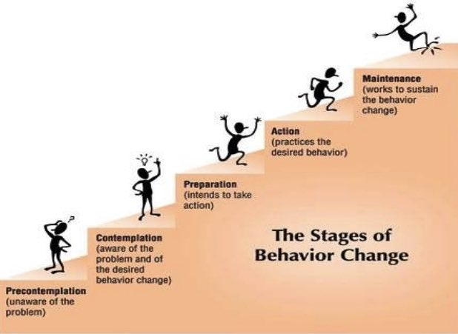
How ready are you to make a change?
Assess where you are in the process of making a change. Have patience and grace with yourself wherever you are in respect to your readiness to make a change
Choose goals that you’re ready and preparing to do
You can put goals that you’re still contemplating as a lower priority

Slide 11
Set yourself up for success
Plan ahead for issues that you might face- you know yourself and what will challenge you to make change
Put supports in place so you have a plan if you “fall off the bandwagon”
Explore what has been helpful in the past
Ask others for ideas
Trial supports- if one doesn’t work try another!

Slide 12
Beware of barriers
Acknowledge potential barriers you might encounter
Barriers come in all forms!
Environmental
Physical
Cognitive
Psychological
Time
Access
Add your barriers to the list

Slide 13
Match your barriers with your supports
Anticipate issues and plan the support that you will utilize to help keep you on track

Slide 14
Being healthy while meeting yourself where you are

Slide 15
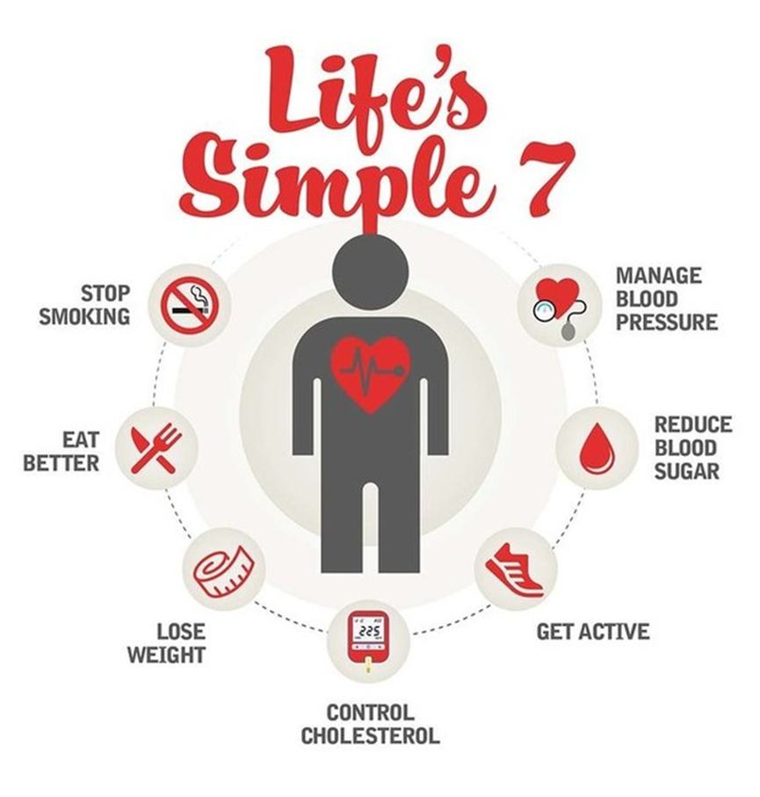
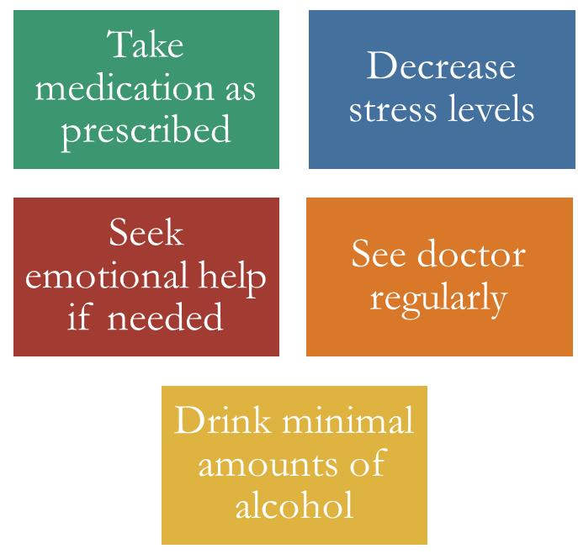
American Heart Association Guidelines

Slide 16
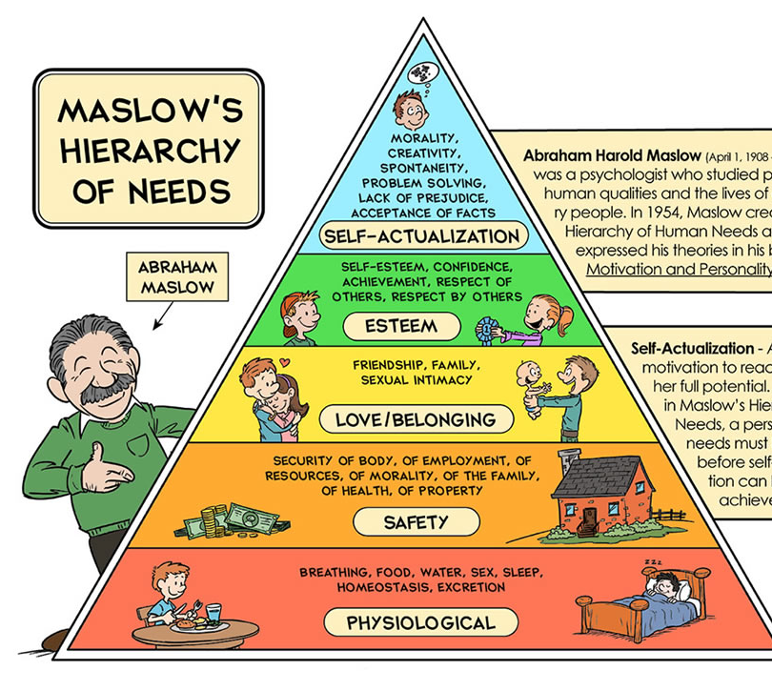
Evaluate your basic needs
Food
Water
Sleep
Safety
Housing
Healthy relationships
Mental health and mood
Self-confidence and self-esteem

Slide 17
Know your labs
Cholesterol
Triglycerides
Blood glucose/sugar
Blood pressure

Slide 18
Manage your medical needs: Self-management
Manage medication
Attend doctor’s appointments
Manage all of the symptoms in the symptom cycle
Manage cognitive changes

Slide 19
You are your own best advocate

Slide 21
Thank you

Slide 22
Questions and Contact Information
Valerie A. Hill, PhD, MS, OTR/L
Assistant Professor and Director of the Life Management Laboratory
Masters of Occupational Therapy Program
Rehabilitation, Exercise, and Nutrition Sciences
College of Allied Health Sciences
University of Cincinnati
hillva@ucmail.uc.edu
513-558-5018

