Slide 1
EFFECTIVE LAWYERS, EFFECTIVE CLINICIANS, EFFECTIVE CLIENTS:
MAKE IT HAPPEN

Slide 2
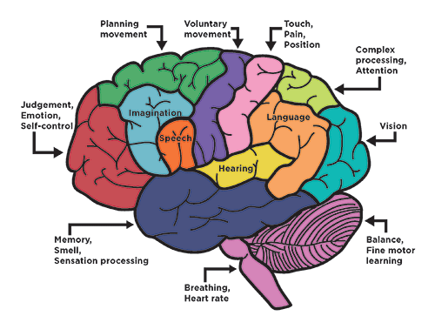
ABOUT THAT BRAIN INJURY
Scientists have learned more about the brain —
how it works and how it heals —
in the last decade or two than ever before.
And, there has been a dramatic increase in the amount of research being done specifically on traumatic brain injury (TBI).

Slide 3
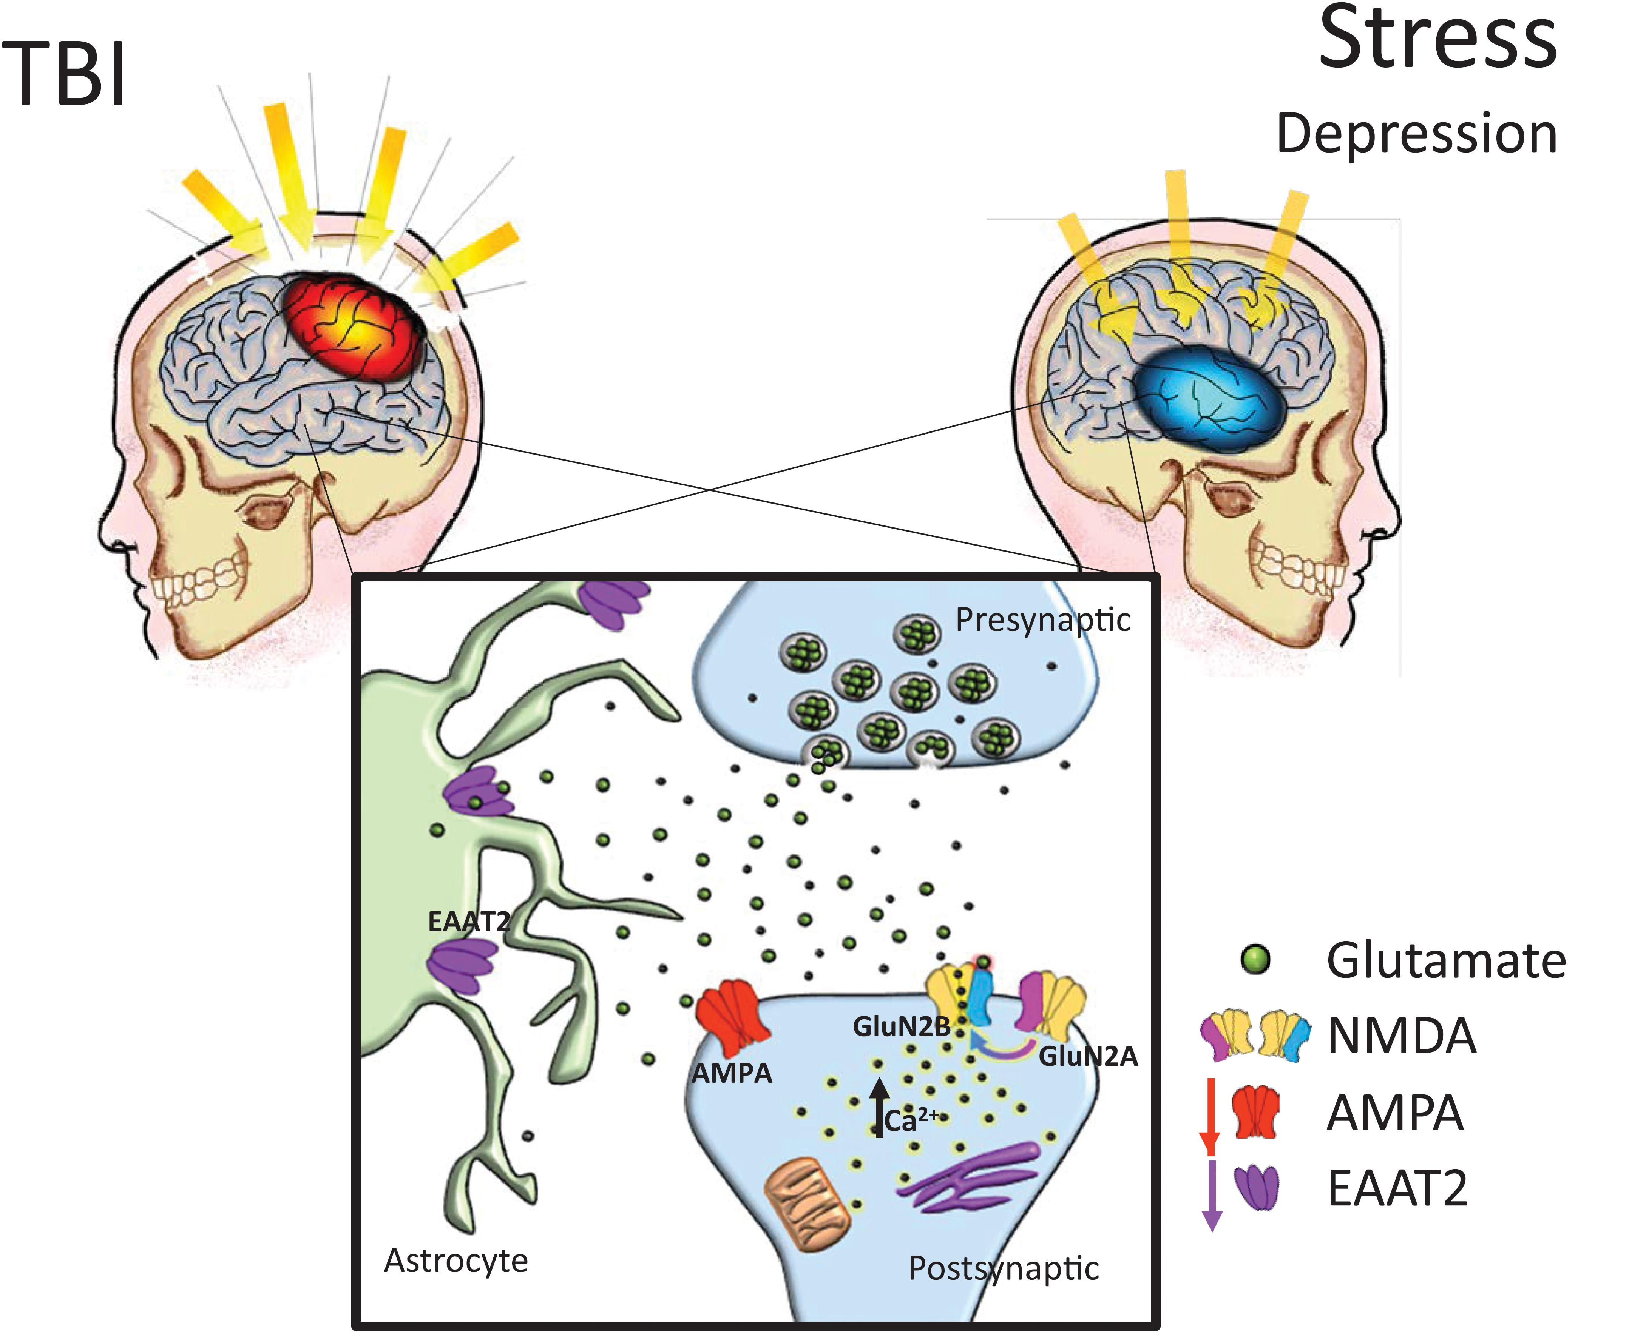
AND YOU OR A SIGNIFICANT OTHER HAS HAD A BRAIN INJURY
You understand the negative emotional and financial impact it has on a family
Recovery can be complex and take a long time for everyone
There is concern about what life will look like in the future

Slide 4
YOU NEED TO LEARN AS MUCH AS POSSIBLE ABOUT YOUR BRAIN INJURY
Medical treatment needed immediately and continuing
Approach to and location for rehabilitative care
Doctors, nurses, therapists should provide:
Clear, comprehensive data about status, ability, demeanor
Evaluation and estimation of future needs
What are the thoughts, observations, expectations of survivor, family, friends?

Slide 5
HOW DO FUNCTIONAL OUTCOMES CHANGE FROM THE ACUTE TO CHRONIC PHASES OF RECOVERY AFTER MODERATE TO SEVERE TBI?
In a study of 484 participants with msTBI, by 12 months post injury, approximately half of those with severe TBI and three-quarters of those with moderate TBI recovered the ability to function independently at home for at least 8 hours per day.
At 2 weeks post injury:
36 of 290 participants with severe TBI (12.4%)
38 of 93 participants with moderate TBI (41%)
had favorable outcomes (Glasgow scores 4-8)
301 of 322 in the severe TBI group (93.5%)
81 of 103 in the moderate TBI group (78.6%)
had moderate disability or worse on the DRS (total score ≥4).

Slide 6
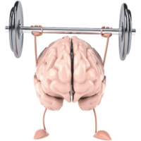
ANOTHER STUDY PROVIDED ADDITIONAL INFORMATION
What were clinical recovery times and factors that might impact on recovery after a sports-related mild traumatic brain injury?
45% of participants showed clinical recovery within 14 days after injury
77% by 4 weeks after injury
96% by 8 weeks after injury

Slide 7
SO WHAT DOES ALL THIS MEAN TO SURVIVORS AND FAMILES?
No one should make early, definitive prognostic statements suggesting specific outcomes
But preparation for all possibilities should be made
And you may need help to prepare for those possibilities

Slide 8
PERHAPS A LAWYER CAN HELP Because----Brain injuries can occur as a result of a variety of events and are often due to someone’s negligence!
Medical malpractice
Birth injuries
Medication errors
Auto accidents
Truck accidents
Falls
Recreational accidents
Defective products or dangerous medications
Workplace accidents

Slide 9
Negligence is where an at-fault party failed to act within reasonable standards of care
Incorrectly using medical equipment
Careless Practice
Running a red light causing an accident.
Impaired driving
Assault causing injury
Defective products
Slip and fall in hazardous environment
Sports injuries
Medication untoward effects
Workplace accidents
Many others

Slide 10
WHAT CAN BE DONE???? WHAT SHOULD YOU DO?
Your first step in seeking compensation for your considerable losses is to file a claim with the party responsible for your TBI.
This will likely be through an insurance company. Though the claims process may seem straightforward, there are multiple challenges.
Claims adjusters can be difficult to work with, as they are employees of the company. They do not prioritize your needs.
Denials or low offers are often the initial response.

Slide 11
WHAT CAN A BRAIN INJURY LAWYER DO TO HELP?
Determine if negligence caused the injury and help recover damages associated with the injury.
Assist you in negotiations with an insurance company, and take the matter to court if necessary.
Depending on state laws, Injured persons may have limited amounts of time in which to file suit. A brain injury attorney can help determine what your state’s laws and regulations are and make sure your case is filed in time.
A brain injury law firm has the necessary experience to prove negligence and advocate for a compensation sum that is commensurate with the injury you’ve experienced.

Slide 12
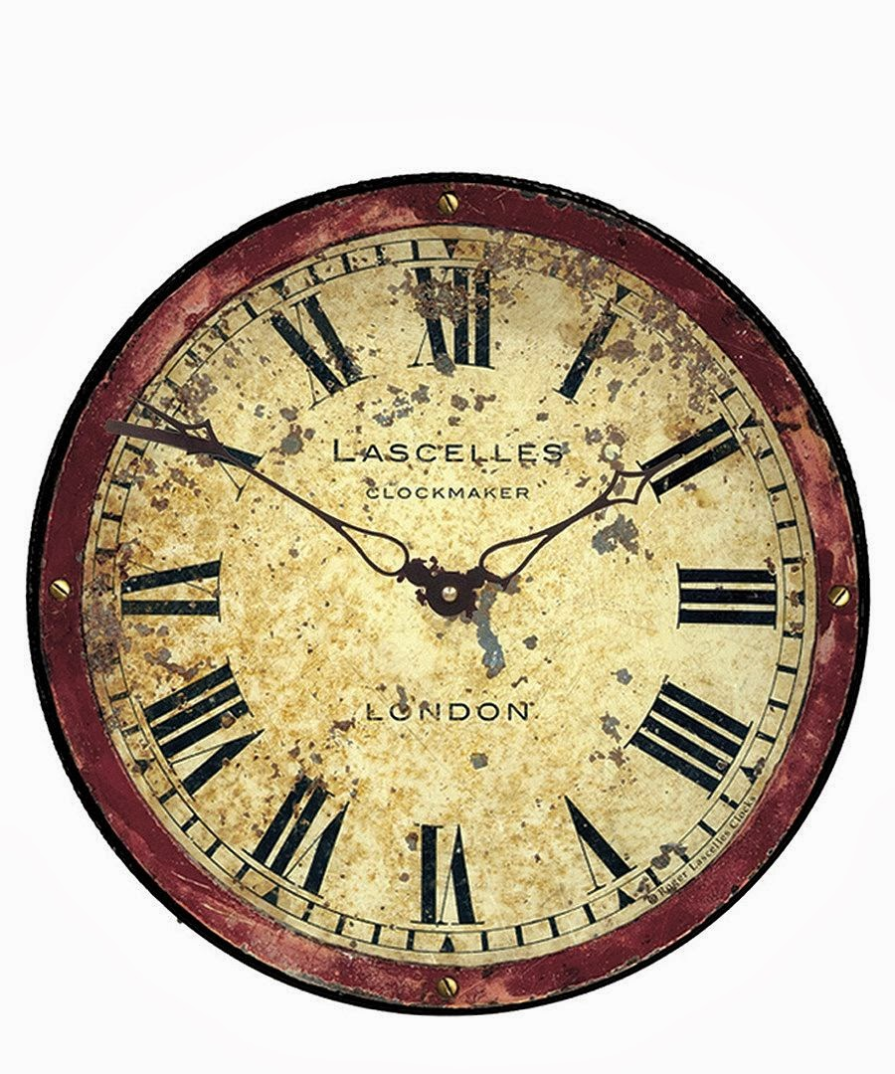
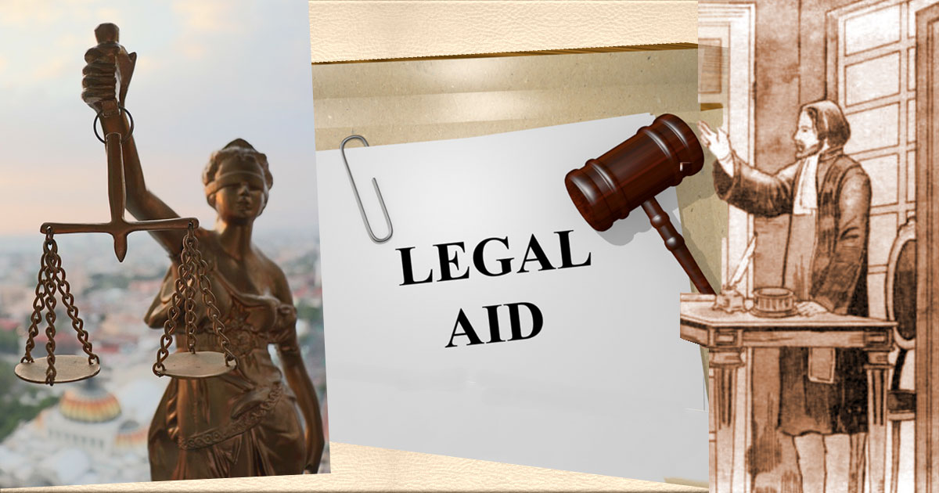
ARE THERE OTHER THINGS TO CONSIDER?
Time limitations vary among states and the kind of injury
Often timing starts when the injury occurred
But sometimes it may not be realized that you have problems until later
Bottom line—it tends to be when you knew or should have known you had a problem
Best not to wait if you have experienced an injury when likely related to another’s action
BIANK and Bridges can help direct you to various kinds of help
Northern Kentucky Bar Association can direct to experienced lawyer

Slide 13
BRAIN INJURY LAWYERS ARE ON YOUR SIDE
Present and future medical expenses
Long-term medical care and therapy
Specialized care and equipment
Physical pain
Emotional suffering
Lost wages
Lost earning capacity
Other life needs
Brain injury cases can result in a variety of settlement amounts. Factors that must be considered when determining compensation include the type and severity of the injury, how the victim’s life is impacted by the injury and other details specific to each individual case. Lawyers will fight for your adequate compensation. And they do so usually on a contingency basis.

Slide 14
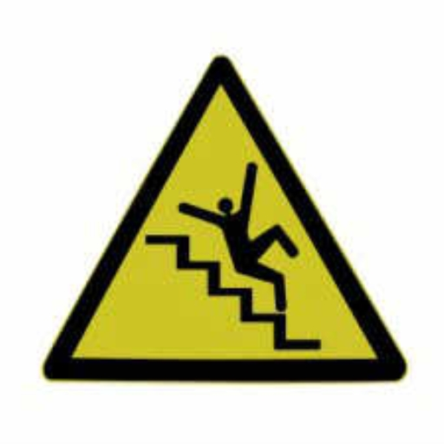
CAN THE CHANCES OF BRAIN INJURY AND ITS SEQUELLA BE PREVENTED?
It is always better to avoid a problem if it is possible to do so By taking action in advance
Wear a helmet while cycling, skating, or similar activities
Aging safely with environmental awareness
Avoid risky locations and activities
Be adequately insured to limit financial loss
Uninsured and underinsured motorists
Adequate health insurance or other support programs

Slide 15
AND IF MORE IS NEEDED TO HELP AND SUPPORT THE BRAIN-INJURED PERSON---
Long-term and ongoing care may be needed and there are ways to provide that security
May also need to protect financial assets
Protect survivor from exploitation
Ensure ongoing support and advice
Power of Attorney
Special Needs Trust
Guardianship or Conservatorship
Housing opportunities
Americans with Disabilities Act
Social Security Programs

Slide 16
AND THE GOOD NEWS IS I leave you with some affirming thoughts from those who know of hardship

Slide 17
THANK YOU FOR YOUR PARTICIPATION “LIVE LONG AND PROSPER”
ALICE G. RINI, JD, MS, RN
ATTORNEY-AT-LAW
CLINICAL SPECIALIST--GERONTOLOGY

