Slide 1
Addressing visual deficits in adults after acquired brain injury
Dr. Kelly Taylor, OTD, MS, OTR/L, CBIS
Assistant Professor, Academic Fieldwork Coordinator
Murray State University, Occupational Therapy Program

Slide 2
Learning Objectives
Understand the foundational components of vision and visual perception as it relates to occupational performance and participation
Identify potential deficits related to vision and visual perception in adults with acquired brain injury
Identify potential functional vision/visual perception screenings and assessments for adults with acquired brain injury
Identify interventions to improve functional vision/visual perception in preparation for occupational performance and participation

Slide 3
Presentation Agenda
Anatomical & physiological foundations of vision and visual function
Common vision and perception deficits post-ABI
OT Scope of Practice related to vision
Evaluation of functional vision
Intervention options
Case Study

Slide 4
Acquired Brain Injury
Injury to the brain resulting in a change in neuronal activity
Traumatic
Non-Traumatic
External or internal force
Focal or diffuse
Internal insult to the brain
Reduction in blood flow
Hemorrhage
Growths
Malformations

Slide 5
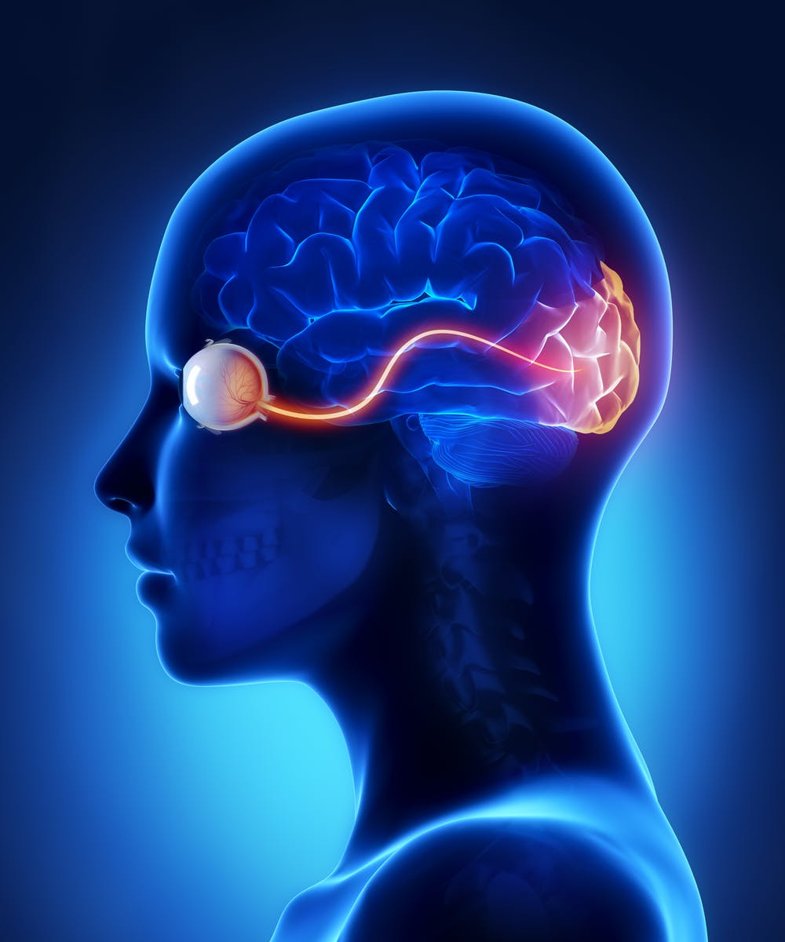
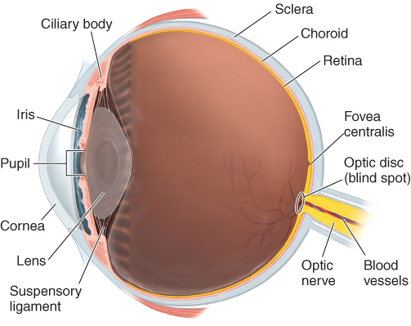
What is vision?
Image source: Dirette & Gutman (2021) pp. 82
Image source: The Discovery Eye Foundation

Slide 6
What is vision?
Visual function
Visual perception
Integrity of the visual system
Eyes
Extra-ocular components
Optic nerve
Optic tracts
Ability to process, interpret, understand, and define visual information

Slide 7
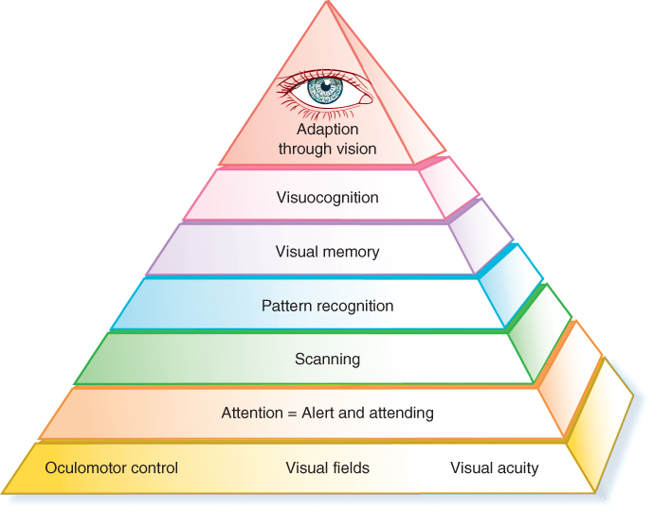
Warren Hierarchical Model of Visual Functioning
Visual perception
Visual function
Image source: Dirette & Gutman (2021) pp. 82

Slide 8
Prevalence and incidence
Stroke
  3.4 million Americans living with stroke
  795,000 new survivors in U.S. per year
  2030 → additional 3.4 million American ≥ 18y (20.5% increase since 2012)
Traumatic brain injury
  1.5 million new injuries per year in the U.S.
CDC (2020); Dirette & Gutman (2021)

Slide 9
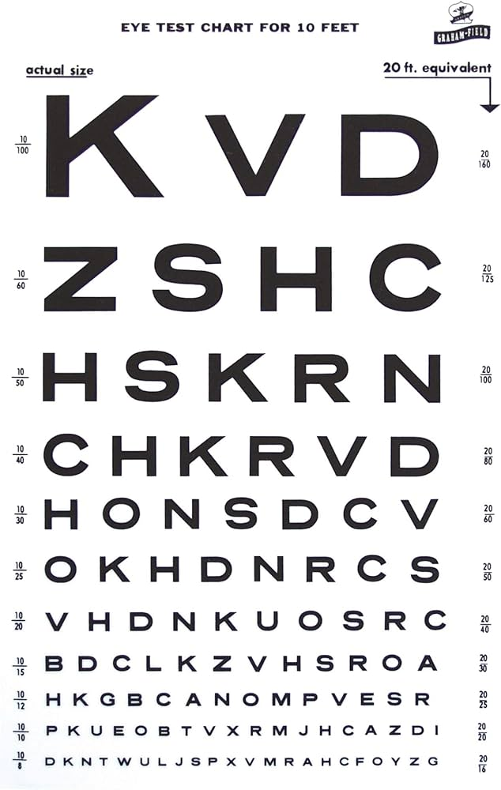
Visual Acuity
Ability to see near and far clearly
  Power of the eye
  Focal point on retina
  Clarity of the visual field
Image source: Google images (Amazon)

Slide 10
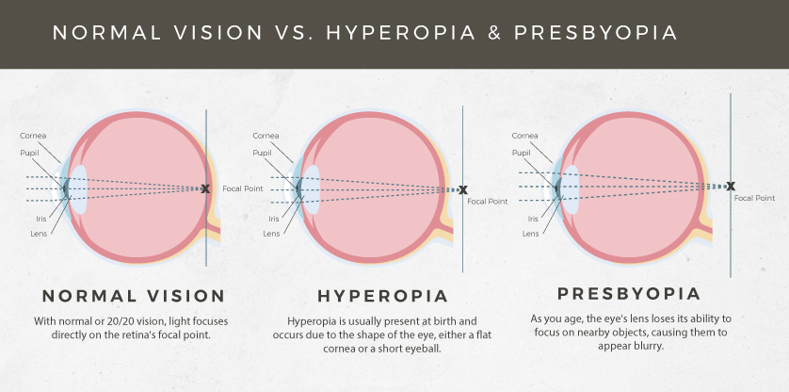
Decreased visual acuity
Image source: Stoney Creek Eye Care

Slide 11
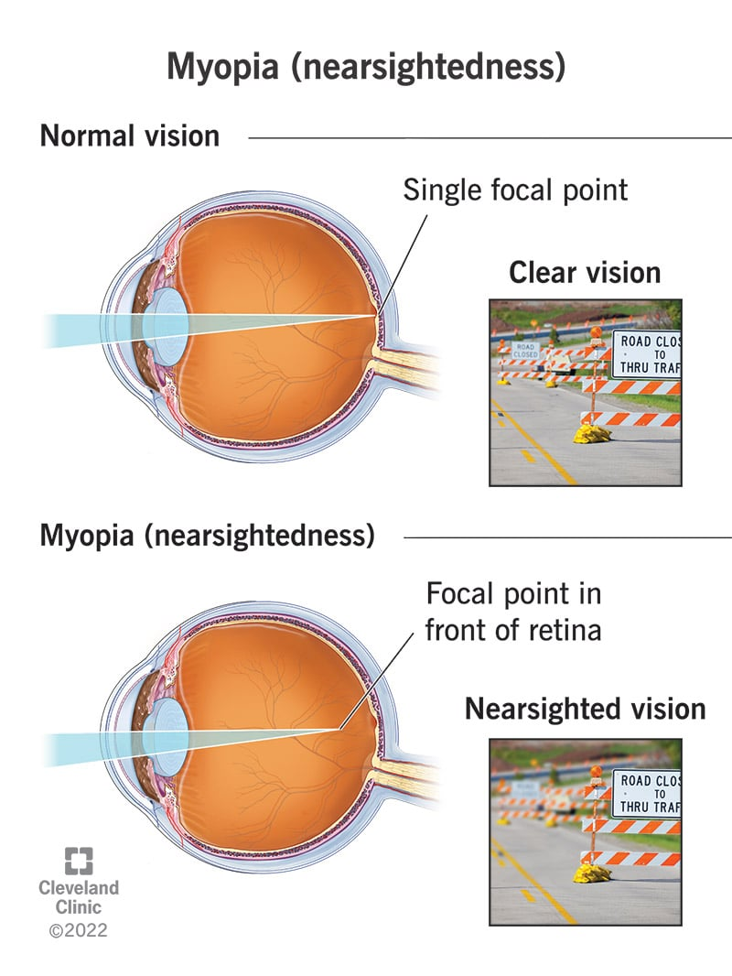
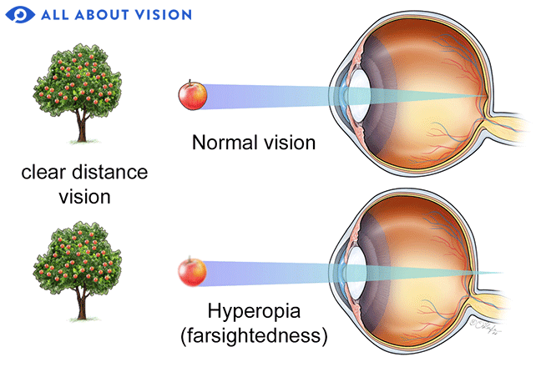
Hyperopia (farsightedness)

Slide 12
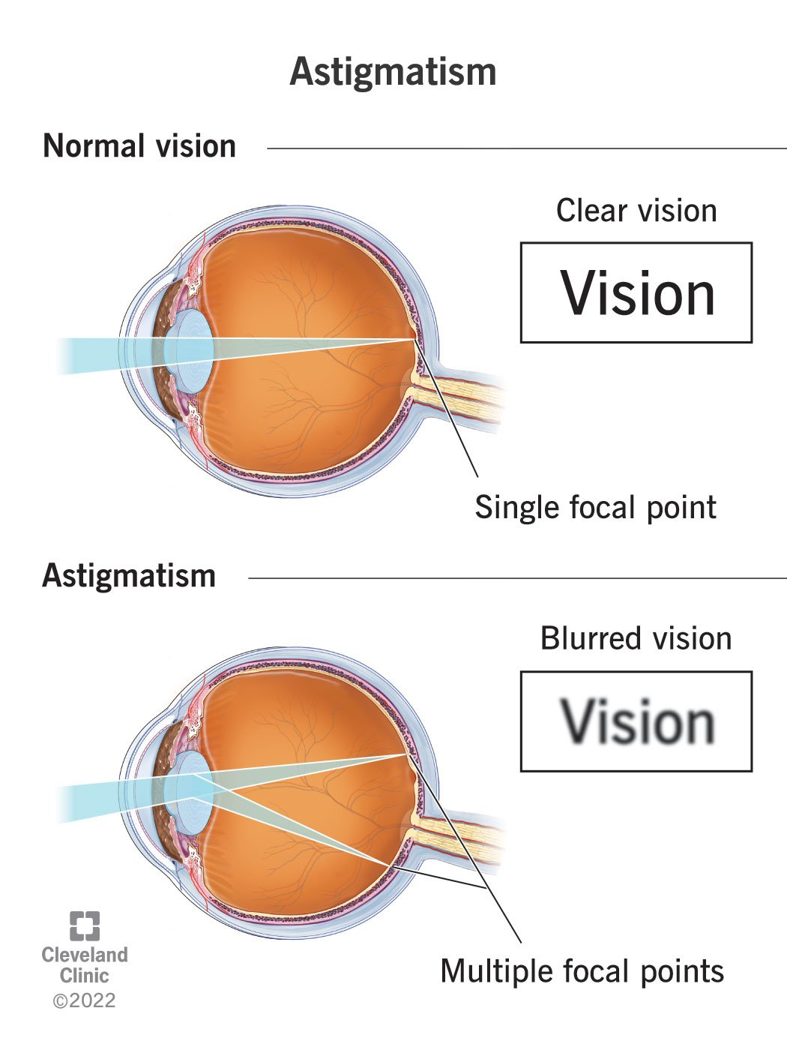
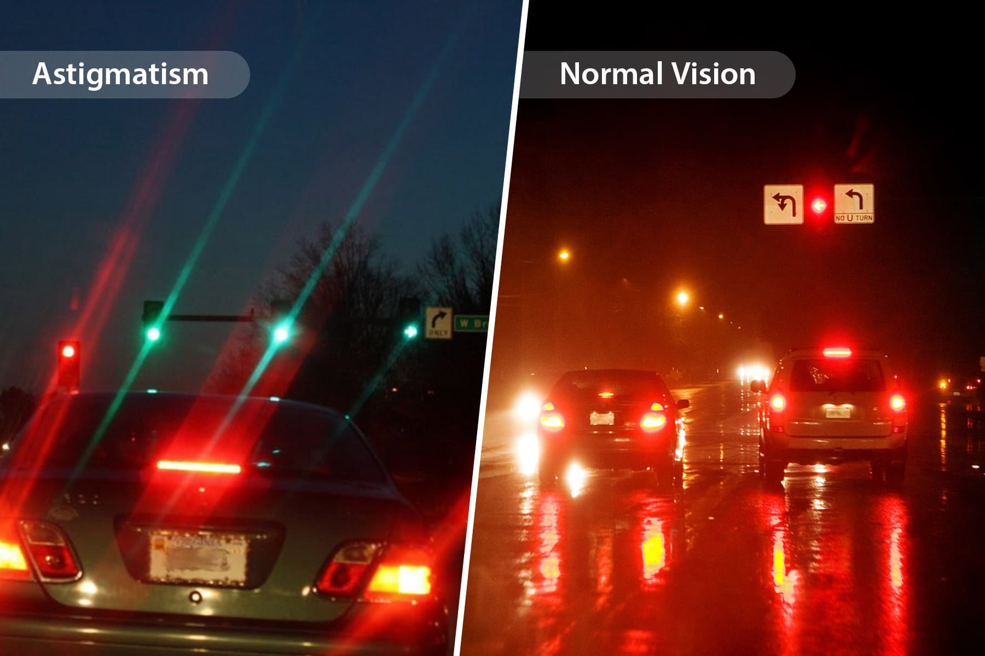

Slide 13
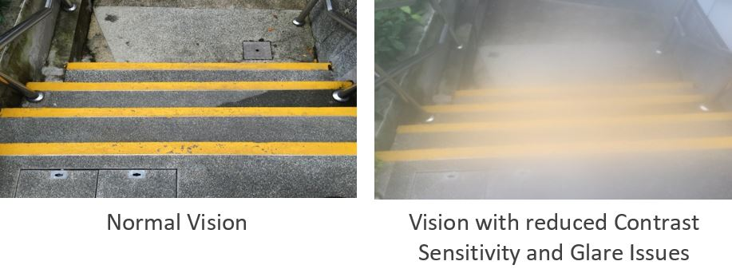
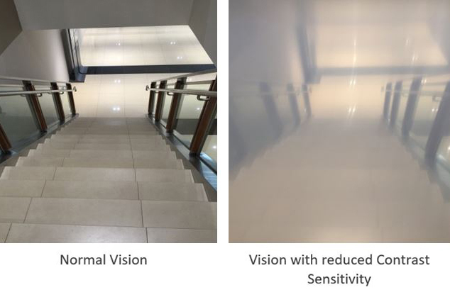
Decreased contrast sensitivity

Slide 14
Oculomotor function: Alignment & ROM
CN3
CN4
Proper alignment promotes single-vision, saccadic eye movements, and visual pursuits
Conjugate gaze
  Ability of eyes to work in unison
  Eyes maintain parallel position to focus on image
Extra-ocular muscle range of motion
CN6
CN3

Slide 15
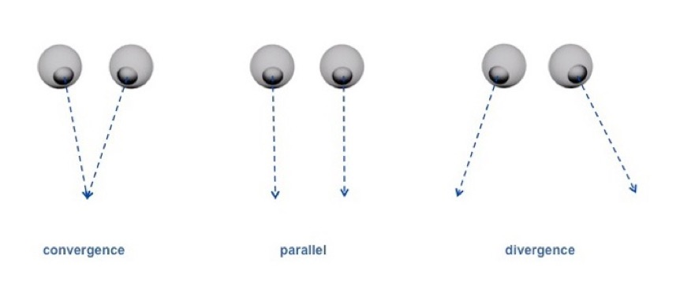
Oculomotor function: Convergence & divergence
Image source: Affonso Beato, ASC, ABC (2011)

Slide 16



Oculomotor misalignment
Phoria: intermittently present (weakness)
Tropia: present at all times (paralysis)
Strabismus
  Dysconjugate gaze
  Eyes positioned or move in different directions to maintain focus/fusion of an image
Misalignments may be subtle
Impacts saccades, pursuits, convergence/divergence
EXO
ESO
HYPER
Image source: Google images

Slide 17
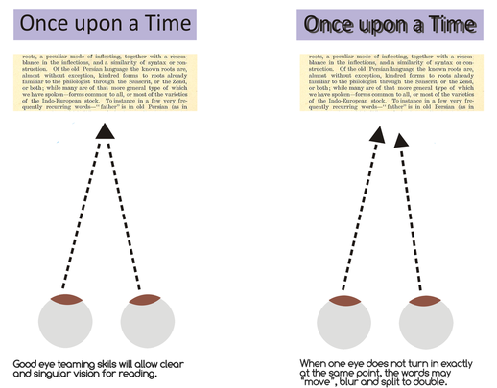
Extra-ocular paresis
Decreased active ROM
Oculomotor misalignments
Oculomotor incoordination
  Decreased accuracy (saccades)
  Decreased smoothness (pursuits)
Convergence insufficiency
Divergence insufficiency
Image source: visionandlearning.com

Slide 18
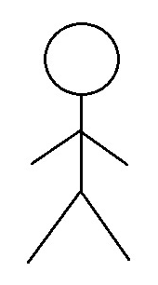
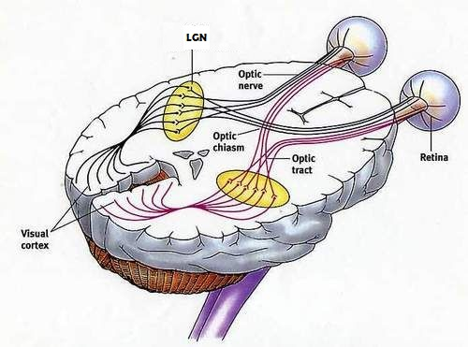
Basic mechanism of single-vision (fusion)

Slide 19


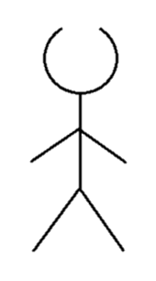
Diplopia (aka double-vision)
Image source: Dubow (2019)

Slide 20
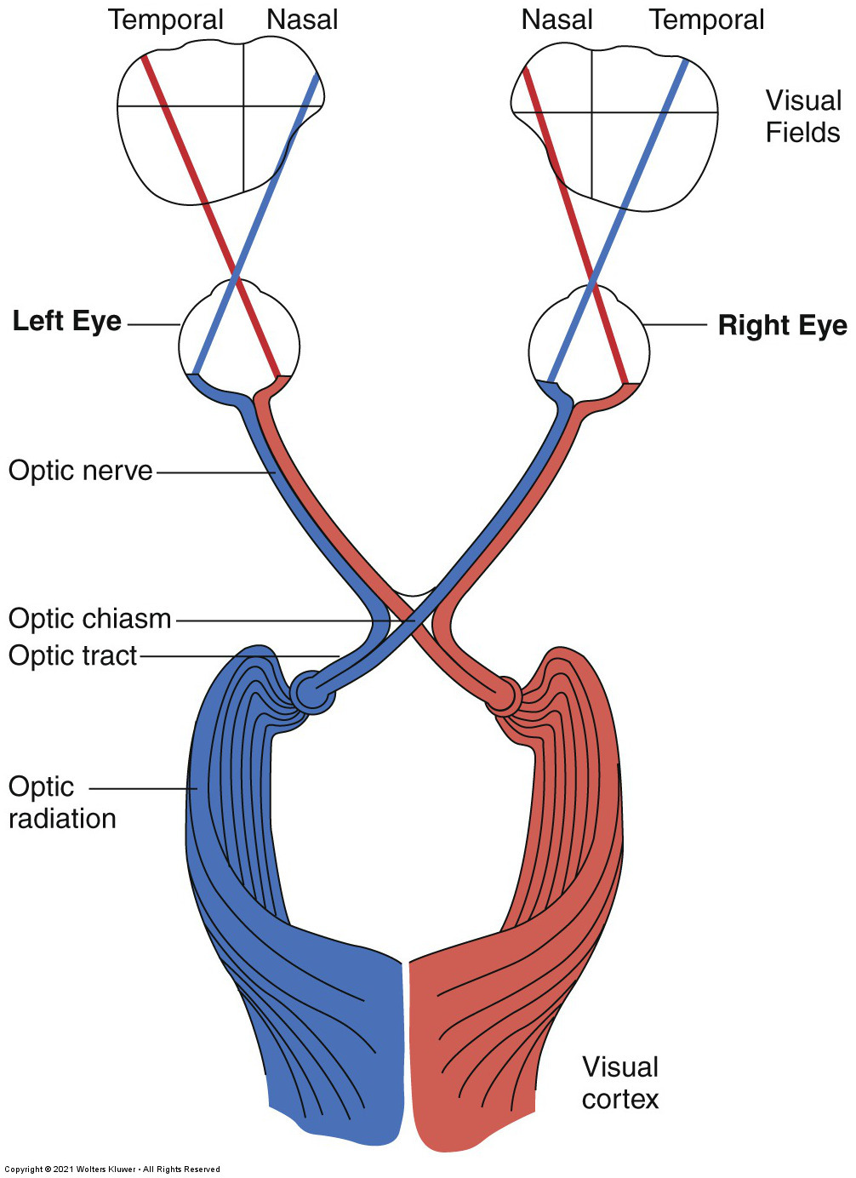
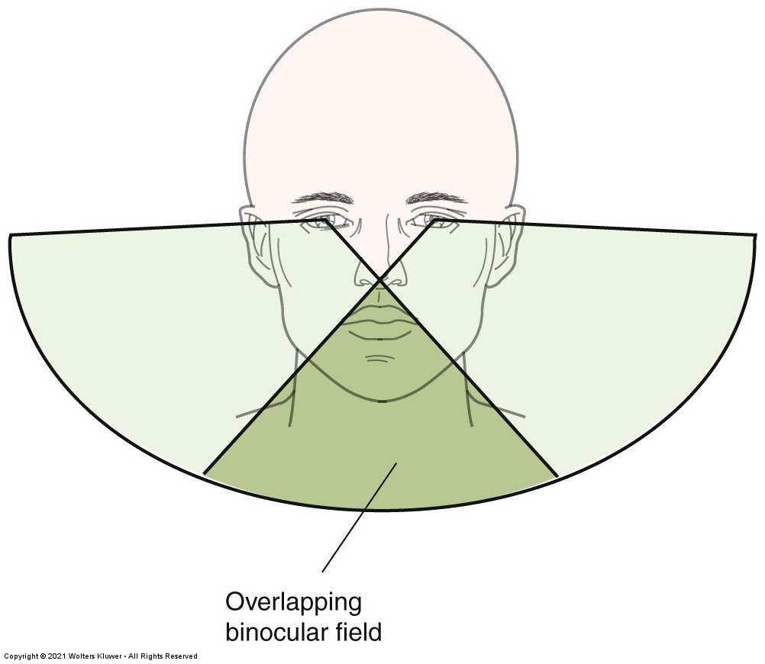
Visual Fields

Slide 21
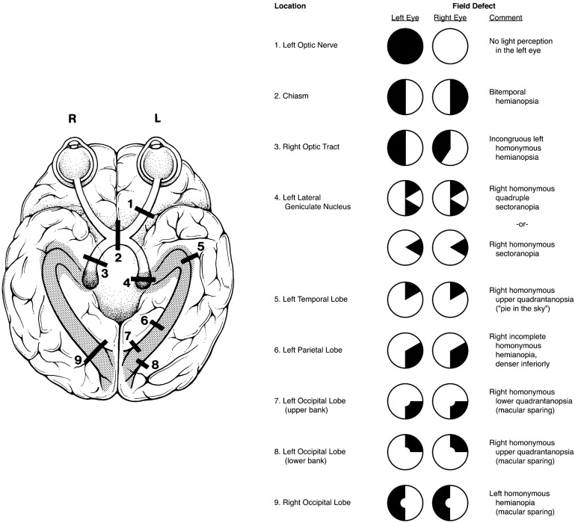
Visual field deficits
Lesion location is important
Image source: https://entokey.com/visual-loss-overview-visual-field-testing-and-topical-diagnosis/

Slide 22

Hemianopia/hemianopsia
Vision loss to half of a visual field (bilaterally)

Slide 23
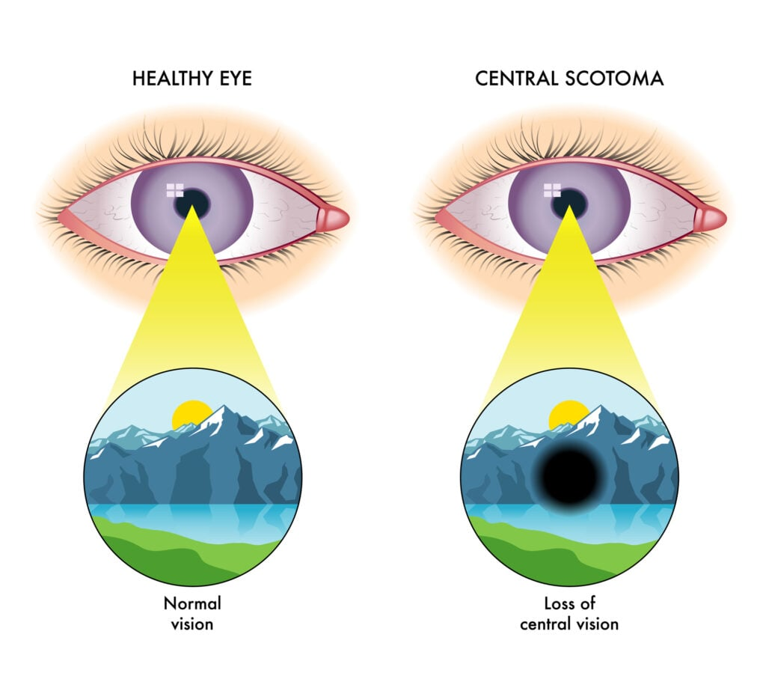
Visual scotomas
Image source: https://www.visioncenter.org/conditions/scotoma/

Slide 24
Visual Attention & Perception
Ability to integrate visual perceptual information with other sensory input to complete executive functioning tasks
Ability to take in visual stimuli, retain its details, and store for later retrieval
Perceptual process of matching incoming visual stimuli with stored visual memories
Organized method for gathering visual information
Visual attention (filter)
Ability to visually orient and respond to our environment
Image source: Dirette & Gutman (2021) pp. 82

Slide 25
Visual Attention & Perception deficits
Visually distractible
Visuospatial inattention
Visuospatial hemi-neglect
Body scheme disorders
Visual discrimination deficits (visual analysis)
  Form consistency
  Pattern recognition
  Figure-ground
Visual agnosia
Decreased depth perception
Decreased visual memory
Visual closure deficits
Visual organization
Visuocognition deficits
  Difficulty with integration of VP information with other sensory input to complete EF tasks (organization, sequencing, problem solving, etc.)

Slide 26
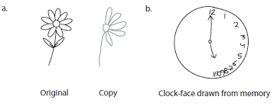
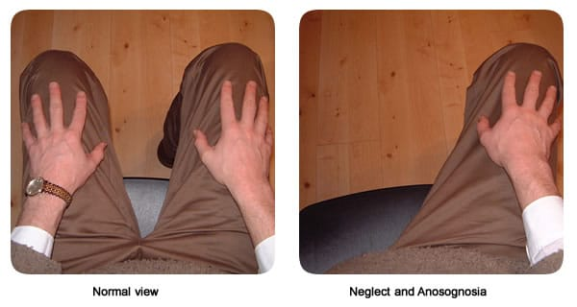
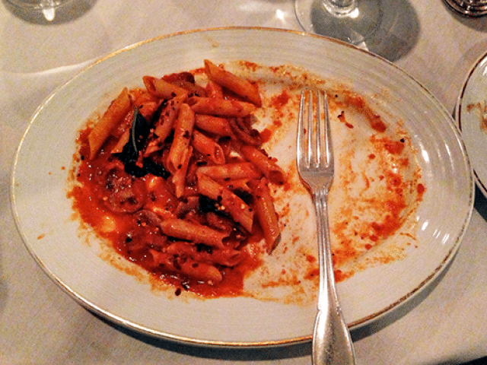
Visuospatial inattention or neglect
Phenomenon resulting in significant difficulty to orient and respond to a side of environmental information

Slide 27
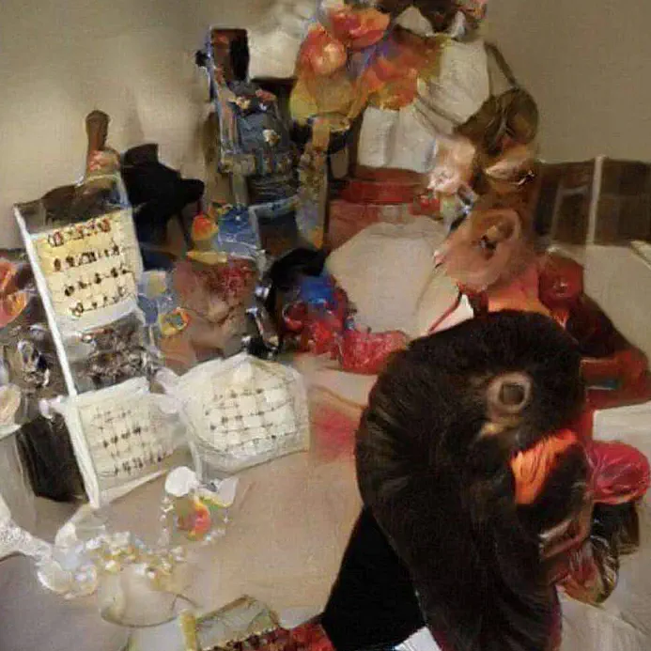
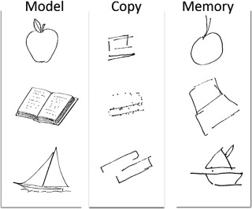
Visual Agnosia

Slide 28
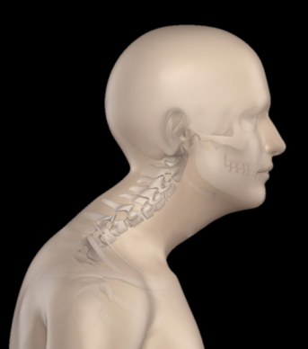
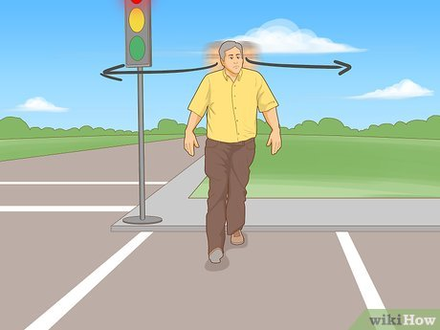
Vision & Posture
Image source: Google image from Youtube video (We laugh, 2020)
Image source: Kniffin (2020)

Slide 29
Occupational Therapy & Vision
OT Scope of Practice
  The practice of occupational therapy includes interventions and procedures to promote or enhance safety and performance in ADLs, IADLs, health management, rest and sleep, education, work, play, and social participation, including remediation and compensation for visual deficits, including low vision rehabilitation (AOTA, 2021, p.4).
Functional vision and how it impacts occupational performance and participation

Slide 30
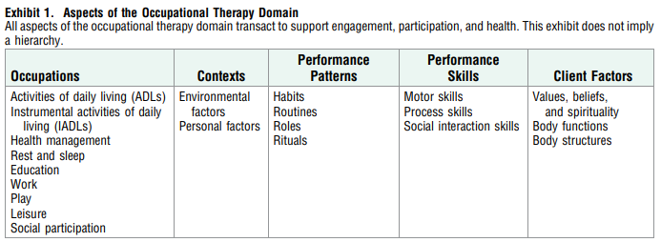
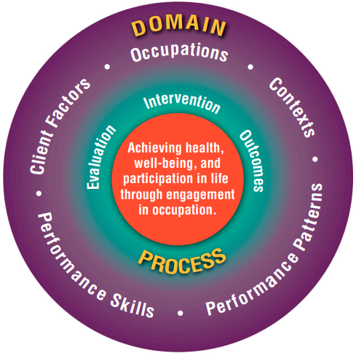
Occupational Therapy & Vision
Sensory functions
Visual functions
Quality of vision
Promote visual awareness of environment at various distances for functioning
AOTA (2020) OTPF-4

Slide 31
Evaluation and interventions to address functional vision

Slide 32
Functional vision screen
Visual history
  Corrective lenses
  PMH
Clinical observation
  Functional tasks
  Assessments
Visual acuity (screen)
Oculomotor skills
Visual fields

Slide 33
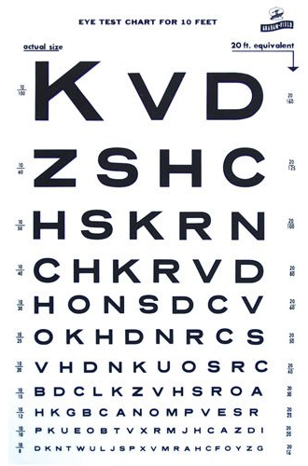
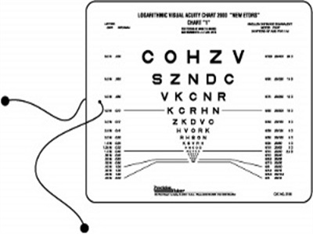
Screening visual acuity

Slide 34
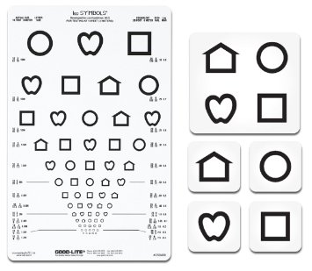
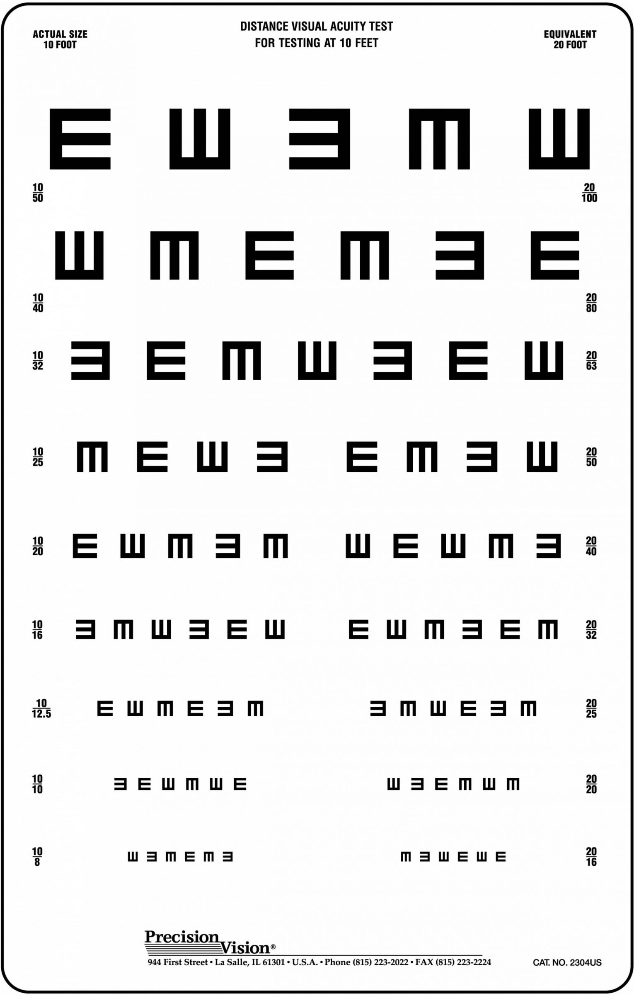
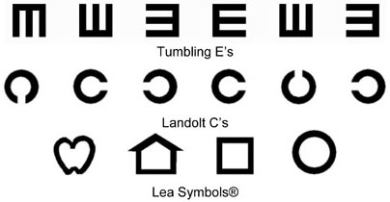

Slide 35
Visual Acuity: Treatment options
Referrals to optometrist or ophthalmologist
Occupational therapists (and other HCPs) take on a supportive role
  Promote adaptive or compensatory strategies for safety and independence
    Encourage wearing corrective lenses
    Larger print
    Contrast enhancement
    Use of other sensory functions (e.g., tactile, auditory)

Slide 36
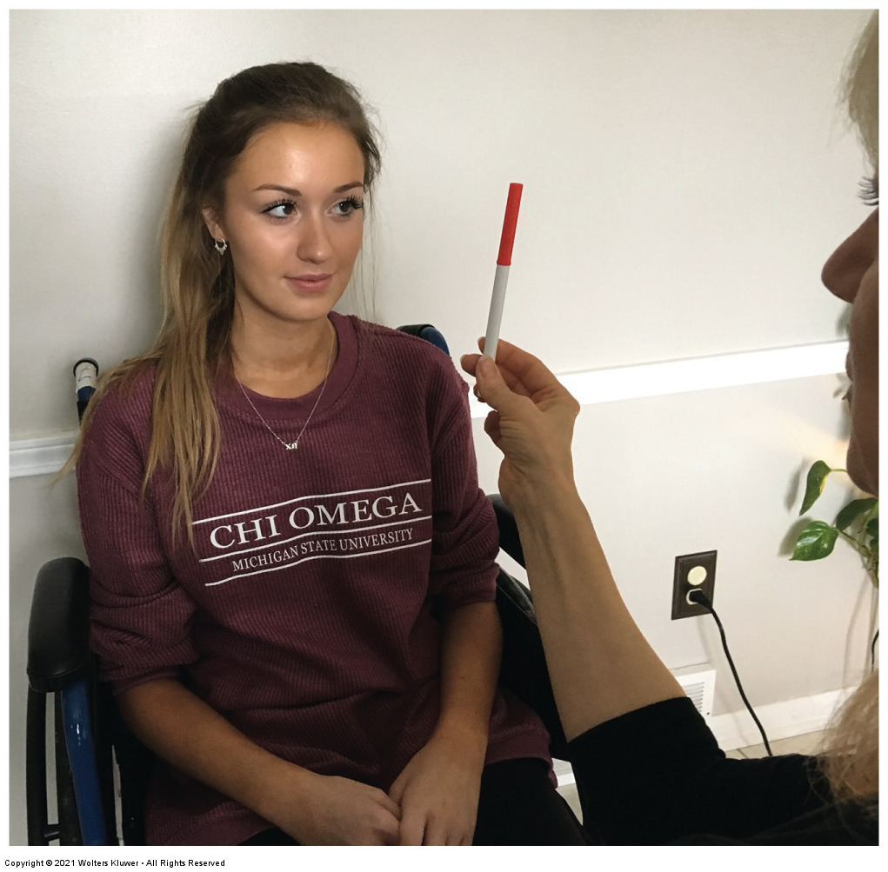
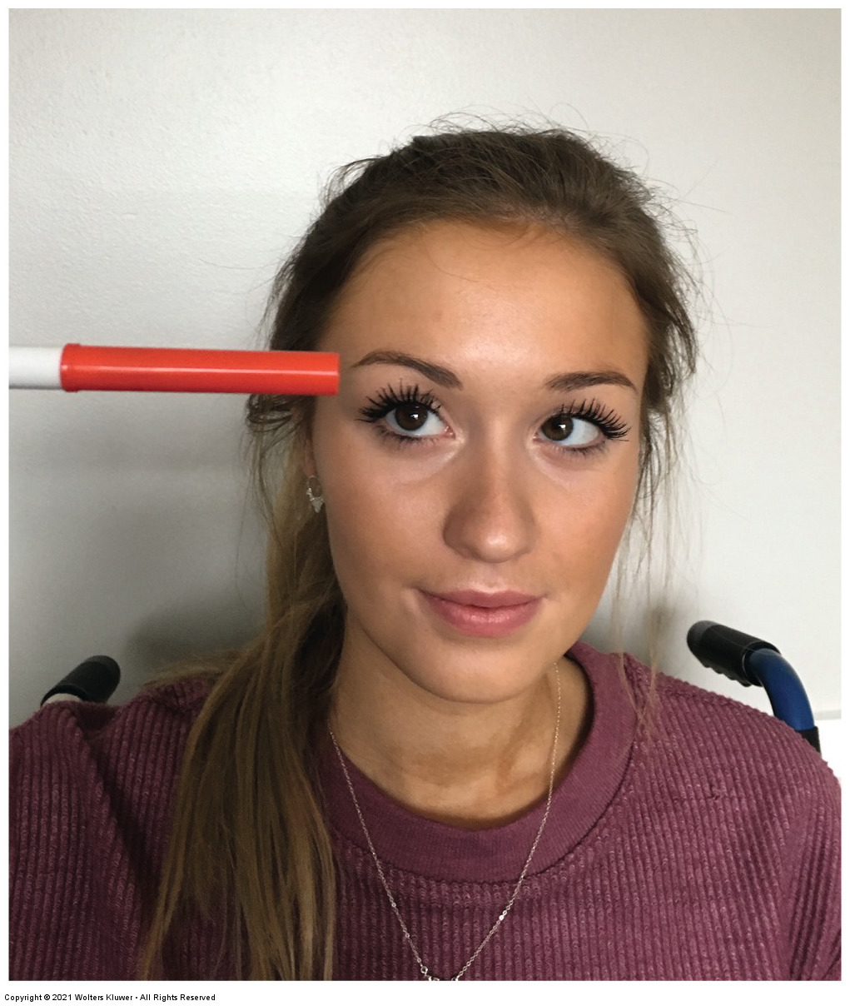
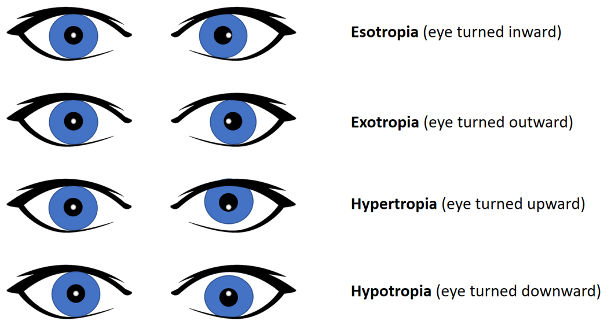
Assessing oculomotor skills
Alignment: Hirschberg Test
Oculomotor range of motion
Tracking (pursuits)
Fixation
Image source: R.A.I.N. Health Care Center

Slide 37
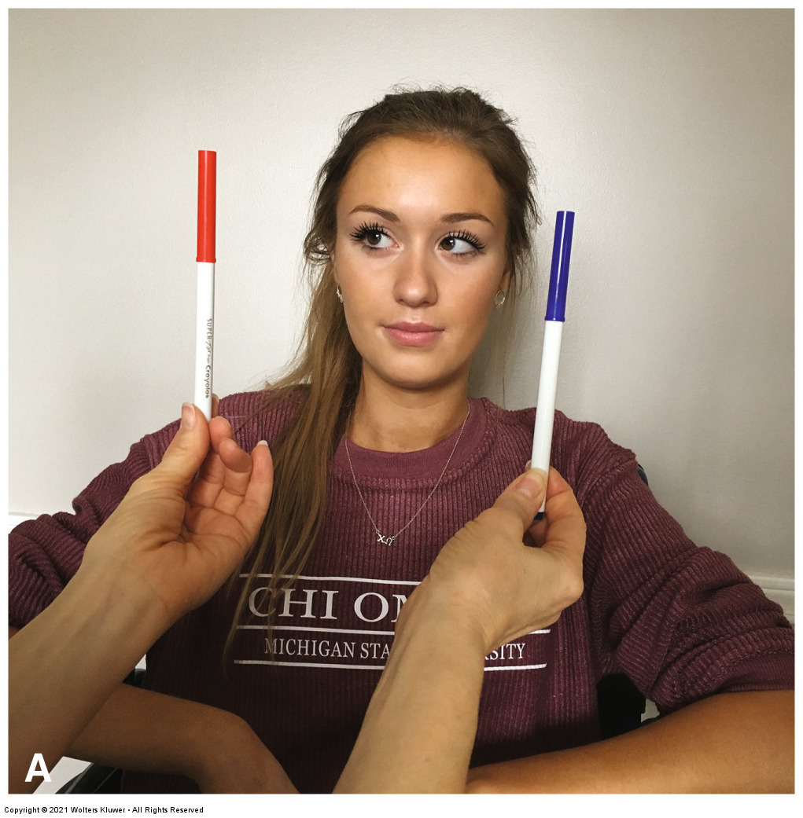
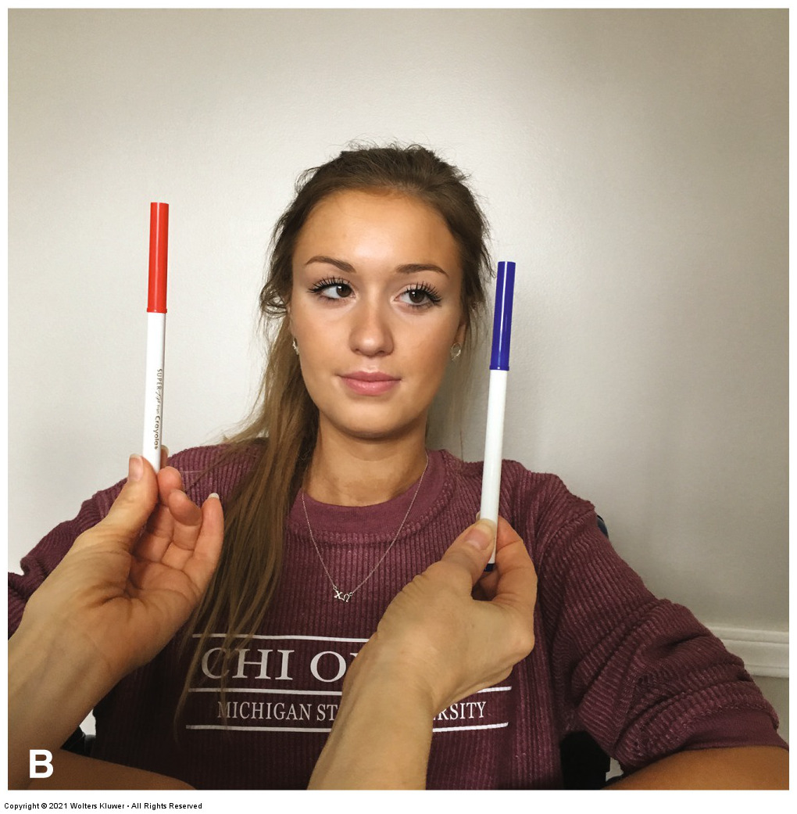
Assessing oculomotor skills: Saccades

Slide 38
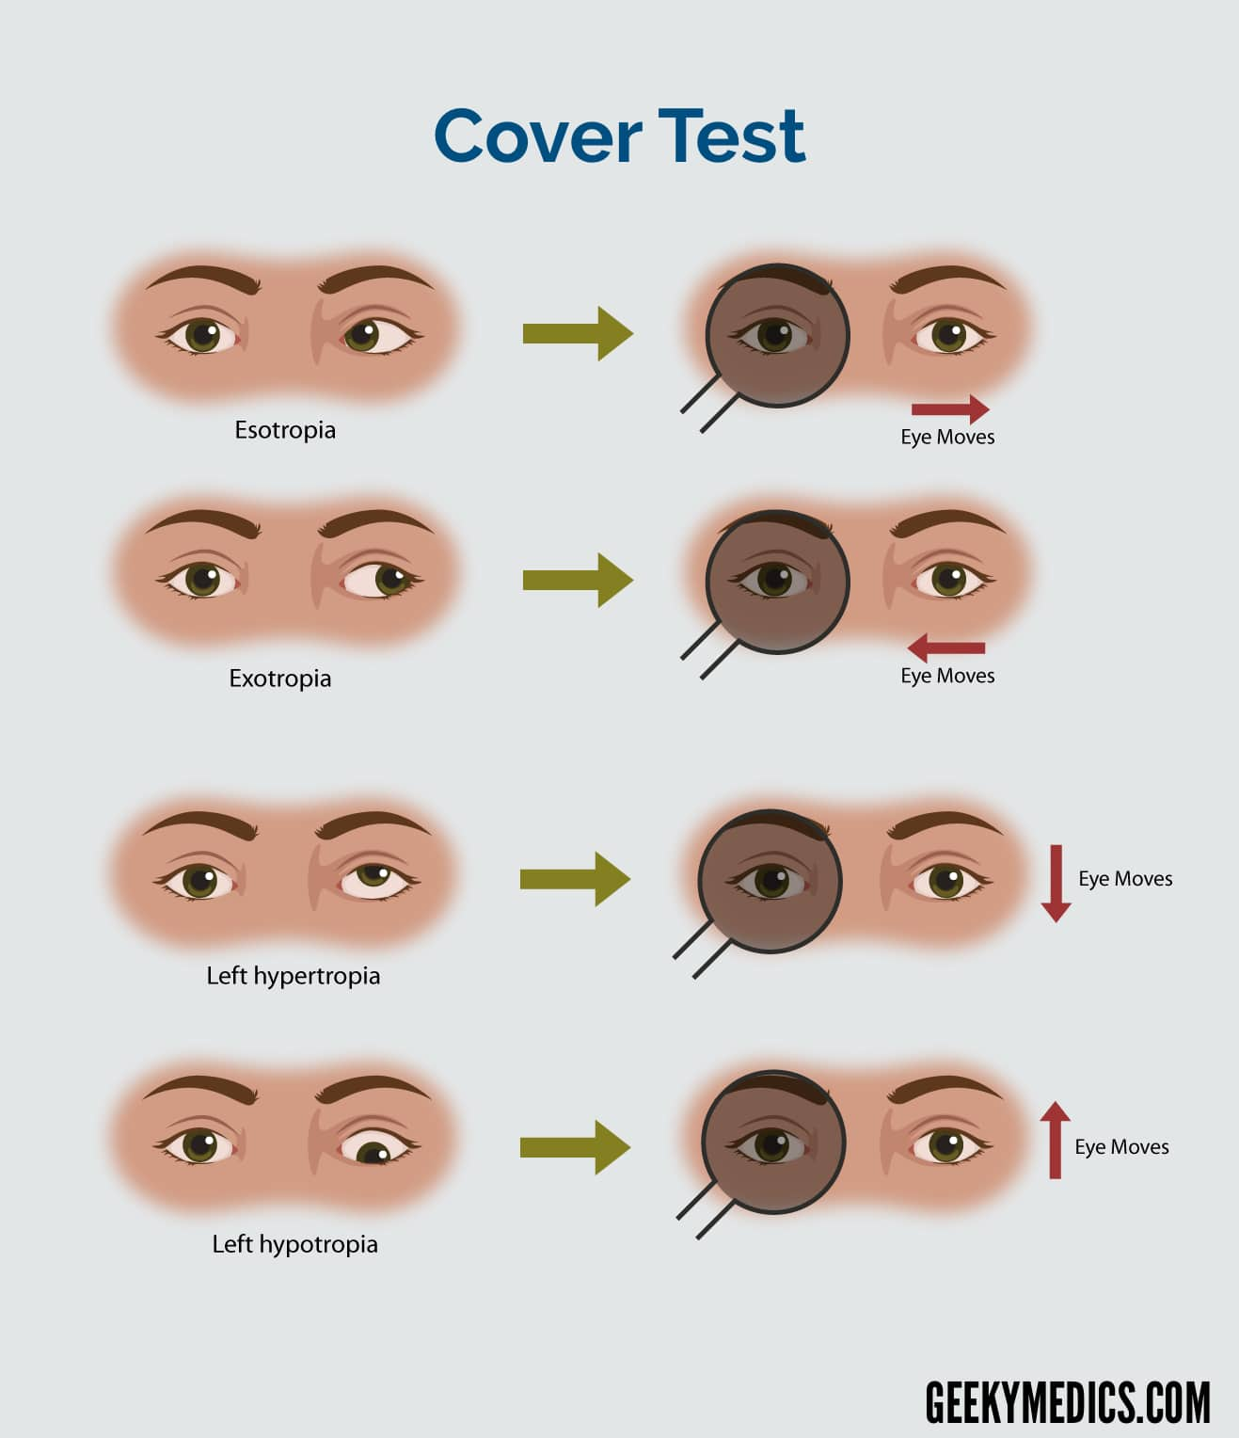
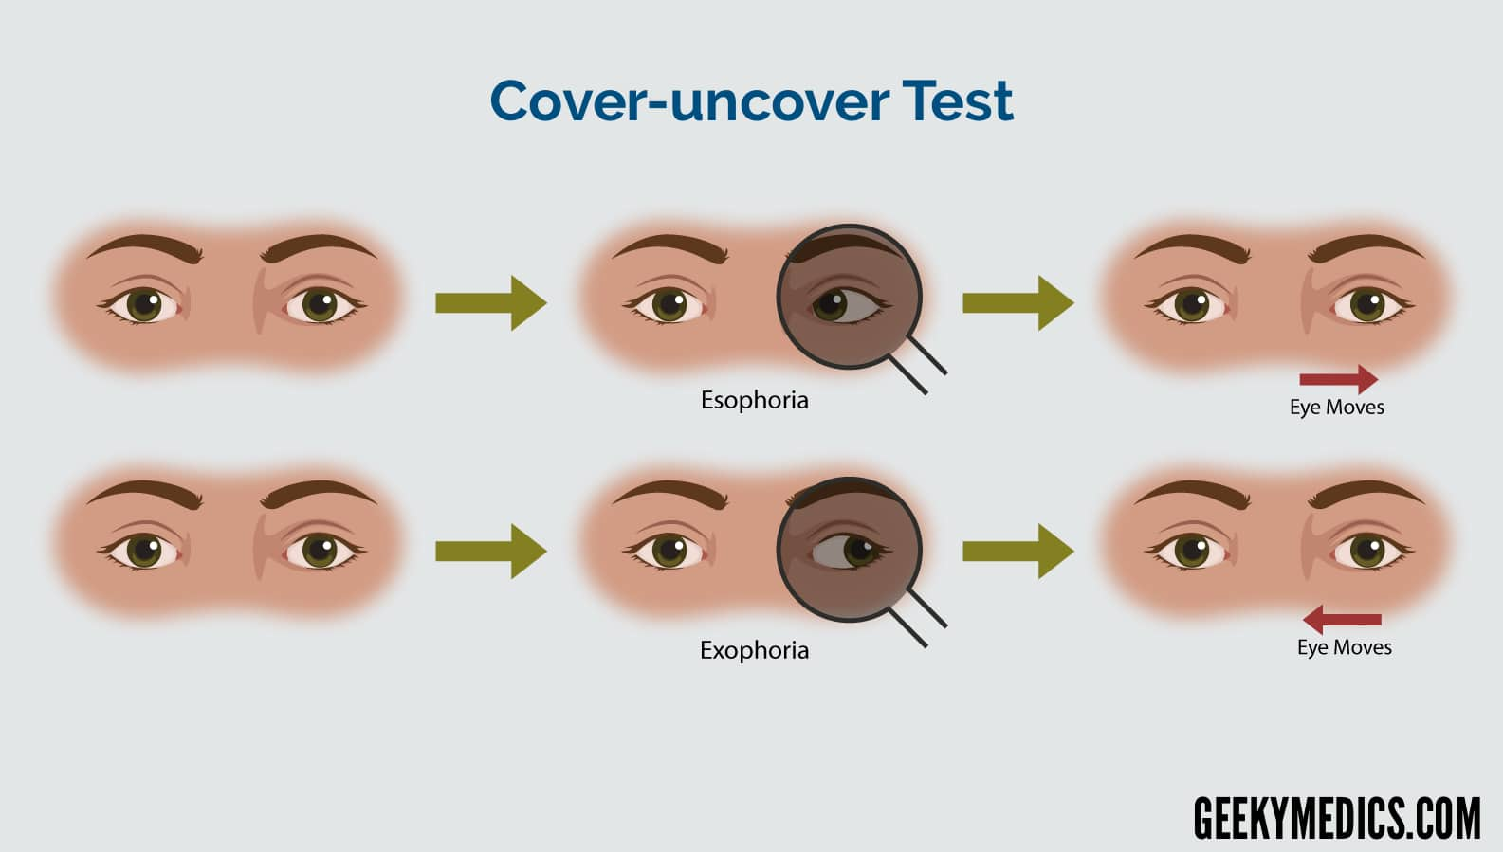
Assessing oculomotor skills: Cover Tests

Slide 39
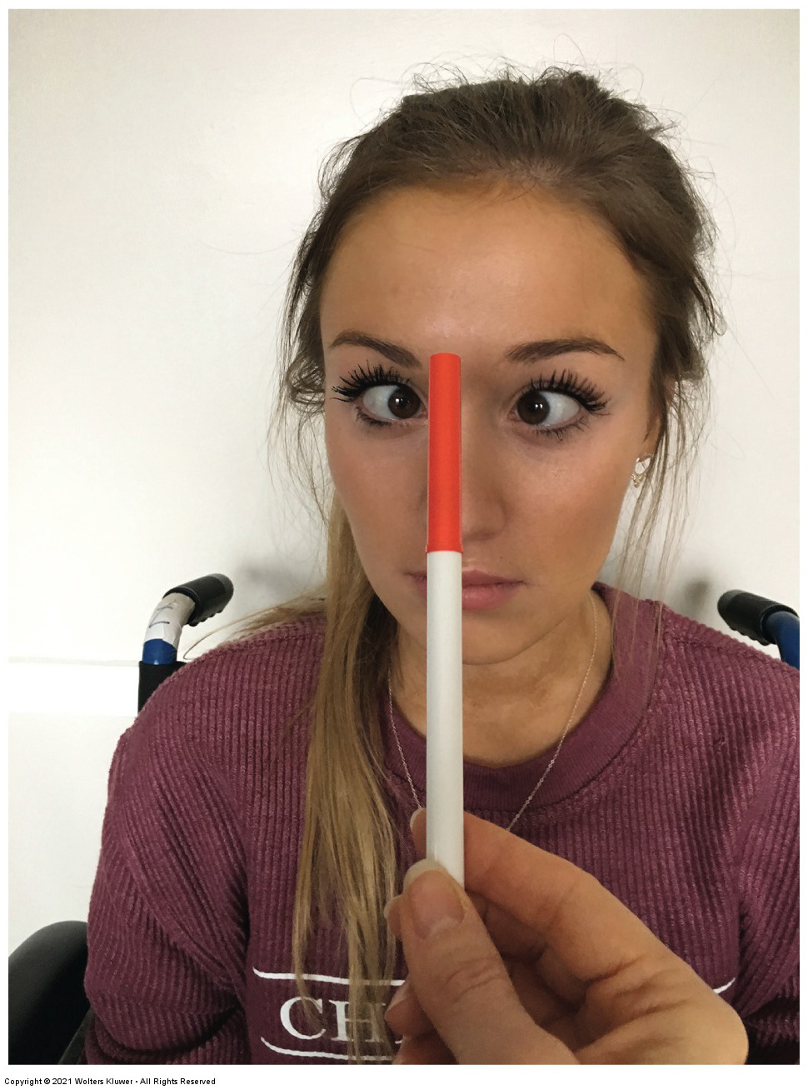
Assessing oculomotor skills: Convergence
Begin with target ~ 16” away
Client focuses on target while therapist slowly moves target toward client
Client verbalizes if/when target becomes blurry or double
  ~4-6” is WNL
Observe client’s eyes’ ability to converge
Opposite steps for divergence

Slide 40
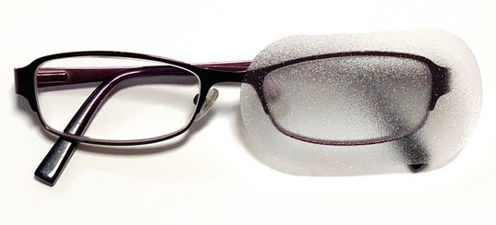
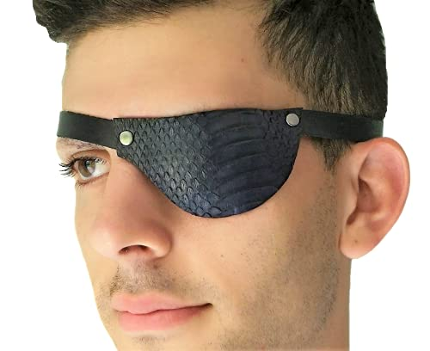
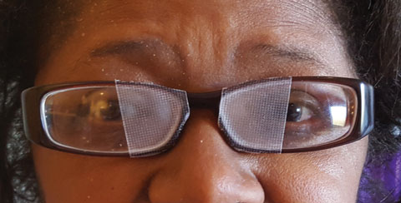
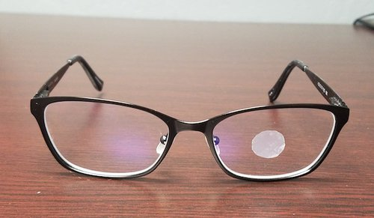
Oculomotor dysfunction: Interventions
Occlusion devices

Slide 41
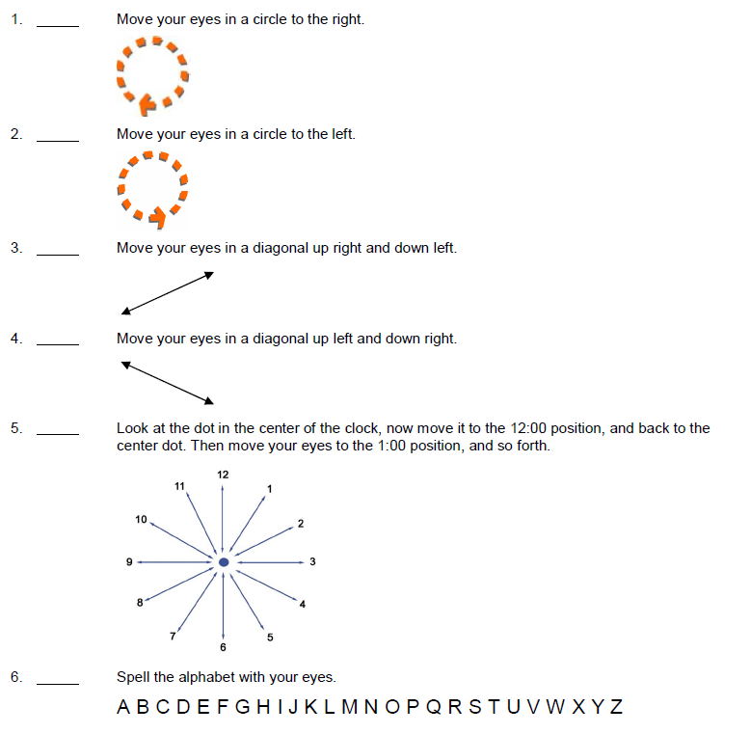
Oculomotor dysfunction: Interventions
Functional vision exercises
Range of motion
Tracking
Fixation
Gaze stabilization
Image source: Scanned image of Vision HEP handout from Acquired Brain Injury Unit at Shepherd Center Rehabilitation Hospital, Atlanta, GA

Slide 42
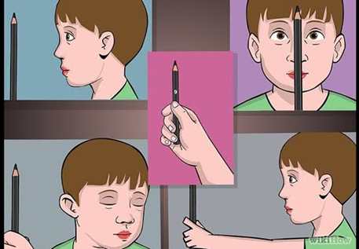
Oculomotor dysfunction: Interventions
Fusion exercises: Pencil pushups
Image source: https://optography.org/heterophoria/

Slide 43
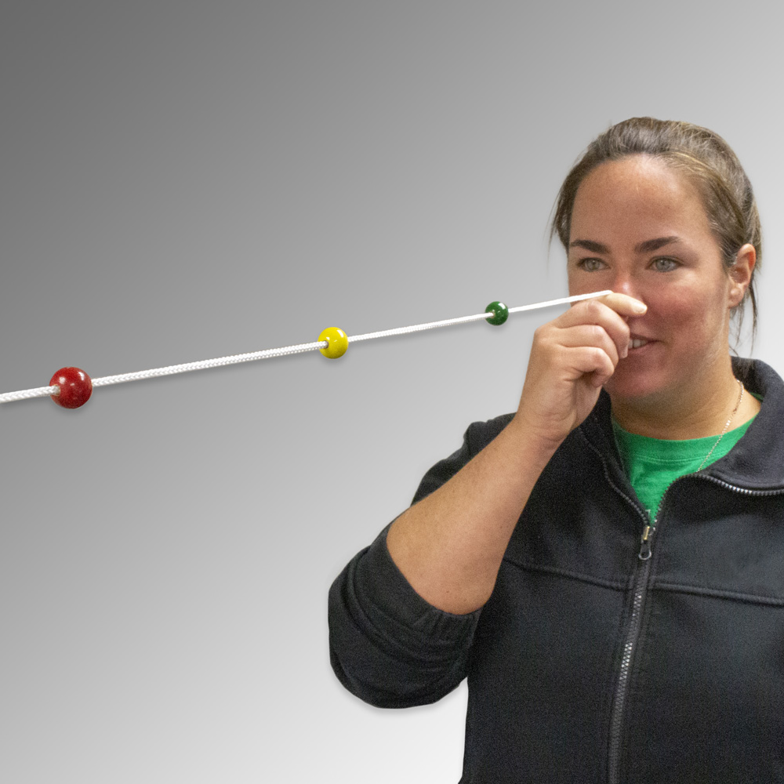
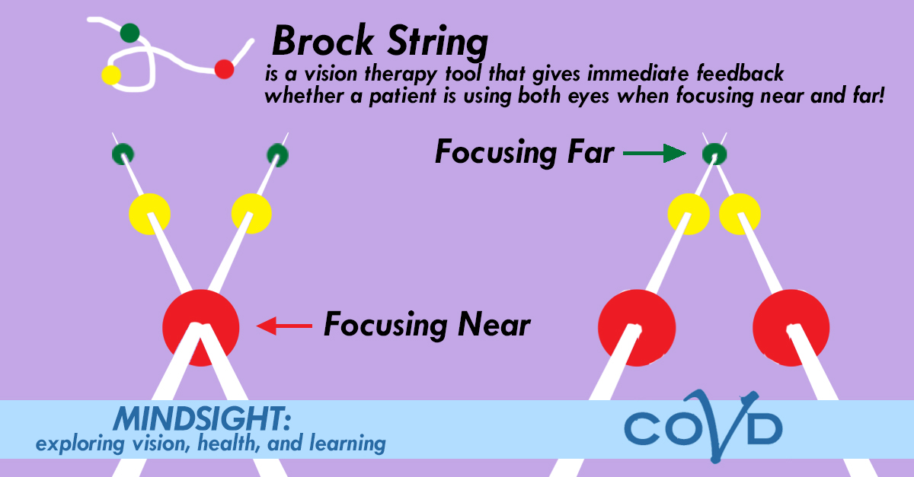
Oculomotor dysfunction: Interventions
Fusion exercises: Brock String
Image source: https://www.bernell.com/product/BC109/Brock-String-Devices

Slide 44

Assessing visual fields
Confrontation Tests
  One-person test
  Two-person test*
Clinical observation during scanning activities
  Table-top
  Functional tasks
  Mobility

Slide 45


Visual field deficits: Treatment options
Education and training
  Improve awareness
  Compensatory strategies for environmental scanning
Scanning activities
Static & dynamic contexts
Field expansion devices
  Fresnel prisms

Slide 46


Fresnel Prisms
Adheres to glasses
Prescribed by optometrists
Purposes
  Shifts image from impaired VF into intact area
  Can also relieve diplopia
  Trial for future permanent grounding in glasses
Good awareness of VF deficit is important
Image source: https://www.reviewofoptometry.com/article/fresnel-prism-to-the-rescue
Image source: https://www.2020mag.com/ce/understanding-prism-designs-for-homonymous

Slide 47

Assessing visual perception: Visual attention
Attention to task
Observe scanning
Line bisection test
Cancellation tests
Design copy
Clock drawing
Image source: Gava (2008) Figure 6. pp. 13

Slide 48
Visual Perception Assessment
Visual attention
  Scanning/cancellation tests
Design copy (discrimination, visuomotor, scanning)
Address and phone number copy (scanning, visuomotor)
Higher-level assessments evaluate skills such as visual memory, visual closure, pattern recognition, visuomotor integration, & visuocognition

Slide 49


Line Bisection Test

Slide 50



Cancellation Tests

Slide 51


Clock drawing

Slide 52

Design Copy
Image source: https://scholarblogs.emory.edu/artsbrain/2020/12/02/secrets-of-the-eye/

Slide 53

Cancellation Tests

Slide 54

Catherine Bergego Scale
Standardized
10 items
Checklist completed by therapist from observations
Corresponding client-report version can assess for lack of self-awareness of deficits
  Anosognosia

Slide 55


Trail Making Test (A & B)

Slide 56

Motor-Free Visual Perceptual Test
High-level standardized assessment
Evaluates overall visual perception without motor involvement
Spatial relations, visual discrimination, figure-ground, visual closure, and visual memory
Image source: performancehealth.com

Slide 57
General principles visual perception intervention
Address foundational sensory deficits
Provide consistent education to increase awareness of deficits
Incorporate consistent training regardless of intervention approach
Remediation approach
Compensation/Adaptation approach
(Warren, 1993)

Slide 58

Visual perception intervention: Visual attention
Address cognitive abilities (sustained attention)
Decrease distracting input
Use of a line guide

Slide 59
Visual perception intervention:
Visuospatial inattention/neglect
Typically addressing visual attention concurrently
Work on improving awareness of deficit
Scanning strategy training
  Static & dynamic
  Various contexts
  Varying levels of distractions
Field expansion devices
Environmental adaptations

Slide 60

Scanning strategies
Remediation
  Functional scanning activities
  Technology
  Tabletop activities
Compensatory strategies
  Lighthouse scanning technique
  Use of a line guide
  Auditory cues
  Visual anchors

Slide 61


Slide 62




Field expansion device: Yoked Prisms
Neuroplasticity principles
Shifts image from impaired processing side into intact area
Optometrist fits patient
  Diopter, Base, Degrees
Can be used as training (remediation) or trial for potential permanent grounding in glasses (compensation)
Education and training

Slide 63


Slide 64
Additional treatment considerations for functional vision deficits

Slide 65




Environmental Adaptations for Low Vision
Lighting
Contrast enhancement
Glare management
Magnification
Application of tactile environmental cues
Consistent environmental setup

Slide 66


Slide 67

What could be better?
What is good?

Slide 68

What low vision modifications do you see?

Slide 69




Technologies

Slide 70
General principles to address visual impairments
Tasks may need to start bottom-up and then gradually become more complex and functional
Appropriate gradation with skill acquisition
Emphasis on repeated practice, mastery of skills, and reacquisition of confidence
Incorporate interventions across various contexts
Remediation + compensatory approaches

Slide 71
Case Study: Dave (inpatient admission)
67 y/o M
14 days s/p R CVA
L hemiparesis
Continuous diplopia
L hemispatial neglect
Postural abnormalities
MAX A-DEP for all ADLs and functional mobility

Slide 72
So, what?
70% of all sensory processing is directly affected by information coming from the eye
Vision impacts other person factors and environmental interactions
Vision changes are prevalent among individuals after cortical neurological injury
Low vision is the third most common cause of impaired function among older adults
  Increases risk of depression, social isolation, falls, and general health decline
Visual and visual perceptual deficits can significantly impact all aspects of safety, independence, and quality of life

Slide 73
Thank you!
Kelly L. Taylor, OTD, MS, OTR/L, CBIS
Murray State University, Occupational Therapy Program
Paducah Regional Campus, Suite 205A
ktaylor60@murraystate.edu

Slide 74
References
American Occupational Therapy Association. (2020). Occupational therapy practice framework: Domain and proces (4th ed.). American Journal of Occupational Therapy, 74(Suppl 2). https://doi.org/10.5014/ajot.2020.74S2001
American Occupational Therapy Association. (2021). Position Statement: Occupational Therapy Scope of Practice. American Journal of Occupational Therapy, 75(Suppl 3). https://doi.org/10.5014/ajot.2021.75S3005
Bowen M, Edgar DF, Hancock B, et al. (2016). The Prevalence of Visual Impairment in People with Dementia (the PrOVIDe study): A cross-sectional study of people aged 60–89 years with dementia and qualitative exploration of individual, carer and professional perspectives. NIHR Journal Library, Southampton, UK.
Centers for Disease Control and Prevention. (2022). Stroke Facts. https://www.cdc.gov/stroke/facts.htm
Dirette, D. & Gutman, S. (2021). Occupational therapy for physical dysfunction (8th ed.). Wolters Kluwer
Dubow, B. (2019. June 27). Double vision: Diplopia causes and treatments. All About Vision. https://www.allaboutvision.com/en-gb/conditions/double-vision/
Gallop, S. (1998). A variation on the use of binasal occlusion. Journal of Behavioral Optometry, 9(2), 1-6.
Gava, L. (2008). The foundations of numerical knowledge in the first months of life. [Unpublished thesis]. Padua Research Archive. https://www.research.unipd.it/handle/11577/3425953
Georges, A., & Das, J.M. (Updated 2022, January 5). Traumatic brain injury. In: StatPearls [Internet]. StatPearls Publishing. Available from: https://www.ncbi.nlm.nih.gov/books/NBK459300/

Slide 75
References
Kapoor, N. & Ciruffreda, KJ. (2002). Vision disturbances following traumatic brain injury. Neurologic Ophthalmology and Otology, 4: 271-280
Kniffin, D. (2020, April 11). Do you have forward head posture? Spineology Chiropractic. https://spineologychiropractic.com/do-you-have-forward-head-posture/
Liu, G.T., Volpe, N.J., & Galetta, S.L. (2019). Visual loss: Overview, visual field testing, and topical diagnosis. In G.T. Liu, N.J Volpe, & S.L. Galettas (Eds.), Neuro-Ophthalmology: Diagnosis and management. (3rd ed., pp. 39-52). Elsevier. https://doi.org/10.1016/C2013-0-12830-9
Ophthalmology Review. (2015, December 12). Visual Fields: Introduction. https://www.ophthalmologyreview.org/articles/visual-fields-introduction
Rowe, F., Brand, D., Jackson, CA., Price, A., et al. (2009). Visual impairment following stroke: Do stroke patients require vision assessment? Age Ageing, 38: 188-193.
Stabismus Solutions. (n.d.). Yoked prisms - How they help plus 20 exercises to try at home. https://strabismussolutions.com/yoked-prisms-and-strabismus-how-they-help-plus-20-exercises/
Taub, M.B., & Harris, P. (2017). Low-tech TBI rehabilitation. Review of Optometry. https://www.reviewofoptometry.com/article/lowtech-tbi-rehabilitation
We laugh. (2020, April 29). Funniest baby and cat are best friends - Cute babies and cats videos [Video]. https://www.youtube.com/watch?v=G8jM2Lo4Kuw

