Slide 1
A Who, What, When, Where, and Why of Contextualized Therapy Practices Post Traumatic Brain Injury
Leigha B. Ochsner M.A. CCC-SLP

Slide 2
Disclosures
Presenter Disclosures: No Financial or Non-Financial Disclosures.
Content Disclosure: This learning event does not focus exclusively on any specific product or service.
Sponsor Disclosure: This course has no external sponsors.

Slide 3
Learning Outcomes After this course, participants will be able to:
Explain the role of a Speech-Language Pathologist in the assessment and treatment of Traumatic Brain Injury (TBI)
Define and identify contextualized manners of speech-language pathology practices for TBI patients
Recognize opportunities to implement contextual-based therapy practices within traditional treatment environments across settings
Identify benefits and importance of contextualized therapy practices for TBI patients throughout the recovery process

Slide 4
WHO?
WHO AM I?
WHO ARE YOU?
WHO DO WE SERVE?

Slide 5
Who Am I?
ASHA Certified/KY Licensed Speech-Language Pathologist
M.A. from the University of Cincinnati 2017
Skilled Nursing Facilities (Adult in-patient rehab/Long Term Care)
Private Pediatric Clinic (0-17 YO)
American Brain Injury Waiver (TBI/ABI)
Server/Bartender/Manager

Slide 6
Who are YOU?
Clinicians
Physicians
Scientists
Nursing
Case Management/Social Work
Educators
Students
Advocates

Slide 7
Who do WE serve?
TRAUMATIC BRAIN INJURY
External trauma
ACQUIRED BRAIN INJURY
Internal trauma
Physical force to the head (e.g. fall)
Mechanism of displacement of brain within the skull (e.g. blast)
1 or more of DSM-5 criteria characteristics
Focal vs Diffuse
Open or closed
Stroke
Hypoxia
Anoxia
Disease
Tumor
Etc.
Notes:
ABI: mild to serious injury to the brain that is not congenital, hereditary, or degenerative and that causes temporary or permanent symptoms including impairments in cognition (such as memory loss or poor concentration), emotional and behavioral changes (such as irritability, impulsivity, agitation, and depression), headaches, dizziness, fatigue, seizures, blurred vision, loss of taste or smell, impaired coordination, and numbness or paralysis of an extremity
TBI:
Traumatic brain injury (TBI) is a form of nondegenerative acquired brain injury, resulting from an external physical force to the head (e.g., fall) or other mechanisms of displacement of the brain within the skull (e.g., blast injuries). Consistent with the diagnostic criteria detailed in the Diagnostic and Statistical Manual of Mental Disorders (5th ed.; DSM-5; American Psychiatric Association [APA], 2013), TBI is associated with one or more of the following characteristics:
Changes in levels of consciousness
Memory disturbances
Confusion associated with deficits in orientation
Neurological signs, such as brain injury observable on neuroimaging, new onset or worsening of seizure disorder, visual field deficits, and hemiparesis

Slide 8
Who do WE serve? Incidence and Prevalence
214,110 hospitalizations in 2020
586/day
69,473 deaths in 2021
190/day
These estimates do not include the many TBIs that are only treated in the emergency department, primary care, urgent care, or those that go untreated.
Age: People age 75 years and older
32% of hospitalizations
28% of deaths.

Slide 9
Who do WE serve? Primary Causes of TBI
Falls
52% hospitalizations
Motor Vehicle Accidents
20% hospitalizations
Collision-related events
17% ER Visits
Violence
Intentional Self-Harm
33% of deaths
Sports related injuries
Explosive blasts
Military combat
Notes:
Falls accounted for almost half (48%) of all TBI-related emergency department visits and 81% of TBI-related emergency department visits by persons aged 65 and older.
Motor vehicle accidents were the leading cause of hospitalizations for adolescents and adults aged 15–44 years of age.
Collision-related events (being struck by or against an object) accounted for about 17% of all TBI-related emergency department visits in the United States in 2014.
Persons aged 15–24 years and 75 years and older are at highest risk of sustaining a TBI, with the most common causes attributed to motor vehicle crashes, falls, and violence

Slide 10
Who do WE serve? TBI: Severity Levels
Notes:
Severity of TBI is based on the extent and nature of the injury, duration of loss of consciousness, posttraumatic amnesia (PTA; loss of memory for events immediately following injury), and extent of confusion at initial assessment during the acute phase of the injury

Slide 11
WHAT?
WHAT IS THE ROLE/RESPONSIBILITY OF THE SLP POST TBI?
WHAT ARE COMMON TYPES OF SIGNS/SYMPTOMS POST TBI?
WHAT IS WITHIN THE SCOPE OF PRACTICE OF THE SLP?
WHAT DOES THE SLP PRACTICE LOOK LIKE?

Slide 12
What is the role/responsibility of the SLP post TBI?
Screening
Assessment
Treatment
Prevention
Advocacy
Education
Research
Notes:
Speech-language pathologists (SLPs) play a central role in the screening, assessment, and treatment of persons with TBI. The professional roles and activities in speech-language pathology include THOSE clinical services (assessment, planning, and treatment), ALONG WITH prevention, and advocacy, as well as education, and research.
Screening individuals with TBI for hearing, speech, language, cognitive-communication, and swallowing difficulties
Conducting a comprehensive assessment and diagnosing speech, language, cognitive-communication, and swallowing disorders associated with TBI with sensitivity to individual differences, including cultural and linguistic variations
Developing and implementing treatment plans involving direct and indirect intervention methods for maintaining functional speech, language, cognitive-communication, and swallowing abilities at the highest level of independence, with sensitivity to the individual and to cultural/linguistic variations
Identifying risk factors for TBI, considering variability among individuals from different racial and ethnic backgrounds and culturally and linguistically diverse populations
Providing prevention information to individuals and groups known to be at risk for TBI as well as to individuals working with those at risk
Determining the need for further assessment and/or referral for other services Facilitating access to comprehensive services
Gathering and reporting treatment outcomes, documenting progress, and determining appropriate discharge criteria
Counseling persons with TBI and their families regarding impairments across the Speech-language pathology scope of practice and providing education aimed at preventing further complications relating to TBI.
Providing training (e.g., in the use of augmentative and alternative communication [AAC] systems) to persons with TBI and their families and caregivers
Serving as an integral member of an interdisciplinary team working with individuals with TBI and their families/caregivers
Consulting and collaborating with other professionals to facilitate program development and to provide supervision, evaluation, and/or expert testimony, as appropriate
Advocating for individuals with TBI and their families, and educating other professionals, third-party payers, and legislators about the needs of persons with TBI and the role of SLPs in diagnosing and managing speech, language, cognitive-communication, and swallowing disorders associated with TBI
Remaining informed of research in the area of TBI and helping advance the knowledge base related to the nature and treatment of TBI

Slide 13
What are common types of signs and symptoms post TBI?
Physical
Sensory-Perceptual
Cognitive
Language
Speech
Voice
Dysphagia
Neurobehavioral
Notes:
Physical
Changes in bowel and bladder function
Changes in level of consciousness, ranging from brief loss of consciousness to coma
Dizziness
Fatigue
Headaches
Impaired movement, balance, and/or coordination
Motor speed and programing deficits (dyspraxia/apraxia)
Nausea
Pain
Reduced muscle strength (paresis/paralysis)
Seizures
Vomiting
Sensory–Perceptual
Auditory and Vestibular
Auditory dysfunction from injury to the outer ear, middle ear, inner ear, and/or temporal lobe, resulting in
Visual
Changes in perception of color, shape, size, depth, and distance
Changes in visual acuity
Blurred vision
Double vision (diplopia)
Problems with visual convergence and accommodation
Sensitivity to light
Visual field deficits/visual neglect
Other Sensory–Perceptual Sequelae
Gustatory—loss of taste
Olfactory—inability to recognize smells
Tactile—sensitivity or defensiveness to touch; changes in perception of pain, pressure, and/or temperature
Neurobehavioral
Affective changes, including over-emotional or over-reactive affect or flat (i.e., emotionless) affect
Agitation and/or combativeness
Anxiety disorder
Depression
Difficulty identifying emotions in others (alexithymia)
Emotional lability and mood changes or mood swings
Excessive drowsiness and changes in sleep patterns, including difficulty falling or staying asleep (insomnia), excessive sleepiness (hypersomnia)
Feeling of disorientation or fogginess
Increased state of sensory sensitivity accompanied by exaggerated response to perceived threats (hypervigilance)
Impulsivity
Irritability and reduced frustration tolerance
Lack of initiation (e.g., for making choices, talking, moving)
Stress disorders

Slide 14
What is within the scope of practice of the SLP and TBI?
COGNITION
Attention
LANGUAGE
Verbal/Written
Expressive/Receptive
Social communication
SPEECH
Apraxia
Dysarthria
VOICE
Aphonia/Dysphonia
DYSPHAGIA
Executive functions
Memory/learning
Information processing
Metacognition
Orientation
Spatial cognition
Hyper/hypofunction of larynx
Neurogenic and psychogenic phonotory abnormalities
Higher risk of aspiration
Oropharyngeal deficits
Cognitive deficits
Notes:
Attention
Deficits in shifting attention between tasks
Difficulty with selective attention
Impaired sustained attention (e.g., for task completion)
Reduced attention span
Executive Functioning
Difficulty with the following:
Patients present with difficulty planning and organizing tasks, initiating tasks, completing tasks.
Patient may have difficulty inhibiting responses (less filter!) and decreased insight.
Involves ability to sustain attention to a single task, working memory, and pragmatic skills
Information Processing
Increased response latencies
Reduced processing speed (e.g., of rapid speech and/or complex language), resulting in confusion
Memory and Learning
Deficits in short-term memory that negatively affect new learning
Deficits in working memory that negatively affect following directions and task completion
Difficulty remembering to perform a planned action (prospective memory) such as remembering to take medication
Difficulty retrieving information from memory
Post-traumatic amnesia marked by impaired memory of events that happened shortly before the injury (retrograde)
Metacognition
Lack of insight for monitoring one's strengths, weaknesses, functional abilities, problem situations, and so forth
Reduced awareness of deficits (anosagnosia)
Other Cognitive Deficits
Deficits in orientation to self, situation, location, and/or time
Impaired spatial cognition that can affect ability to navigate and ambulate
Spoken Language
Anomia or word retrieval deficits
Decreased ability to formulate organized discourse or conversation
Difficulty following directions
Difficulty formulating fluent speech
Difficulty making inferences
Difficulty understanding abstract language/concepts
Difficulty making inferences
Tendency to perseverate in verbal responses
Tendency to use tangential speech
Use of incoherent or confabulatory speech
Pragmatic/Social Communication
Conversational turns marked by verbosity
Difficulty initiating conversation and maintaining topic
Difficulty taking turns in conversation
Difficulty inhibiting inappropriate language or behavior
Impaired ability to use nonverbal communication effectively (e.g., tone of voice, facial expression, body language)
Impaired social cognition skills (e.g., regulating emotion; expressing emotion and perceiving emotion of others; ability to take the perspective of others and to modify language accordingly)
Inability to interpret others' nonverbal communication
Tendency to be tangential
Language
Written Language
Difficulty comprehending written text, particularly with respect to complex syntax and figurative language
Difficulty planning, organizing, writing, and editing written products
See ASHA's Practice Portal pages on Aphasia, Spoken Language Disorders, Written Language Disorders, and Social Communication Disorder.
Speech
Apraxia of speech (motor programming)
Aprosodia/dysposodia, marked by deficits in intonation, pitch, stress, and rate
Dysarthria characterized by reduced respiratory support, articulatory imprecision, and/or vowel distortions
Hypernasality secondary to paresis or paralysis of velopharyngeal muscles involved in speech
See ASHA's Practice Portal pages on Acquired Apraxia of Speech, Dysarthria in Adults, and Resonance Disorders.
Voice
Aphonia/dysphonia resulting from intubation, tracheostomy, or use of mechanical ventilator
Laryngeal hyper/hypofunction marked by
Neurogenic phonatory abnormalities resulting from injury to sensory or motor innervations to the vocal folds
Psychogenic phonatory abnormalities (e.g., related to post-traumatic stress disorder)
See ASHA's Practice Portal page on Voice Disorders.
Dysphagia
Swallowing problems secondary to oral and/or pharyngeal sensory disorders and/or motor deficits (e.g., weakness or paralysis of oropharyngeal musculature, oral apraxia)
Risk of aspiration while eating related to impact of cognitive impairment (e.g., poor memory, reduced insight, limited attention, impulsivity, and agitation; Logemann, 2006; Morgan, Ward, & Murdoch, 2004)
See ASHA's Practice Portal pages on Adult Dysphagia.

Slide 15
What does the SLP practice look like?
TO YOU?
What do we do to assess our patients?
What do we do with our patients to treat these symptoms?
What do our goals look like?
Notes:
What do you think?
Break up into groups and talk about what the SLP practice look like to you?
What do we do to assess our patients?
What do we do with our patients to treat these symptoms?
What do our goals look like?

Slide 16
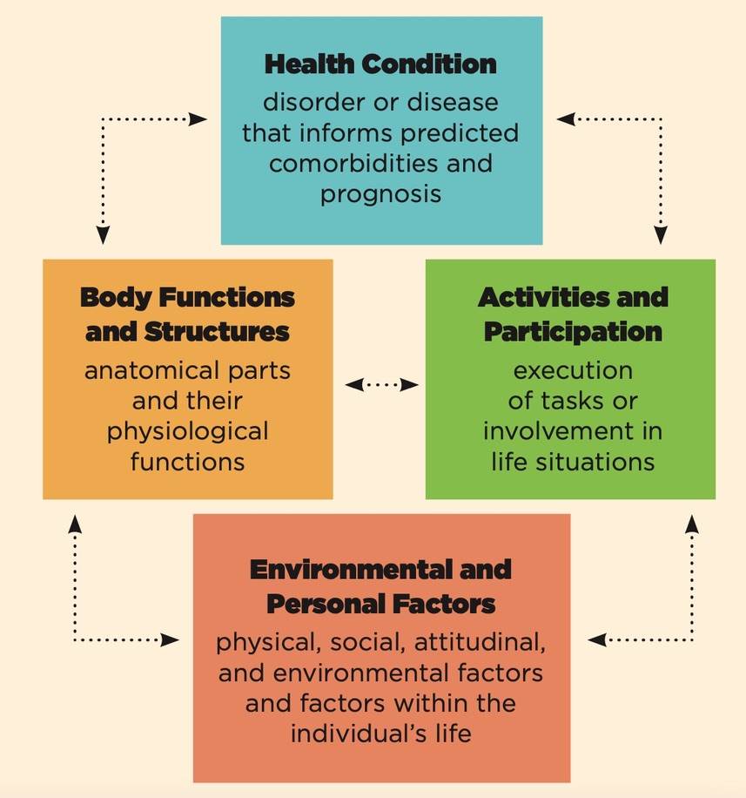
What does the SLP practice look like? Assessment Goal Setting Treatment
Notes:
The International Classification of Functioning, Disability and Health (ICF)—developed by the World Health Organization (WHO)—is a framework to address functioning and disability related to a health condition within the context of the individual’s activities and participation in everyday life.
The ICF framework consists of two parts: Functioning and Disability and Contextual Factors. These parts are further broken down in the following manner:
Functioning and Disability includes:
Body Functions and Structures—describes actual anatomy and physiology/psychology of the human body.
Activity and Participation—describes the person's functional status, including communication, mobility, interpersonal interactions, self-care, learning, applying knowledge, etc.
Contextual Factors include:
Environmental Factors—factors that are not within the person's control, such as family, work, government agencies, laws, and cultural beliefs.
Personal Factors—include race, gender, age, educational level, coping styles, etc. Personal factors are not specifically coded in the ICF because of the wide variability among cultures. They are included in the framework, however, because although they are independent of the health condition they may have an influence on how a person functions.

Slide 17
What does the SLP practice look like? Assessment/Goal Setting/Treatment
Patient-Family Centered
Respect/Dignity
Listen
Honor
Information Sharing
Complete
Accurate
Participation
Decision Making
Collaboration
Incorporate
Useful
Chosen Level
Policy/Program Development
Implementation
Evaluation
Professional Education
Service Delivery
Notes:
collaborative approach to the planning, delivery, and evaluation of clinical services. It is grounded in the mutually beneficial partnership among individuals served, families, and providers. Each party is equally important in the relationship, and each party respects the knowledge, skills, and experiences that others have to share (Baas, 2012; Institute for Patient- and Family-Centered Care).
This approach to care is used across professionals (e.g., physicians, counselors, educators, speech-language pathologists, occupational therapists, and physical therapists). Although it may be referred to by different names (e.g., patient- and family-centered care), the emphasis is the same—working with the individual and family.
Core concepts of person- and family-centered care include the following:
Respect and dignity. Providers listen to and honor the perspectives and choices of the person and their family, and incorporate the knowledge, values, beliefs, and cultural backgrounds of the person and family members when planning and implementing services.
Information sharing. Providers communicate with the person and family, sharing complete and accurate information in ways that are useful and that allow the person and family members to fully participate in decision making.
Participation. The person and family are encouraged to participate in decision making at the level they choose.
Collaboration. The person and family are included on an institution-wide basis and collaborate in various ways and on various levels—for example, in policy and program development, implementation, and evaluation; professional education; and service delivery.

Slide 18
What does the SLP practice look like? Assessment/Goal Setting/Treatment
Collaborative
Patient/Family
SLP/SLP-A
Psychologist
Physicians/Surgeons
Dietitian
OT/COTA
PT/PTA
Social Work
Case Management
Recreational Therapy
Vocational Rehabilitation
Audiologist
Behavioral Specialist
Psychiatrist
Counselor
Notes:
Multidisciplinary teams
Work separately and independently
Come together to report assessment results and intervention outcomes from the perspective of their own discipline
Do not engage in joint planning or intervention
Interdisciplinary teams
Discuss and share perspectives to set goals and identify intervention priorities
Collaborate and communicate for assessment and intervention
Aim to provide less fragmentation of services
Transdisciplinary teams
Coordinate and collaborate for assessment and intervention frequently and consistently
Blend professional boundaries
Offer flexible professional roles; may have role release, where some of the responsibilities are shared across disciplines
Share information for planning and intervention
Determine intervention goals jointly
Share responsibility for documenting outcomes
IPE/IPP
Consistent with the World Health Organization definitions, ASHA defines IPE as an activity that occurs when two or more professions learn about, from, and with each other to enable effective collaboration and improve outcomes for individuals and families whom we serve. ASHA defines IPP as service that occurs when multiple service providers from different professional backgrounds provide comprehensive healthcare or educational services by working with individuals and their families, caregivers, and communities to deliver the highest quality of care across settings.

Slide 19
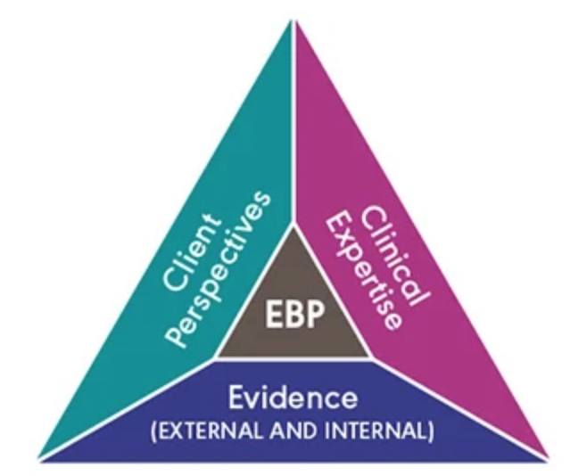
What does the SLP practice look like? Assessment/Goal Setting/Treatment
Evidence-Based
Notes:
Clinical expertise/expert opinion
The knowledge, judgment, and critical reasoning acquired through your training and professional experiences
Evidence (external and internal)
The best available information gathered from the scientific literature (external evidence) and from data and observations collected on your individual client (internal evidence)
Client/patient/caregiver perspectives
The unique set of personal and cultural circumstances, values, priorities, and expectations identified by your client and their caregivers

Slide 20
What does the SLP practice look like? Assessment/Goal Planning/Treatment
Standardized/Non-standardized
Restorative/Compensatory
Decontextualized/Contextualized
Notes:
Assessment protocols can include both standardized and nonstandardized tools and data sources. The decision to use standardized or nonstandardized tools is based upon a variety of factors, including the needs of the person with TBI, the complexity of impairment, payer rules, and facility policy.
Standardized
When selecting a standardized assessment tool, clinicians consider
the severity of the underlying neurological damage;
the individual's level of alertness;
the presence of comorbid physical, sensory, and cognitive deficits; and
cultural and linguistic representation in the norming population.
Treatment for TBI can be restorative and/or compensatory. These approaches are not mutually exclusive; aspects of more than one approach often are integrated into the delivery of services.
Restorative approaches involve direct therapy aimed at improving or restoring impaired function(s) through retraining. Treatment is often hierarchical, targeting specific processes in the impaired domain before introducing more demanding higher-level tasks, and eventually generalizing skills to more functional activities and tasks (Sohlberg & Mateer, 2001).
Compensatory approaches focus on adapting to deficits by learning new or different ways of doing things to minimize difficulties (National Institutes of Health [NIH], 1998). Compensatory approaches draw on the individual's strengths to maximize their abilities, often through the use of external or internal aids.
A compensatory approach to treatment may also include accommodations and/or modifications. Accommodations are changes to the environment, task, or mode of response that allow an individual to access and participate in an activity without changing the activity itself. Modifications are changes to the nature of an activity to facilitate participation and promote success in home, community, academic, and work settings.
“Contextualized” is a term that has been used to describe interventions provided in the context of a real life activity “decontextualized” has been used to designate clinic-based activities targeting a specific cognitive or motor impairment, using treatment tasks that are not normally encountered in everyday life

Slide 21
What does the SLP practice look like? COLLABORATIVE GOAL SETTING
Occurs AFTER assessment and BEFORE intervention
Clinician serves as the facilitator of the discussion
Clinician uses knowledge and experience to select appropriate evidence-based intervention strategies
Establish measurable goals
Audience, Behavior, Condition, and Degree (ABCD)
Specific, Measurable, Achievable, Realistic, Timely (SMART)
Goal Attainment Scaling

Slide 22
WHEN?
WHEN IS IT APPROPRIATE FOR THE SLP ASSESS AND TREAT TBI?
WHEN CAN CONTEXTUALIZED/FUNCTIONAL PRACTICES BE USED BY THE SLP?

Slide 23
When is it appropriate for the SLP to assess and treat TBI?
What are your thoughts?
When does the role of the SLP start in the TBI recovery process?
When does it end?

Slide 24
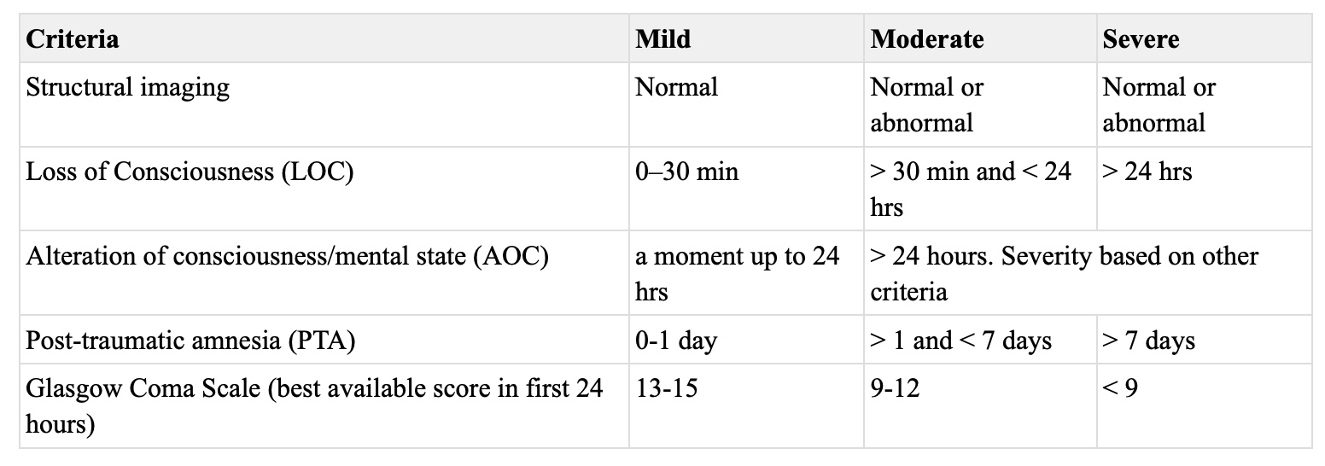
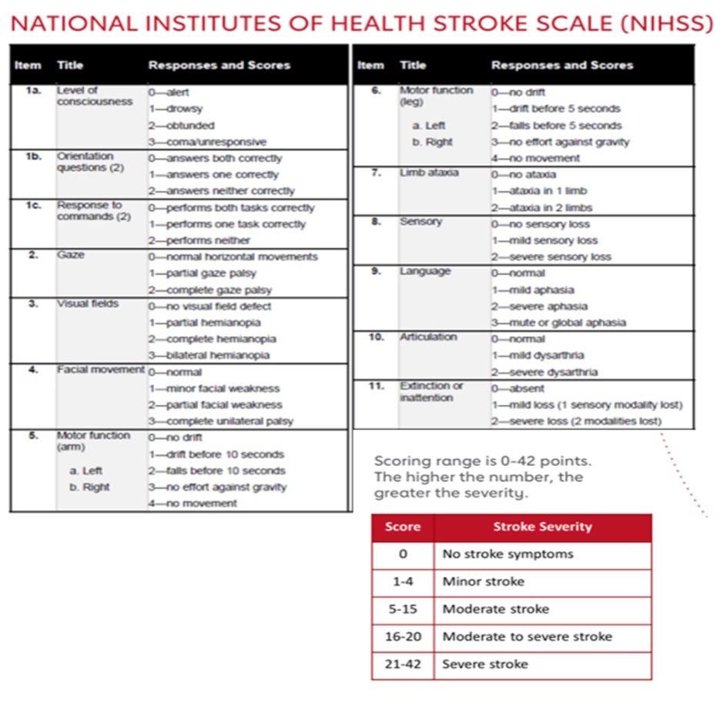
INTERDISIPLINARY INTAKE
Severity Scaling
Glasgow Coma Scale (GCS)
Ranchos Los Amigos Scale of Cognitive Functioning (RLAS-R)
NIH Stroke Scale (NIHSS)
Notes:
Severity of TBI is based on the extent and nature of the injury, duration of loss of consciousness, posttraumatic amnesia (PTA; loss of memory for events immediately following injury), and extent of confusion at initial assessment during the acute phase of the injury (APA, 2013; Centers for Disease Control and Prevention [CDC], 2015).
The Glasgow Coma Scale (GCS) is a system to “score” or measure how conscious you are. It does that by giving numbered scores for how awake you are, your level of awareness and how you respond to basic instructions.
(RLAS-R):
The Rancho Los Amigos Scale (RLAS-R), also known as the Ranchos Scale, is a widely accepted medical scale used to describe the cognitive and behavioral patterns found in brain injury patients as they recover from injury. It was originally developed by the head injury team at the Rancho Los Amigos Hospital in Downey, California to assess patients emerging from a coma. It is often used in conjunction with the Glasgow Coma Scale during the initial assessment of a brain injury patient.
However, unlike the Glasgow Coma Scale, it is used throughout the recovery period and not limited to the initial assessment. It takes into account state of consciousness as well as their reliance on assistance to carry out their cognitive and physical functions.
The NIHSS is a 11-part scoring tool and is the gold standard when assessing stroke patients in hospital (figure 3). Higher scores indicate a more severe stroke and usually correlate with infarct size on CT and MRI. Taken within the first 48 hours of acute stroke, the NIHSS helps predict three month and one-year clinical outcomes.

Slide 25
RLAS-R I-IV ASSESSMENT/TREATMENT
JFK Coma Recovery Scale Revised (CRS-R)
Standardized Scoring
Differential Diagnosis/prognostic assessment/treatment planning
Auditory
Visual
Oromotor
Communication
Arrousal
Westmead Post-Traumatic Amnesia Scale
Standardized Scoring
PTA
Retrograde and anterograde
Can last a few minutes to days or months, depending on TBI severity
Duration directly correlates to long term outcome
Declarative memory impaired; implicit/procedural memory intact
Education, education, education
Sensory Stimulation
Oral care
Co-treating
Notes:
CRS-R
Initially released by Giacono and colleagues in 1991 and revised in 2004. (Giacino, Kalmar and Whyte, 2004)
The purpose is to “assist with differential diagnosis, prognostic assessment and treatment planning in patients with disorders of consciousness.”
Auditory, visual, motor, oromotor, communication, and arousal functions assessed
Lowest item “represents reflexive activity while the highest items represent cognitively-mediated behaviors.”
Scoring is standardized. Recommend training by a therapist who has performed the CRS-R prior to administration and application.
The Westmead Post-traumatic Amnesia Scale (WPTAS) is a brief bedside standardised test that measures length of post-traumatic amnesia (PTA) in people with traumatic brain injury. It consists of twelve questions that assess orientation to person, place and time, and ability to consistently retain new information from one day to another. It is administered once a day, each and every day, until the patient achieves a perfect score across three consecutive days, after which the individual is deemed to have emerged from post-traumatic amnesia
PTA:Post-traumatic amnesia (PTA), defined, is a period of confusion and disorientation following a TBI. It is important to note that post-traumatic amnesia is only going to be seen after a traumatic brain injury.
Post-traumatic amnesia can last for a few minutes to days or months. The duration of PTA is directly correlated to the patient’s outcome. If a patient is in PTA for five minutes, then chances are they are going to recover to very limited symptoms. Whereas, a patient who is in a coma, then wakes up and is in PTA for months, is going to have a poorer prognosis.
The most important question for the SLP is, “How does post-traumatic amnesia impact my treatment and assessment?” The primary focus is always on orientation and that is one of the first things that you want to look at when assessing a patient. Everyone - the neurologist, other physicians, nurses, everyone is going to ask, “What is the date? Where are you? What happened?” A patient who is in PTA is not oriented and cannot be oriented because he/she is not laying down new memories. It is important to know that. For that reason, you do not want to have an orientation goal for this patient because there is really no treatment that is going to cause that patient to become oriented.
You also want to make sure that you are focusing on implicit tasks as opposed to declarative memory tasks. This is not the time to teach a patient compensatory strategies for dysarthria. The focus should be on more procedural, automatic tasks such as steps to brushing their teeth or steps to getting dressed if the patient is safe for transfers and stable. That is really what the focus should be with a disoriented patient.
Many facilities run orientation groups and there are definitely pros and cons for these types of groups. Unfortunately, there is really no evidence of efficacy for orientation groups because the patients are not forming new memories. You can repeat to them all day long what the date and day are and where they are, but that is not going to help with the post-traumatic amnesia. However, the groups do provide peer interaction and exposure to others with injury, so there is that social aspect which can be a benefit. But I think that goals related to orientation will not be easily met or treated based on being part of an orientation group.
Again, the focus should be on implicit, procedural, routine activities. You do not want to focus on teaching compensatory strategies for memory, for example. These patients cannot learn new things at this time if they are in PTA. They are not laying down memories, and that is why they are not oriented.
Educate/Train Family Caregivers

Slide 26
RLAS-R V-VIII ASSESSMENT/TREATMENT
Motivational Interview
Cognitive-Linguistic Screeners
Standardized Assessments
Direct Instruction
Strategy-Based Training
Errorless Learning
Notes:
Key Principles of Motivational Interviewing
Express Empathy: ​By reflective listening, the SLP can help the patient feel “heard.” The principle is important through the whole process. Develop Discrepancy: ​The SLP guides the patient to see a discrepancy between goals and current behavior. This helps lead the patient on the path to deciding about ​why ​and ​how ​to change.
Roll With Resistance: ​If the SLP hears resistance from the patient, avoid falling into a persuasive style of talking. Instead, understand that this is a necessary part of the process. Listen carefully and use empathetic statements to lead the patient to supportive problem-solving.
Support Self-Efficacy: ​This means that the SLP and the patient both believe the patient has the ability to change and follow-through with the plan.
Motivational Interviewing uses the following interaction styles (selectively) to focus the conversation upon change and help lead the patient down that road. I’ve created example statements using the techniques, for different parts of the clinical process.
✧Open Questions: ​By phrasing a question / statement in an open-ended manner, you allow the client to take the response in the direction that is important to them. ✧Affirmations: ​This technique allows you to recognize the client’s skills or appreciate them in a genuine way - you are highlighting strengths and facts in a way that differs from a compliment. ✧Reflections: ​Studies have shown that we need to do more of these as speech-pathologists! These statements are important in letting a client know that you are really listening. These statements can be as simple as rephrasing what the client said, or more complex by adding meaning while rephrasing what the client said. As you start with this skill, use 1 reflection for each question you ask, and as you get better, use 2 reflections for each question you ask.
✧Summaries: ​This technique involves consolidating a discussion. The point of summarizing what you’ve discussed is to highlight change talk, promote strengths, consolidate info and move the discussion forward.
Screeners
Montreal Cognitive Assessment (MOCA)
Repeatable Battery for Assessment of Neuropsychological Status (RBANS)
Scales of Cognitive Ability for Traumatic Brain Injury (SCATBI)
Scales of Cognitive and Communicative Ability for Neurorehabilitation (SCCAN)
St. Louis University Mental Status Examination (SLUMS)
Cognition
• Woodcock-Johnson Psycho-Educational Battery
Attention
Attention Process Training Test (short)
Test of Everyday Attention (long)
Memory
Contextual Memory Test Everyday Memory Questionnaire
Rivermead Behavioral Memory Test
Executive Functions Delis-Kaplain Executive Function System (D-KEFS)
Trail Making A & B Functional Assessment of Verbal Reasoning and Executive Strategies (FAVRES)
Direct instruction is a comprehensive instructional technique that involves identifying target and prerequisite skills; conducting a task analysis to break skills down into smaller steps; providing models; giving consistent and immediate feedback; and providing both massed practice (longer, intensive practice sessions) and spaced/distributed practice (practice broken up into a number of smaller practice sessions).
Strategy-based instruction focuses on the use of various strategies to improve awareness, self-monitoring, and self-regulation.
Compensatory strategy training capitalizes on intact skills to overcome deficits resulting from TBI (Wilson, 2002). Compensatory strategies use internal aids and external aids (Shum, Fleming, Gill, Gullo, & Strong, 2011). Internal aids are strategies used to enhance memory and executive function (de Joode, van Heugten, Verhey, & van Boxtel, 2010; Gillespie, Best, & O'Neill, 2012; Sohlberg et al., 2007; Wild, 2013). They include mnemonics; visual imagery (Kashel et al., 2002; OʼNeil-Pirozzi, Kennedy, & Sohlberg, 2015); elaborative encoding and association (Oberg & Turkstra, 1998); and chunking (Kennedy, 2006). External aids are used to improve attention, time management, organization, and recall of events and information (Burns, 2004; Teasell et al., 2013). Computers and handheld devices, including smartphones and voice recorders, can be used as functional external aids. Low-tech options include calendars, timers, checklists, maps, color-coded binders, and small notebooks (Burns, 2004; DePompei et al., 2008).
Errorless learning is an instructional technique that tries to minimize errors as the individual learns a new skill (Ownsworth et al., 2013). Errorless learning involves task analysis to break skills down into smaller steps, modeling before the first attempt at performing the task, giving immediate corrective feedback, and carefully fading supports and prompts (Sohlberg, Ehlhardt, & Kennedy, 2005; Sohlberg & Turkstra, 2011). Spaced/distributed practice may facilitate errorless learning (Melton & Bourgeois, 2005). Errorless learning is most helpful for individuals with relatively unimpaired procedural memory (memory of how to perform certain procedures) and severely impaired declarative memory (memory of facts and events).

Slide 27
RLAS-R IX-X ASSESSMENT/TREATMENT
Motivational Interview
Cognitive-Linguistic Screeners
Standardized Assessments
Observation/Assistance in Completion of Functional Daily Tasks
Direct Instruction
Strategy-Based Training
Notes:
CAVEAT***
• Executive Functioning
Behavioral Assessment of Dysexecutive Syndrome (BADS)
Functional Assessment of Verbal Reasoning and Executive Strategies (FAVRES)
• Attention
Test of Everyday Attention (TEA)
Attention Process Training Test (APT)
• Memory
• Rivermead Behavioural Memory Test (RBMT-III)
Observation of Functional Daily Tasks
Ask the patient to use an internal memory strategy (or external depending on level of functioning), to recall 5 locations you provide
Take the patient into an unfamiliar environment and ask them to find these locations, while observing attention, memory, pragmatics, etc. and any signs/symptoms of anxiety
Increase or decrease task complexity based on patient
Memory
Ask patient to email therapist three things at three separate times (e.g., date of birth at 1300, their last appointment of the day at 1800, their rank at 0800 the following morning)
Ask patient to brainstorm and then utilize an external memory strategy to assist with medication management or appointment recall (e.g., apps, pill boxes, etc.)
Have patient read an article in the morning and summarize the article to partner or spouse at the end of the day
Attention
Attention Process Training (APT) tasks
Scavenger hunt
Cancellation tasks
Reading in a distracting environment
Executive Functions
Goal setting and planning
Scavenger hunt
Working memory functional tasks (e.g.,
Discuss projects in the home, involving spouse, if possible, to develop project completion plans and ways to motivate the patient to complete tasks
Verbal Fluency: Word Finding
Visualization
Alphabet scanning
Circumlocution
Patient brief to the treatment team (also incorporates all other areas of cognitive symptoms!)
Metacognitive skills training uses goal-setting strategies to facilitate learning and behavioral success. This training uses strategies such as self-talk, self-reflection, mental imagery, and agendas that provide feedback and track progress toward goals. See for example, Cicerone (2006) and Ownsworth, Quinn, Fleming, Kendall, and Shum (2010).
metacognitive strategy instruction (e.g., goal management training, plan-do-check-review, and prediction performance) is recommended. Metacognitive strategies should be used for difficulties across a range of executive functioning impairments (problem-solving, planning and organization, and other elements of executive function) and include: self-monitoring,
incorporatiation of feedback into future performance,
emotional self-regulation training, and
target individualized problems in everyday situations and functional outcomes (Level A Evidence).

Slide 28
When are contextualized/functional practices appropriate?
ASSESSMENT
GOAL SETTING
TREATMENT

Slide 29
Where?
WHERE DOES THE SLP ASSESS AND TREAT TBI?
WHERE CAN CONTEXTUALIZED PRACTICES BE UTILIZED?

Slide 30
Where does the SLP practice?
Acute
Rehabilitation
Community Re-integration

Slide 31
Where does the SLP practice at your place of employment?
Where do you see us working?

Slide 32
Acute: Hospital/ICU
Nurses Station
Hallways
Patient Room
Waiting Room
Radiology Lab
Notes:
Patients admitted into acute care hospitals present with complex medical issues. Typically, only the most critically ill patients remain in the hospital for more than a few days. The speech-language pathologist working in this setting must have a grasp of medical terminology and procedures and the roles of medical specialists and other health care professionals. Speech-language pathologists in this setting provide evaluation and treatment of swallowing disorders and speech and language problems
SLPs are usually expected to be competent in dysphagia management, including conducting and interpreting videofluoroscopic examinations. Patients typically are seen soon after admission, particularly for swallowing issues, and require daily individual treatment. While some patients are able to tolerate longer sessions, some may only be seen for brief periods of time or more than once per day for short periods, as tolerated. Weekend SLP services for new admissions or seriously involved patients are often provided.

Slide 33
Rehabilitation: Acute Rehab Hospital/SNF/Sub-Acute/Post-acute
Patient Room
Dining Room
Hallways
Activities Room
Office
Therapy Gym
Outside
Community
Bathroom
Notes:
• SLP: Memory
• Patient will recall names of primary therapists with moderate visual and verbal cues.
• Patient will route to room using environmental cues with maximum verbal cues.
• Co-treatment PT and SLP: Memory
Patient will recall steps to safely transfer from bed to
walker with minimal verbal cues.
SLP review photos of transfer steps with patient at beginning of session. Patient sequences these. Then SLP and PT assist patient with physical transfer.
Patient will write down his/her schedule every morning.
Patient will identify medication and purpose of medication at each administration.
Patient will recall compensatory strategies for dressing the lower extremity.
Patient will attend to 15 minute treatment session with moderate verbal cues.
Patient will attend to safety signs on unit while routing to room with minimal verbal cues.
Goal setting and planning (patient centered goals!)
Scavenger hunt around unit
Structured conversation with fellow patients, staff, and family members
Requests from staff for various items
Use of compensatory strategy for nonverbal patients who can attend and are aware enough (e.g., communication board, text on phone, writing, etc.)
Increase intelligibility instructured and non-structured environments
Be sure to observe the patient’s speech and language not only in the therapy environment but also in more complex environments to determine functional communication
Speech and language is a perfect area of focus for a co- treatment. Any therapy session involving communication can serve as a speech and language treatment task.
Walking with PT, work on patient’s intelligibility strategies throughout session.
OT and SLP bathing co-treat, ask patient to name items in shower.
Community outing with recreational therapy, ask patient to order food items for self and other patients with focus on pragmatics.

Slide 34
Community Re-Integration Home Health/Outpatient Clinic/Assisted Living/Independent Living
Patient Home/Apartment
Clinic Office
Therapy Gym
ADT Room
Community
Car
Work Place
University
Notes:
Co-treatment OT and SLP: Attention
Patient will prepare a hot meal for three fellow patients with moderate verbal cues for attending to tasks and sequencing.
Can build on discipline specific and interdisciplinary goals.
Choose meal for xx number of people. • Sequence steps to meal. • Write out and organize grocery list. • Plan route to grocery store.
• Estimate cost of grocery items.

Slide 35
Why?
WHY ARE CONTEXTUALIZED OR FUNCTIONAL PRACTICES APPROPRIATE ACROSS SEVERITIES AND SETTINGS IN TBI?

Slide 36
Why are contextualized or functional practices appropriate across severities and settings in TBI?
Assessment
Goal Setting
Treatment
Community Re-Integration
Notes:
Standardized Assessment—Currently, there are few standardized communication assessments for use with individuals TBI. Tests that are too difficult for individuals with severe deficits will not yield useful information. In addition to selecting tests that assess the targeted areas of deficit, clinicians must also evaluate if the tests selected have been normed for use with TBI.
Nonstandardized Assessment—Functional nonstandardized assessments are particularly valuable because individuals with TBI often perform disproportionately better or worse in activities of daily living compared with abilities predicted by standardized test scores.
Nonstandardized assessment procedures serve a variety of purposes, including
Identifying the individual's abilities in domains for which there are no, or limited, standardized tests;
the individual's abilities within functional contexts and activities of daily living;
strategies and task modifications to maximize the individual's functional abilities in various communication contexts;
helpful information for communication partners; and
outcomes in response to intervention (Coelho, Ylvisaker, & Turkstra, 2005).
Goal Setting
WHY patient-centered functional goals?
To maximize outcomes that lead to functional improvements that are important to the individual
To optimize the individual’s potential to participate in meaningful activities
To facilitate a partnership that ensures the individual and family have a voice in the care received and outcomes achieved
To demonstrate to the payers the value of skilled services
Treatment
The goal of intervention in TBI is to achieve the highest level of independent function for participation in daily living. Consistent with the ICF framework (WHO, 2001),
intervention is designed to:
capitalize on strengths and address weaknesses related to underlying structures and functions that affect communication;
facilitate the individual's activities and participation by assisting the person in acquiring new skills and strategies; modify contextual factors that serve as barriers and enhance facilitators of successful communication and participation,
including development and use of appropriate accommodations.
Interventions that enhance a patient's activity and participation through modification of contextual factors may be warranted, even if the prognosis for improved body structure/function is limited.
Treatment should be individualized, provide opportunity for practice, target communication skills in situations where the person lives, works, studies, and socializes and use goal attainment scaling to measure person-centered intervention outcomes (Level A Evidence).
Transitioning After TBI
Individuals with persistent cognitive-communication deficits after a TBI may continue to face challenges as they return to work or academic settings and manage daily activities such as shopping and handling finances (e.g., Colantonio et al., 2004; Kennedy, Krause, & Turkstra, 2008; Meulenbroek, Bowers, & Turkstra, 2016; Meulenbroek & Turkstra, 2016).
The potential impact of persisting deficits highlights the need for continued support. The role of the SLP is to identify communication-related deficits, determine how they might affect the individual in various settings, and design treatment approaches to minimize the impact of these deficits.
Considerations in Work Settings
The nature of deficits associated with TBI creates unique challenges in work settings. Fatigue, sensory issues, health concerns, and cognitive-communication deficits (e.g., language processing, reading and writing, verbal reasoning, memory, and pragmatics) can have a negative impact on performance (see, e.g., Meulenbroek et al., 2016; Meulenbroek & Turkstra, 2016).
The SLP identifies current cognitive-communication deficits, determines how these may affect life skills and job performance, and then trains the individual on strategies they can use to minimize the impact of the deficits in work settings (Bonelli, Ritter, & Kinsler, 2007).
The SLP collaborates with counselors and psychologists, vocational rehabilitation specialists, job coaches, and employers, as appropriate, to help implement necessary accommodations for maximum outcomes.
Individuals with TBI may be eligible for protections in the workplace under Section 504 of the Rehabilitation Act of 1973. This law protects a qualified individual from discrimination based on their disability. Section 504 prohibits employment discrimination against individuals who meet job requirements and can perform essential job duties with or without reasonable accommodations. It may also provide vocational training and employment services for eligible individuals.
SLPs can give input about reasonable accommodations to minimize the effects of cognitive-communication deficits. These include providing written task instructions and using time management devices to help the individual stay on task.
Considerations in Academic Settings
Attention, memory, learning, executive function, and social–emotional impairments—coupled with self-regulation challenges—place individuals with TBI at greater risk for failure in academic settings (Kennedy et al., 2008).
The SLP can provide support to individuals in college (and vocational training programs) by identifying systems and services to facilitate studying, learning, and time management, and by training individuals to use compensatory strategies and promoting self-advocacy (Kennedy & Krause, 2011; Turkstra, Gamazon-Waddell, & Evans, 2004; Volkers, 2015).
Disability support services staff may collaborate with SLPs to select courses, modify schedules, and implement accommodations (under Section 504 or similar plans, if applicable). Accommodations might include notetakers, extended time for tests and assignments, and assistive technology (e.g., text-to-speech and speech-to-text devices that help with reading and writing tasks).

Slide 37
Why?
PATIENT-FAMILY CENTERED CARE
Notes:
The implementation of person- and family-centered care may require some initial time investment—for example, to modify treatment approaches, build relationships, and teach individuals and families the strategies they will need to actively participate in the service delivery process (Institute for Patient- and Family-Centered Care).
This initial time investment will result in many benefits, including
improved clinical decision making that is based on better information;
a greater understanding of the individual’s and family’s strengths and needs;
better follow-through when the treatment plan is developed collaboratively;
more effective communication leading to fewer misunderstandings; and
better outcomes and greater satisfaction with services (American Academy of Pediatrics, 2012).

Slide 38
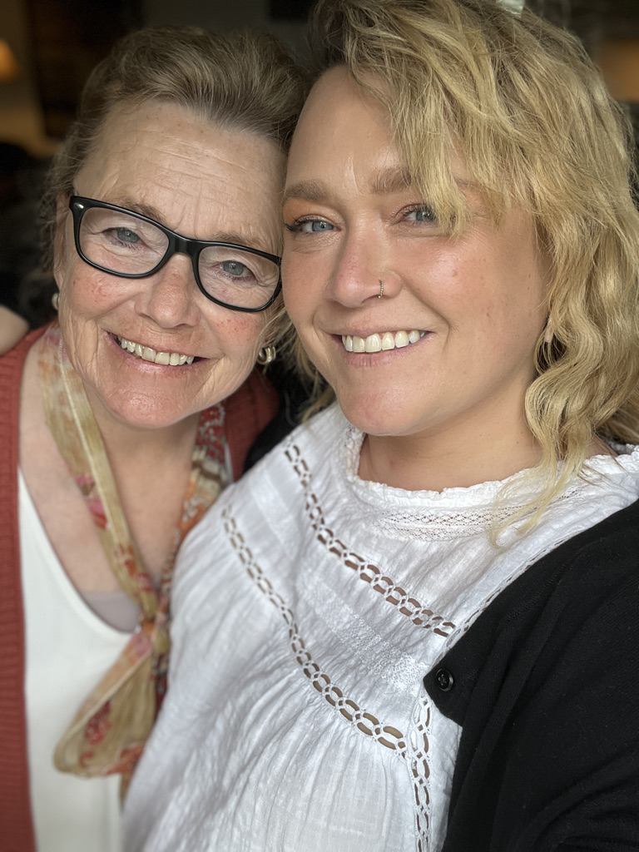
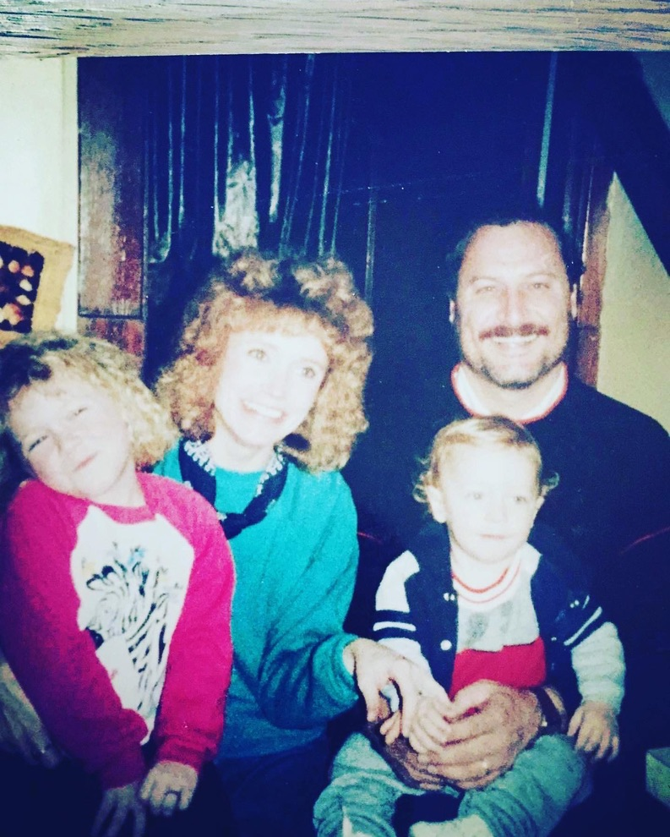
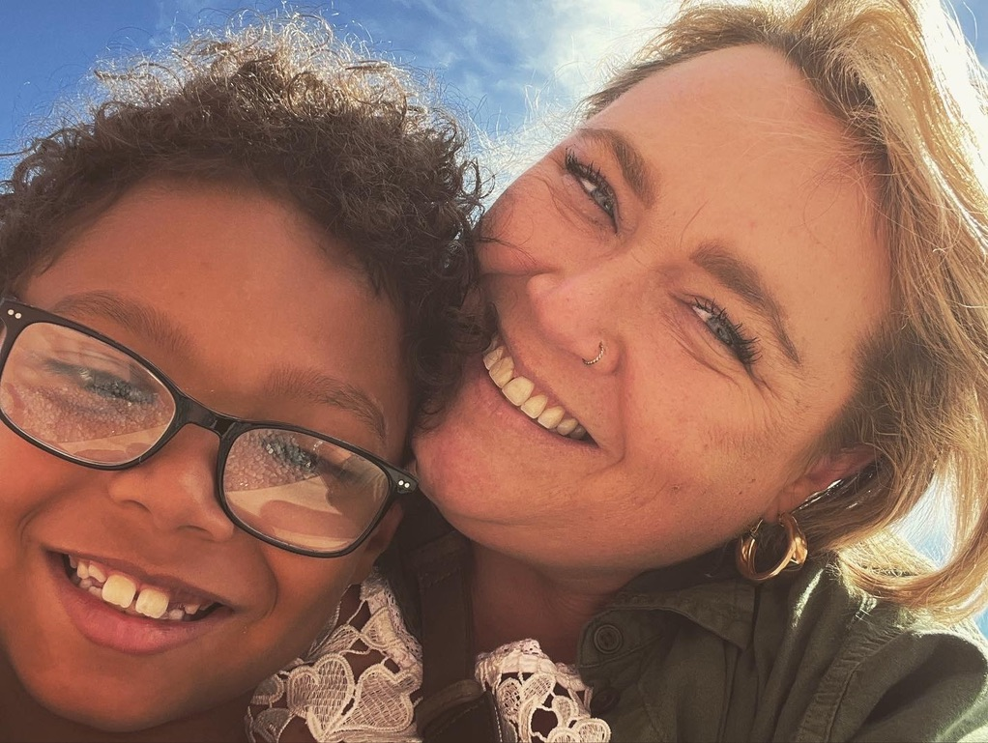
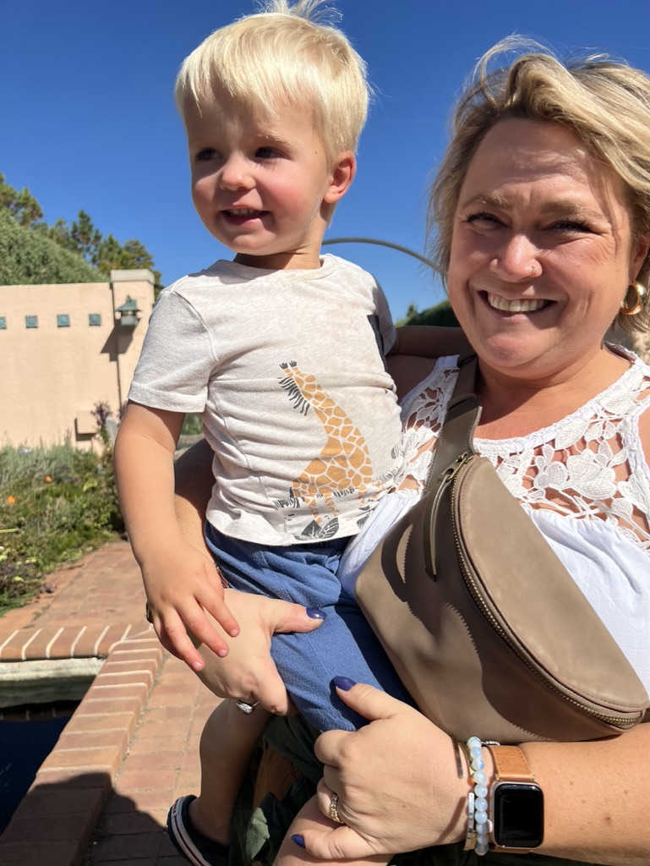
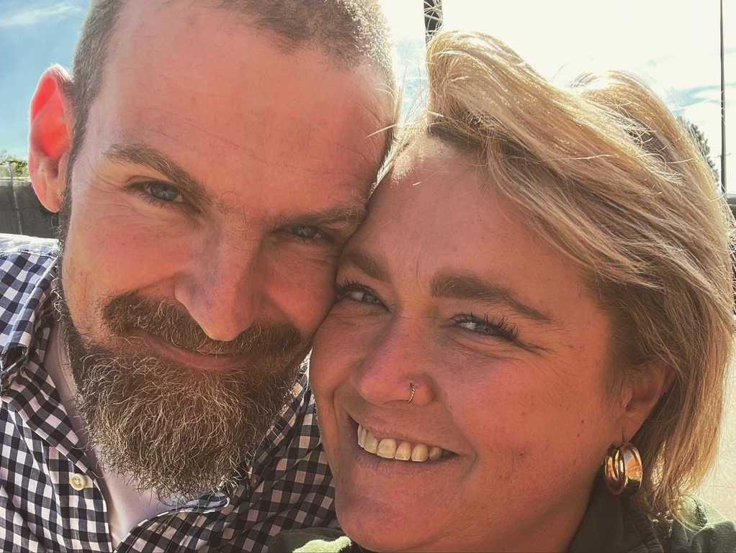
Daughter
Sister
Partner
Mom
Aunt
Friend
TBI Survivor
WHY?

